Slide 1
ABC Phonics Chant
Notes:
Wall chart

Slide 2
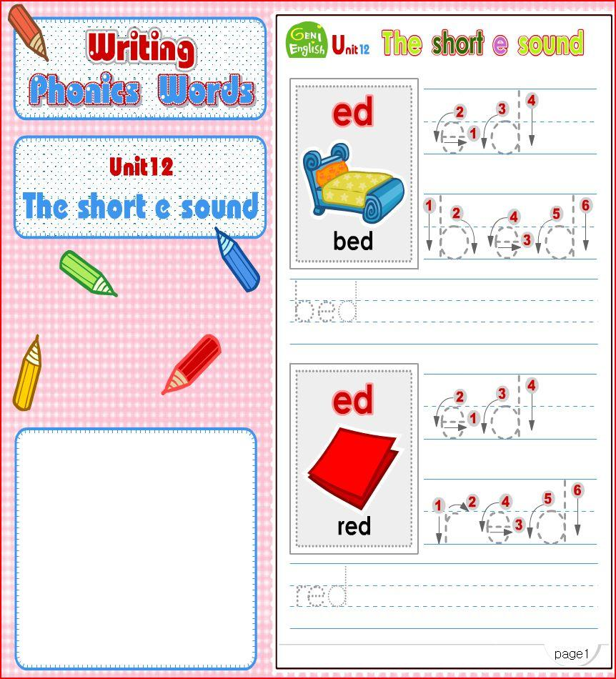
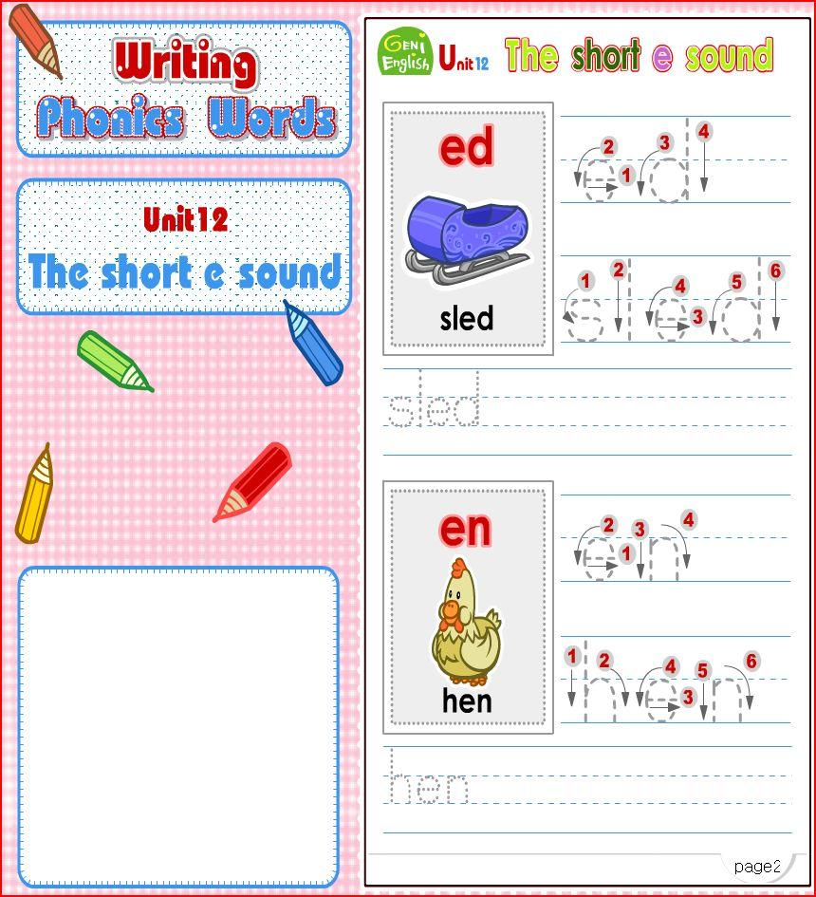
Phonics 2
Notes:
Book

Slide 3
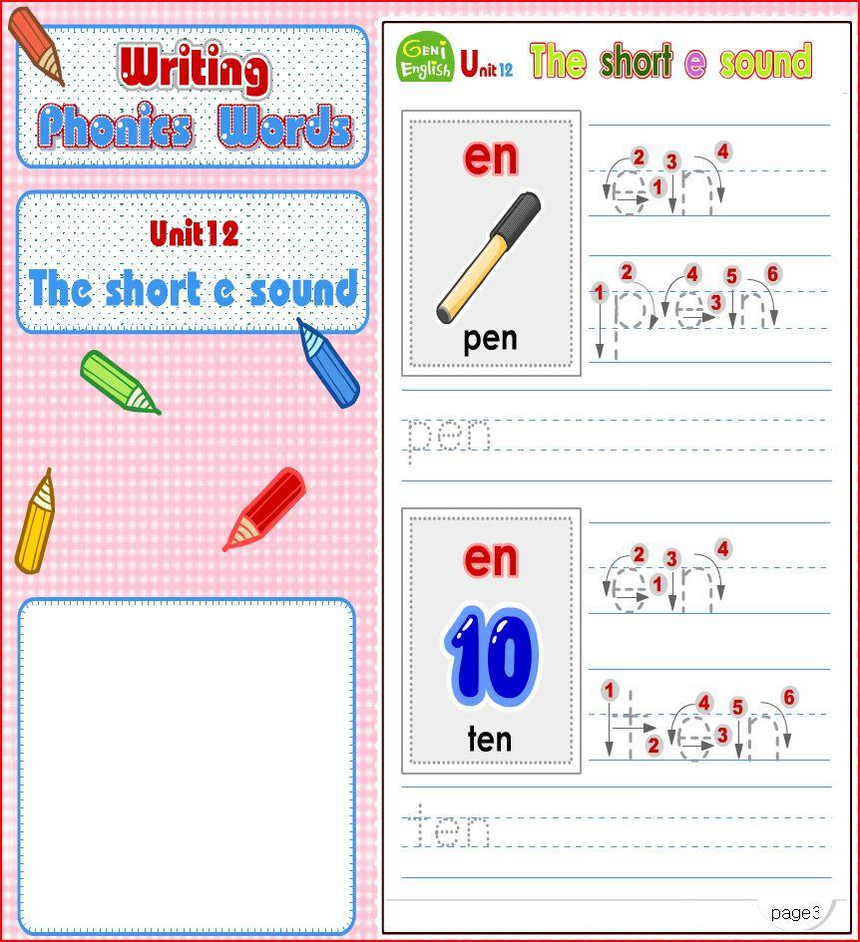
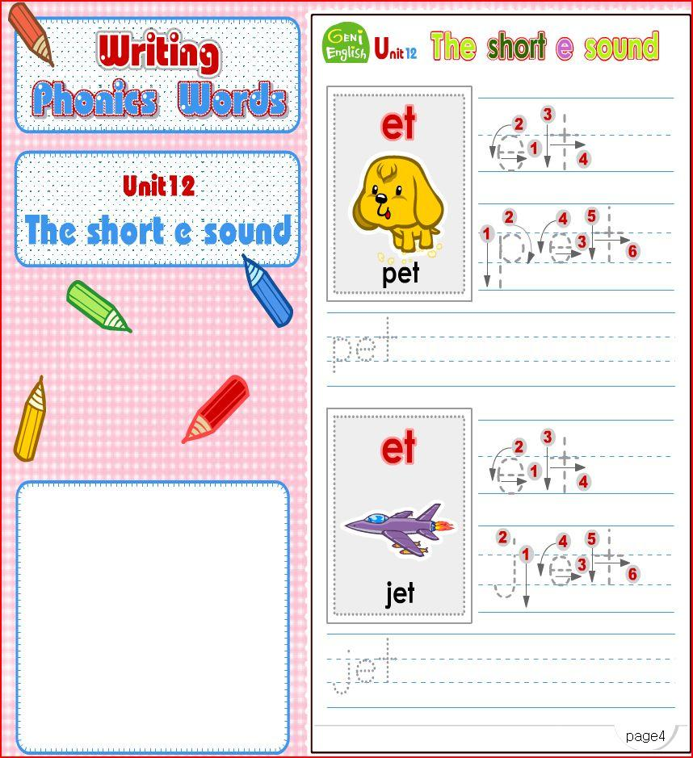
Phonics 2
Notes:
Book

Slide 4
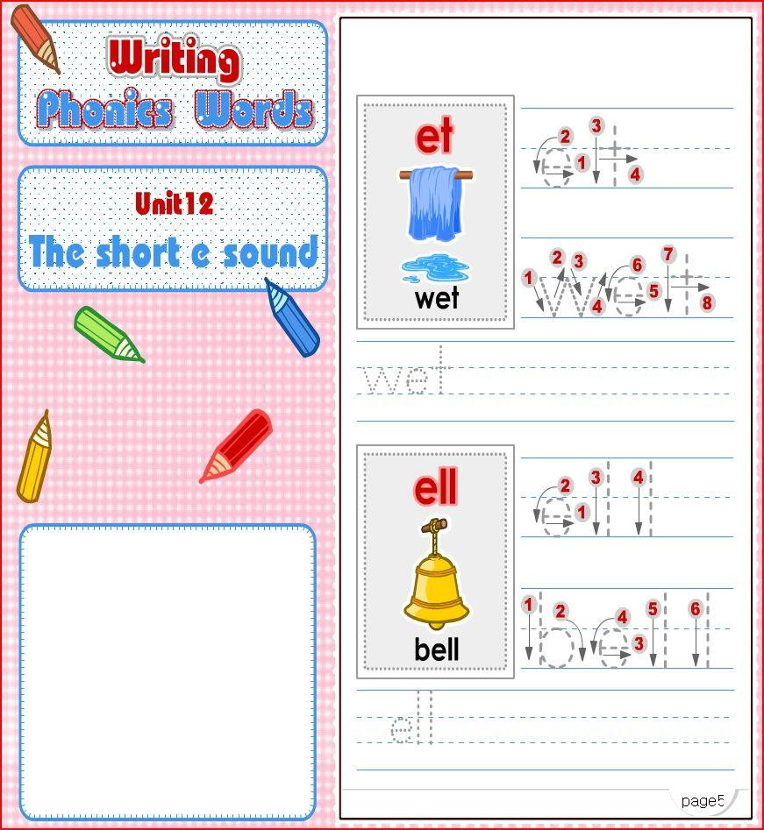
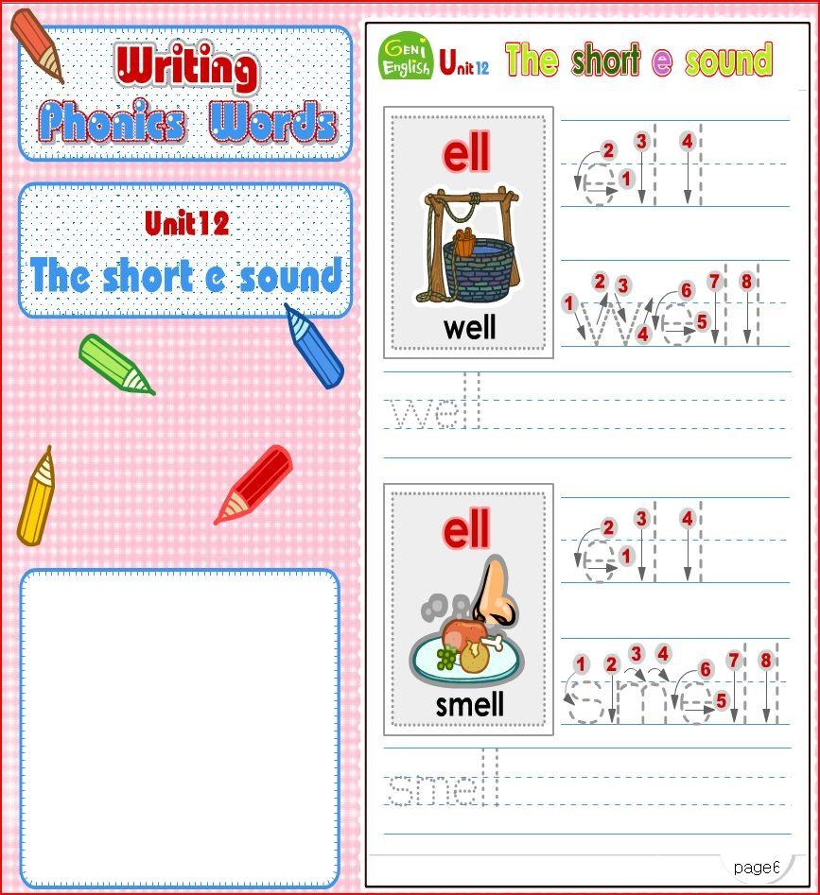
Phonics 2
Notes:
Book

Slide 5
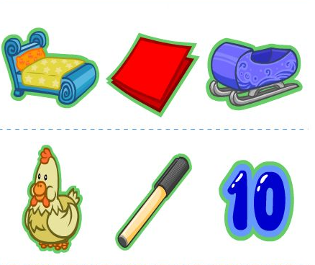
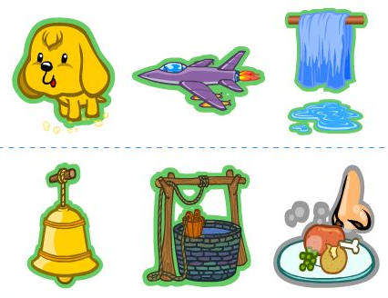
Worksheet
* Put a sticker on the picture
Notes:
Worksheet

