Slide 1
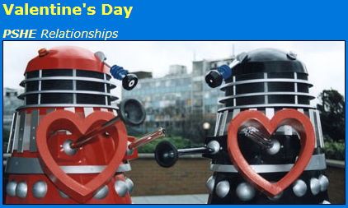
What is Valentine's Day?
Valentine's Day, or St Valentine's Day, is celebrated every year on 14 February. It's the day when people show their affection for another person (or people!) by sending anonymous cards, flowers or chocolates with messages of love.
And traditionally on Valentine's Day in a leap year - every four years - women can propose marriage to their partner!

Slide 2
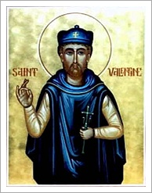
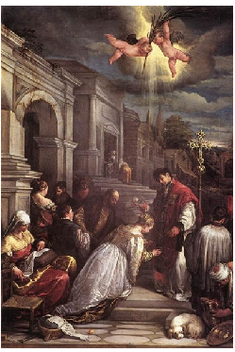
Why is it called Valentine's Day? The day gets its name from a famous saint, but there are several stories of who he was. The most popular belief about St Valentine is that he was a priest from Rome in the third century AD.
Emperor Claudius II had banned marriage because he thought married men were bad soldiers. Valentine thought this was unfair, so he broke the rules and arranged marriages in secret.
When Claudius found out, Valentine was sentenced to death and thrown in jail. There, he fell in love with the jailor's blind daughter.
The story says his love and belief in God cured her blindness, and when he was taken to be killed on 14 February he sent her a love letter signed "from your Valentine".

Slide 3
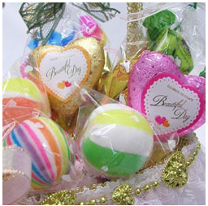
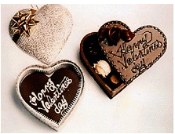
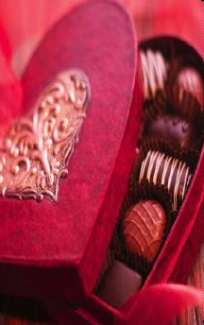
How did it become a celebration? Valentine's Day is a very old tradition, thought to have originated from a pagan fertility festival. The Romans had a festival called Lupercalia in the middle of February, officially the start of their springtime.
As part of the celebrations, boys drew names of girls from a box. They'd be boyfriend and girlfriend during the festival and sometimes they would even get married! The Christian church decided it wanted to turn this festival into a Christian celebration and decided to use it to remember the death of St Valentine too.
Gradually, St Valentine's name started to be used by people to express their feelings to those they loved.

Slide 4
Think about it……………..
So, do we need these days for our love?
Why we have to keep these days?
Why do we give chocolates to our loved ones?
Is there anything else that we can give aside from candy or chocolates?
Why do we give presents on these days?
Did you know that White Day is only celebrated in Japan and Korea? What do you think is the reason?

Slide 5
I agree with | I disagree with

Slide 6
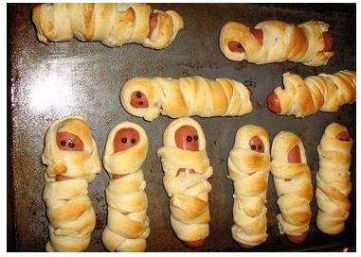
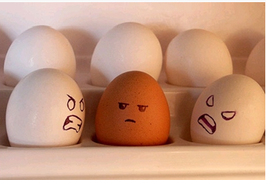
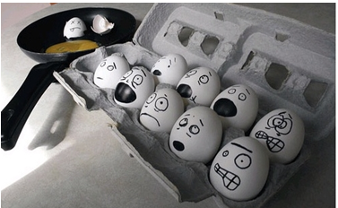
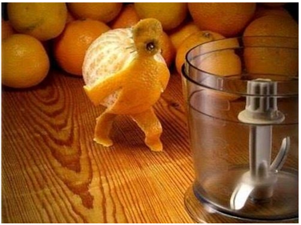
Imagine what situation is / what they say

Slide 7
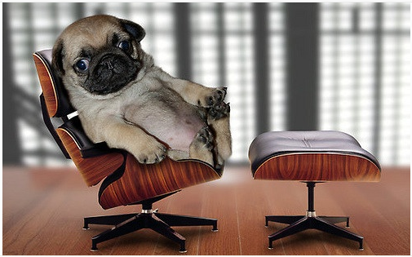
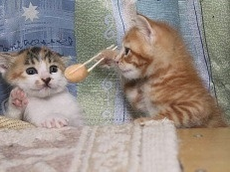
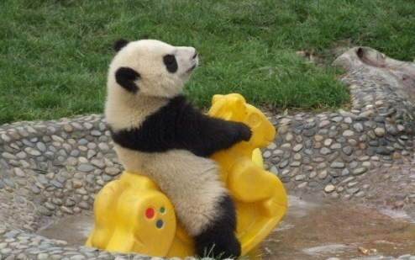
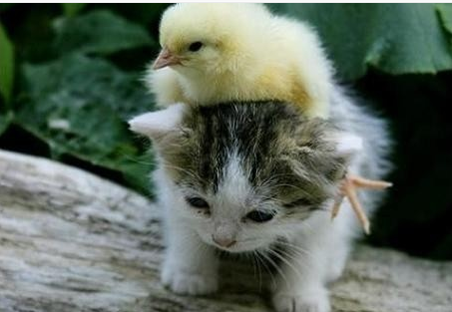
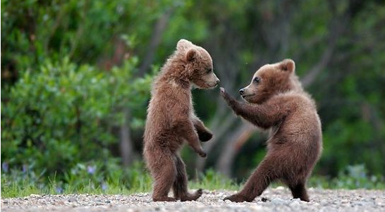
Imagine what situation is / what they say

Slide 8
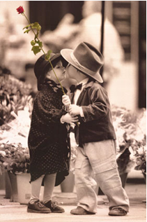
Year Round Valentine
I love you all through February, Not just on Valentine’s Day; I cherish you when flowers of spring Appear in the midst of May.
I adore you in the summer, When the air is filled with heat; Without you in my life each day, I wouldn’t be complete.
I treasure you in fall, When leaves are turning gold; I loved you when you were younger; I’ll love you when you’re old.
I prize you in the winter, When colder days are here; I love you, love you all the time, Every minute of the year.
So I’ll give to you this Valentine, But I want to let you know, It’s not just today, but always, That I will love you so.
By Joanna Fuchs

Slide 9
I WILL - THE BEATLES
Who knows how long I've loved you You know I love you still Will I wait a lonely lifetime If you want me to--I will For if I ever saw you I didn't catch your name But it never really mattered I will always feel the same Love you forever and forever Love you with all my heart Love you whenever we're together Love you when we're apart
And when at last I find you Your song will fill the air Sing it loud so I can hear you Make it easy to be near you For the things you do endear you to me You know I will I will

