Slide 1
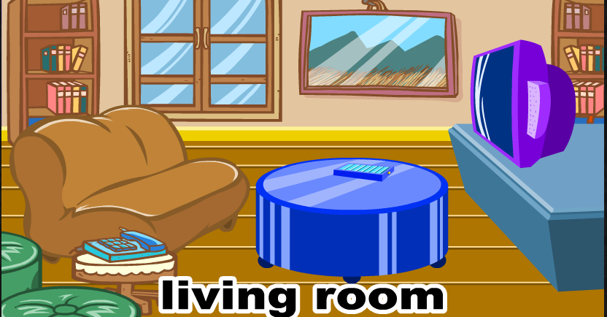
Where is the cat?
On the sofa
Notes:
presentation

Slide 2
Where is the cat?
On the table
Notes:
presentation

Slide 3
Where is the cat?
On the chair
Notes:
presentation

Slide 4
Where is the cat?
Under the table
Notes:
presentation

Slide 5
Where is the cat?
In the bathtub
Notes:
presentation

Slide 6
Where is the cat?
In the toilet
Notes:
presentation

Slide 7
Where is the cat?
On the window
Notes:
presentation

Slide 8
Where is the cat?
Under the bedclothes
Notes:
presentation

Slide 9
….............…….is in / on / under.................
Notes:
presentation

Slide 10
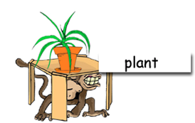
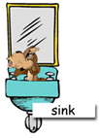
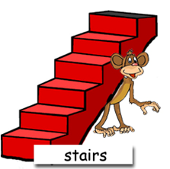
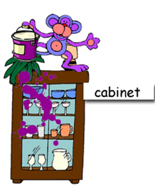
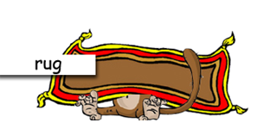
Worksheet Where are the monkeys?
The monkey is _____the______.
_____________ is _____the______.
_________________________________.
_______________________________.
_______________ is _____the______.
__________________________________.
______________ is _____the______.
Notes:
worksheet

Slide 11
Notes:
Picture puzzle

Slide 12
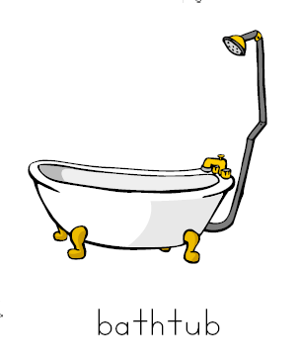
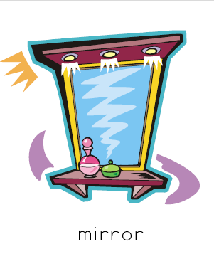
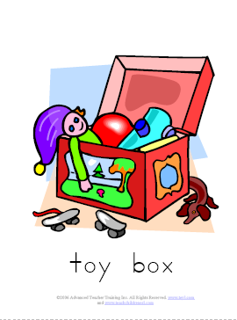
Notes:
Flash cards

Slide 13
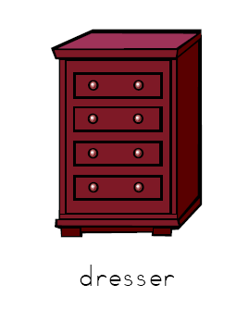
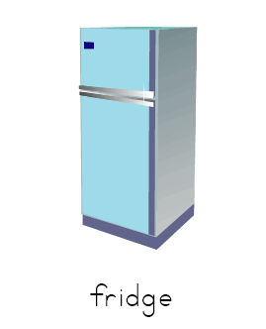
Notes:
Flash cards

Slide 14
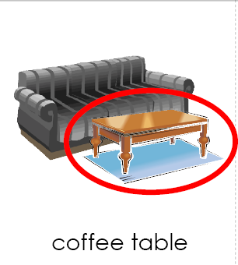
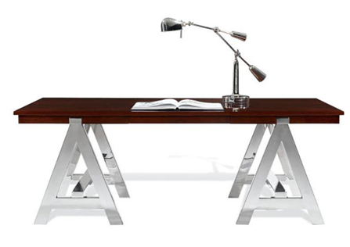
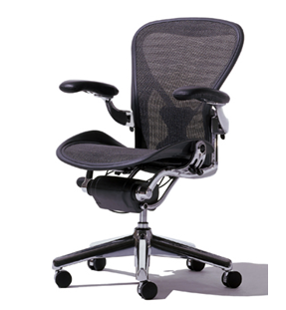
Notes:
Flash cards

