Slide 1
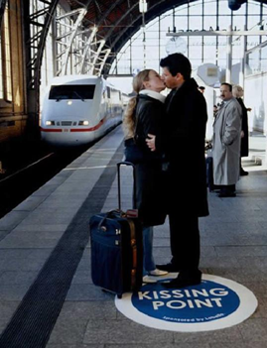
THE KISS
Notes:
LEAD-IN

Slide 2
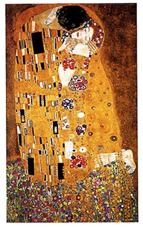
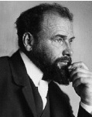
Gustav Klimt
Notes:
PRE - ACTIVITY

Slide 3
Gustav Klimt
was an Austrian Symbolist painter. Klimt's primary subject was the female body, and his works are marked by a frank eroticism.

Slide 4
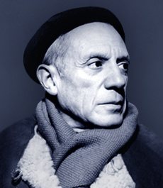
Pablo Ruiz Picasso
Notes:
PRE - ACTIVITY

Slide 5
The Kiss, an oil on canvas painted the day before the artist's 88th birthday.
Picasso was married twice and had four children by three women
He saw women as a mere vehicle/inspiration for his art.

Slide 6
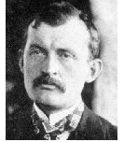
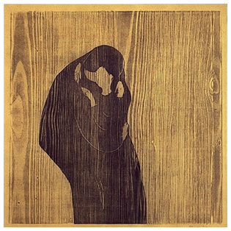
Edvard Munch
Notes:
PRE - ACTIVITY

Slide 7
Munch was a deeply disturbed man, it is believed by some that the women in his paintings are portrayal of his sister who died at fifteen.
What is certain is that he lived his life in complete despair.

Slide 8
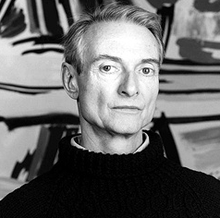
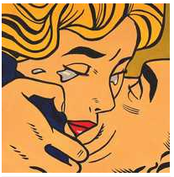
Roy Lichenstein
Notes:
PRE - ACTIVITY

Slide 9
Most American pop artists of the 1960s came from a field outside of painting, specifically the mass media. Roy Lichenstein had worked in window display. Andy Warhol did newspaper work. The subject matter of Pop Art had already been published or designed. For example, Lichtenstein's paintings Were based on comic strips, and Warhol's were of Coke bottles and soup cans.

Slide 10
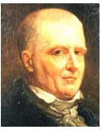
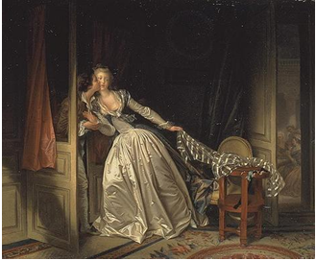
The Stolen Kiss - Jean Honore Fragonard
Notes:
PRE - ACTIVITY

Slide 11
Among his most popular works are genre paintings conveying an atmosphere of intimacy and veiled eroticism.
The French Revolution deprived Fragonard of his private patrons: they were either guillotined or exiled. He died in poverty and completely forgotten in 1806.

Slide 12
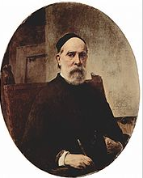
Francesco Hayez
Notes:
PRE - ACTIVITY

Slide 13
Francesco Hayez was an Italian painter, the leading artist of Romanticism in mid-19th-century Milan.
He was what is known as a ''costume and historical'' painter. His work is similar to those TV historic dramas, we watch on TV now.

Slide 14
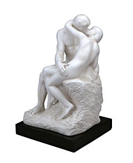
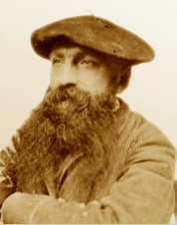
August Rodin
Notes:
PRE - ACTIVITY

Slide 15
The Kiss is a marble sculpture by the French sculptor Auguste Rodin. Like many of Rodin's best-known individual sculptures, including The Thinker, the embracing couple depicted in the sculpture appeared originally as part of a group of reliefs decorating Rodin's monumental bronze portal The Gates of Hell, commissioned for a planned museum of art in Paris. The couple were later removed from the Gates and replaced.
Notes:
PRE - ACTIVITY

Slide 16
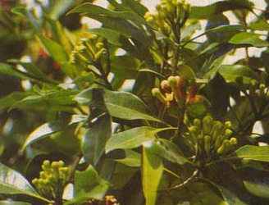
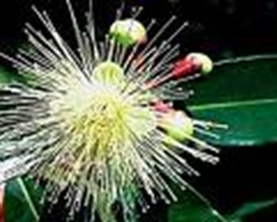
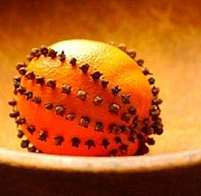
Clove & clove studded

Slide 17
Worksheet
What do you think of people doing these things in public places?
Complete the table below. Share what you wrote.
In a public place? | How bad? (score 1-5) | Punishment? | What you would say
Kissing
Spitting
Urinating
Swearing
Smoking
Wearing swimwear
Notes:
Back up

Slide 18
Origin of the kiss
The strangest theory on the history of the kiss that I have heard finds its roots in the age of the cave man. It is thought that in primitive times that a mother pre-chewed the food for her baby and transferred it 'in a kiss'. Although this could never be proved, it would explain why the kiss is a sign of affection, between mother and child and later, adults.
The second theory that I found was that the kiss was reflected in the Ziller Valley of Central Europe, where the exchange of pre-chewed tobacco between a male and a female was common. The young man would let a tip of the piece of tobacco, or spruce resin, etc rest between his closed teeth and invite the girl to grasp it with her teeth -- which of course obliged her to press her mouth firmly on that of the young man -- and pull it out. If a girl accepted the wad of pre-chewed tobacco, it meant she returned the boy's love.
The third theory that I found was from a religious or sacred origin. There have been examples from around the world, as early as 2000 BC, which show that people could have brought their faces together to symbolize spiritual union. Even in the Indians culture, it was believed that the exhaled breath was part of the soul, and by two people bringing their mouths together, showed the joining of their souls. (Another variation on this believed that kissing evolved from the smelling of a companion's face as an act of greeting.)
KEY WORDS
primitive -belonging to a society in which people live in a very simple way, usually without industries or a writing system.
spruce - is a kind of evergreen tree.
Resin - is a sticky substance that is produced by some trees
oblige - to be helpful to them by doing what they have asked you to do
sacred - is believed to be holy and to have a special connection with God
Exhale - breathe out the air that is in your lungs
Notes:
MAIN ACTIVITY

Slide 19
Kiss through history
Even without fully knowing where the kiss came from, it is well known that the kiss has been with us for a long time.
In the sixth century in France, dancing was one way to display affection, and every dance was ended in a kiss.
Apparently, Russia was the first to incorporate the kiss into the marriage ceremony, where a promise was sealed with a kiss.
The Romans kissed to greet each other. One Roman emperor showed a persons importance by what part of his body they were allowed to kiss, from the cheek to the foot.
In 16th century England, the clove-studded apple originated. An apple was prepared by piercing it with as many cloves as the fruit could hold and then a maid carried the apple through the fair until she spied a lad she thought worth kissing. She would offer him the apple, and once he'd selected and chewed one of the cloves, they would share a kiss. After that, the apple passed into the man's possession, and he would venture off in search of another lass to continue the game with.
At one stage it was even thought that people found kissing pleasurable because when the two lips met during kissing, an electric current was generated.
KEY WORDS
apparently - you have heard, but you are not certain that it is true
Clove (cleave ) - to split or divide it into two separate parts, often violently.
studs - are small pieces of metal which are attached to a surface for decoration.
lad - is a young man or boy.
lass - is a young woman or girl
generate - to cause it to begin and develop.
Notes:
MAIN ACTIVITY

Slide 20
Kiss your way to good health
Kissing is a great way to connect with your partner, but did you also know there are also health benefits from kissing? Kissing is good for our teeth, bodies and out minds. Kissing helps relax us and believe it or not it actually can help us look and feel younger. Kissing can be a magic cure for hiccups and allergy symptoms too.
Did you know that when you are kissing you are using more then 30 muscles, and it said that regular kissing can actually tone cheek and jaw muscles and could even prevent sagging. Also during a passionate kiss you can burn as little as 1 calorie per minute.
There are some powerful proteins and protective bacteria's in saliva that make a natural antiseptic; This helps in reducing plaque, gingivitis and tooth decay. Swapping saliva with your partner increases both your saliva production and helps to increase the power of your immune system.
According to statistics, a man who gets a morning kiss have raised their annual salary by 20%.
Also, a passionate kiss can burn 12Kcal of calories at a time and a kiss can ease pains and help anti-aging.
Of course beside the facts that kissing can be good for you, and can reduce stress as well as help prevent health problems the best part of kissing is the action its self. Kissing sends signals to your brain that tell your brain you are happy, and when you feel happy you feel good. So what are you waiting for when your partner or certain someone come around, pucker up and lay it on them; after all it is good for you....and of course it feels good too.
All of advantages are proven scientifically.
KEY WORDS
jaw - is the lower part of your face below your mouth
Sag - hangs down loosely or sinks downwards in the middle / become weaker
Protein - is a substance found in food and drink such as meat, eggs, and milk
Saliva - is the watery liquid that forms in your mouth and helps you to chew and digest food
Antiseptic - is a substance that kills germs and harmful bacteria
Gingivitis - inflammation of the gums
immune - protected against a disease
Notes:
MAIN ACTIVITY

Slide 21
Worksheet
Match the following phrases from the texts.
The strangest theory on the history of the kiss that
the kiss was reflected in the Ziller Valley of Central Europe, where the exchange of pre-chewed tobacco
it was believed that the exhaled breath was part of the soul,
Even without fully knowing where the kiss came from,
Did you know that when you are kissing you are using more then 30 muscles,
Kissing sends signals to your brain that tell your brain you are happy, and when you feel happy you feel good.
between a male and a female was common.
I have heard finds its roots in the age of the cave man.
it is well known that the kiss has been with us for a long time.
and by two people bringing their mouths together, showed the joining of their souls.
you are happy, and when you feel happy you feel good.
and it said that regular kissing can actually tone cheek and jaw muscles and could even prevent sagging.
Notes:
Main worksheet

Slide 22
Worksheet
What are the theories of the origin of the kiss ?
Why the kiss is good for our health?
Why do we kissing?
Do you know any theory about the origin of the kiss?
Do you know the origin of the handshaking?
Do you know the origin of the expression “Lady First”?
Notes:
MAIN WORK SHEET

Slide 23
Worksheet
Match the key words and meanings.
KEY WORDS
primitive
exhale
oblige
resin
sacred
generate
apparently
immune
jaw
saliva
Meanings
belonging to a society in which people live in a very simple way, usually without industries or a writing system.
is a sticky substance that is produced by some trees
to be helpful to them by doing what they have asked you to do
is believed to be holy and to have a special connection with God
breathe out the air that is in your lungs
you have heard, but you are not certain that it is true
to cause it to begin and develop.
is the lower part of your face below your mouth
is the watery liquid that forms in your mouth and helps you to chew and digest food
protected against a disease
Notes:
Back up

Slide 24
Romeo & Juliet
Romeo Oh, Juliet!
Juliet Oh, Romeo!
Romeo Oh, Juliet!
Juliet Oh, Romeo!
Romeo Oh, Juliet! (dies)
Juliet Oh, Romeo!......Romeo?......Dammit.
THE END
Notes:
POST ACITIVITY

Slide 25
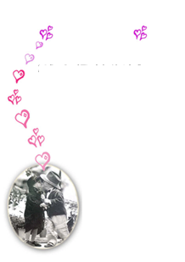
kiss me -by sixpence none the richer
Kiss me out of the bearded barley Nightly, beside the green, green grass Swing, swing, swing the spinning step You wear those shoes and I will wear that dress. Oh, kiss me beneath the milky twilight Lead me out on the moonlit floor Lift your open hand Strike up the band and make the fireflies dance Silver moon's sparkling So kiss me Kiss me down by the broken tree house Swing me upon its hanging tire Bring, bring, bring your flowered hat We'll take the trail marked on your father's map
Oh, kiss me beneath the milky twilight Lead me out on the moonlit floor Lift your open hand Strike up the band and make the fireflies dance Silver moon's sparkling So kiss me
Kiss me beneath the milky twilight Lead me out on the moonlit floor Lift your open hand Strike up the band and make the fireflies dance Silver moon's sparkling So kiss me
So kiss me
So kiss me
So kiss me

Slide 26
kiss me -by sixpence none the richer
Kiss me _______ ____ the bearded barley Nightly, beside the ______ _______grass Swing, swing, swing the spinning step You ______ those shoes and I will _______ that dress. Oh, kiss me beneath the milky twilight ________ me out on the moonlit floor Lift your open hand ________ up the band and make the fireflies _________ Silver moon's sparkling So _______ ____ Kiss me _______ by the broken tree house Swing me upon its hanging tire Bring, bring, bring your flowered hat We'll take the trail marked on your father's map
Oh, kiss me beneath the ________ _________ Lead me out on the moonlit floor _______ your open hand Strike up the band and make the _________ dance Silver moon's sparkling So kiss me
Kiss me beneath the milky twilight Lead me out on the moonlit floor Lift your open hand Strike up the band and make the fireflies dance Silver moon's sparkling So kiss me
So kiss me
So kiss me
So kiss me
Notes:
FILL THE BLANKS

Slide 27
Handsome young prince needs money or a kiss.

Slide 28
You call that a kiss?

Slide 29
How would you like to kiss the frog formerly known as 'Prince'?

Slide 30
Princesses eat frog that lies about being a prince.

