Slide 2
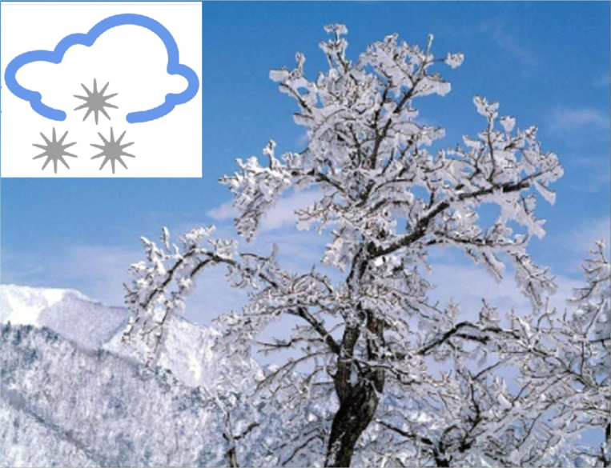

Slide 5
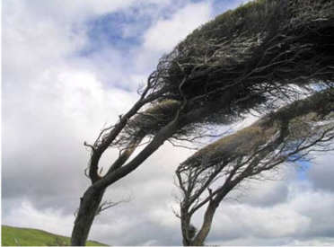

Slide 6
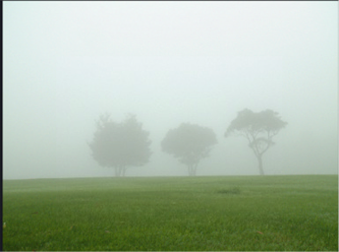

Slide 7
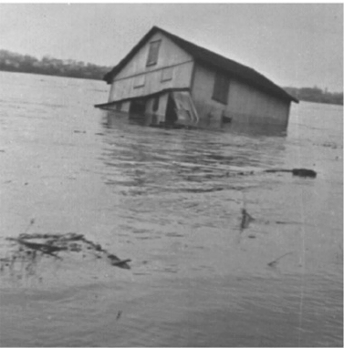

Slide 8
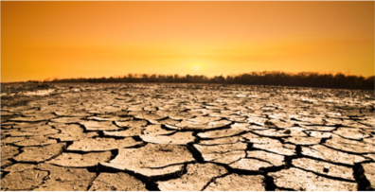

Slide 9
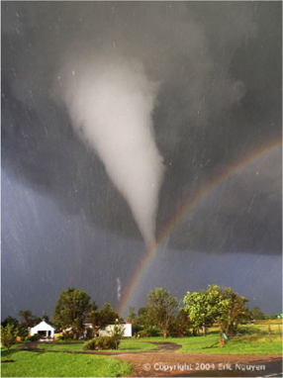

Slide 10
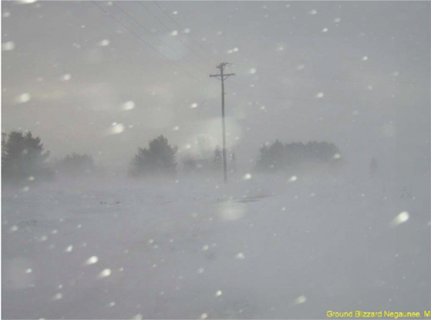
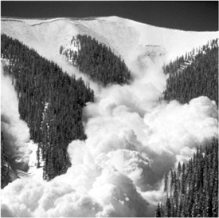

Slide 11
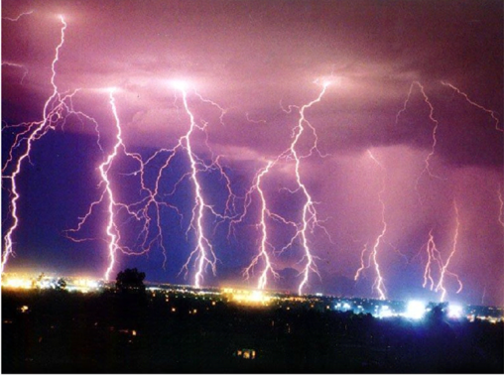

Slide 12
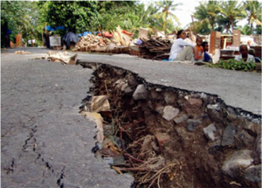
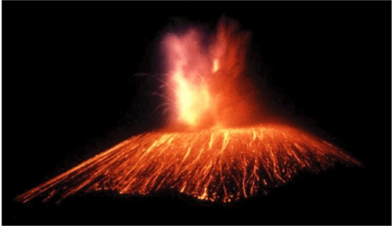

Slide 14
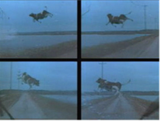

Slide 15
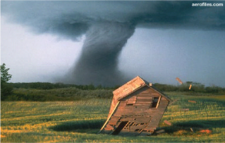
Notes:
HURRICANES AND TORNADOES
What's the difference?
Hurricanes and tornadoes both form in warm, damp air when winds blow into each other from opposite directions. Hurricanes develop over warm, tropical oceans, while tornadoes form over land and are more violent. In a hurricane, the winds swirl around in a spiral at up to 200 mph. In the middle is a calm "eye" 4 - 25 miles wide, surrounded by the worst wind and driving rain.
A tornado is a tall, funnel-shaped whirlwind of cloud up to 2,000 feet high. In the middle is an eye of descending air, surrounded by a strong upward current that sucks up or destroys everything in its path. Tornadoes can travel hundreds of miles before they die down.
Now you know!

