Slide 1
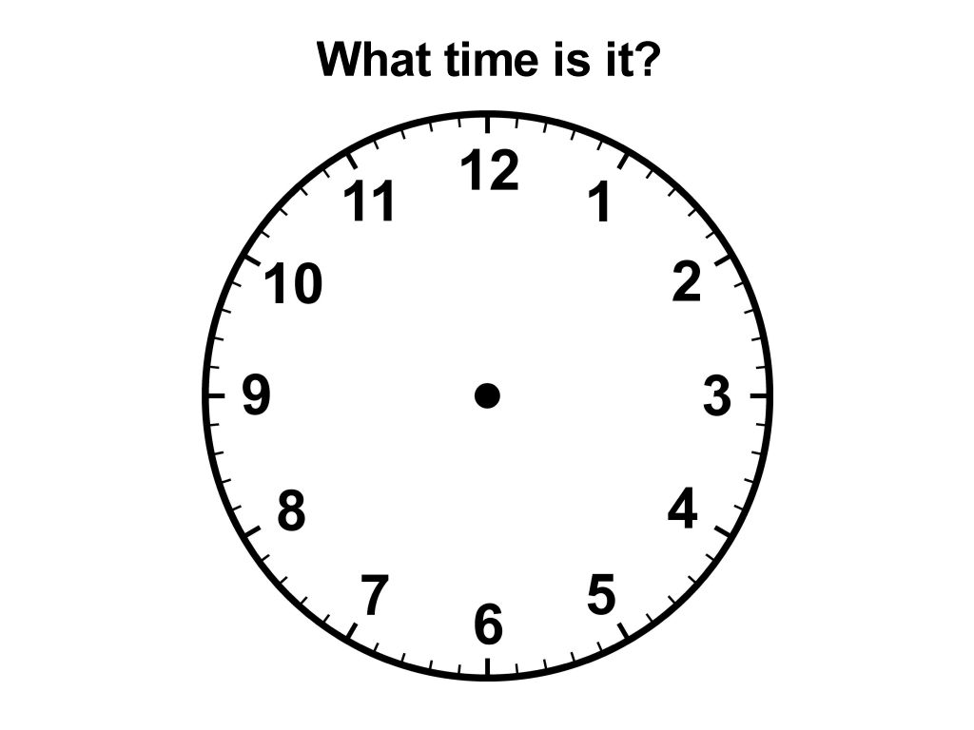

Slide 2
Today’s learning objectives
Ss will be able to learn various time expressions and apply them to the pair and group activities.
Ss will be able to tell the time based on their everyday routine.
Ss will be able to complete the homework sheet on their own.

Slide 3
Words for time telling in English
Hour hand
Minute hand
Clock hand
O’clock
Colon (:)
Digital clock
Analogue clock

Slide 4
Unfamiliar time expressions 1
In English we use "past" to say times after the hour until half past, or 30 minutes past the hour. | We use "to" to say times before the hour from 31 minutes until the full hour.
In English we use o'clock only at the full hour. Example: It's eight o'clock | We can also just say the numbers in groups of two. Example: It's seven twenty-five
When speaking about the different times of the day we Often use: in the morning, in the afternoon, in the evening | Be careful! In English we use at night NOT in the night

Slide 5
Unfamiliar time expressions 2
Let’s practice:
http://esl.about.com/library/beginner/bltime.htm

Slide 6
Unfamiliar time expressions 3
I usually get up at a quarter past seven in the morning. I have breakfast at eight o'clock and then take the bus to work at half past eight. I usually arrive at work at a quarter to nine. Sometimes, the bus is late and I arrive at about nine. My morning is usually pretty busy and I like taking a coffee break if possible. I then work to lunchtime at noon. at twenty to eleven In the afternoon, I usually have another break at three fifteen. I usually finish work at a quarter to five and arrive home around six in the evening. At night, I usually go to bed at eleven o'clock.

Slide 7
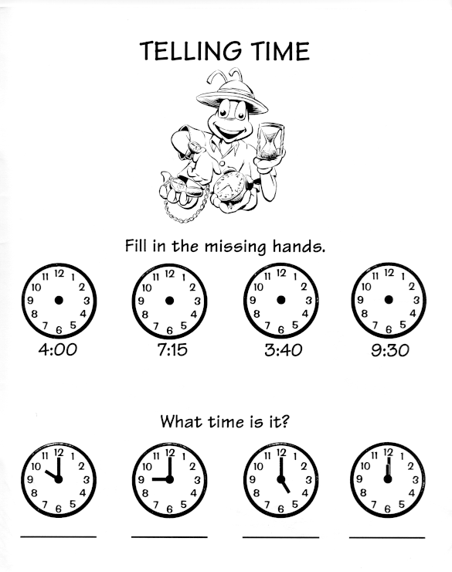
Pair worksheet

Slide 8
Homework sheet
TV guide
http://www.teachingtime.co.uk/tvguide.html

