Slide 1
Find a different
Two years ago
Now

Slide 3
Compare the picture
Five years ago
Now
II travel a lot
I don’t go away much these days

Slide 4
Compare the picture
Five years ago
Now
I play the piano.I
I haven’t played the piano for years.

Slide 5
Compare the picture
Five years ago
Now
II’m very lazy.
I work very hard these days.

Slide 6
Compare the picture
Five years ago
Now
II don’t like vegetable
I eat lots of vegetables now

Slide 7
Compare the picture
Five years ago
Now
II have a dog.
I have a cat.

Slide 8
Compare the picture
Five years ago
Now
I’m a teacher
I ‘m a university student

Slide 9
Compare the picture
Five years ago
Now
II have lots of friends
I don’t know many people these days

Slide 10
Compare the picture
Five years ago
Now
II never read newspapers.
I read a newspaper every day now.

Slide 11
Compare the picture
Five years ago
Now
I don’t drink tea.
Tea’s great!
I like it now

Slide 12
Compare the picture
Five years ago
Now
I often go to club.
I haven’t been to a club for ages

Slide 14
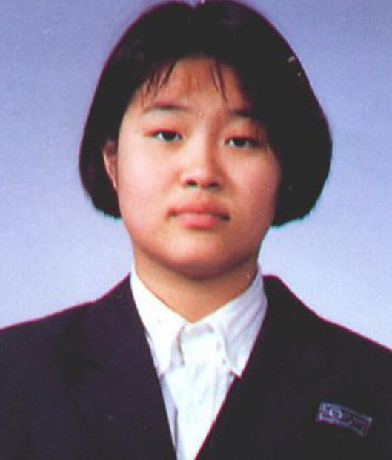
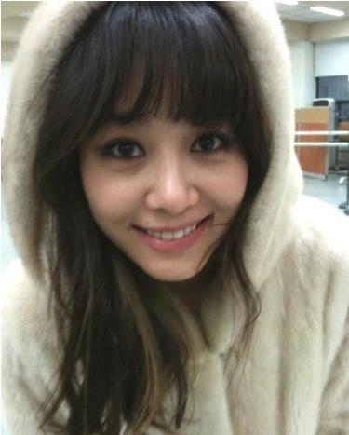
Let’s compare “Then & Now”
Then
Now

Slide 15
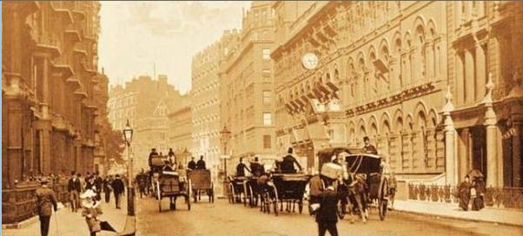
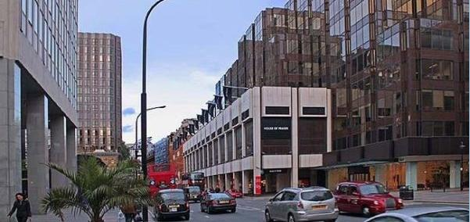
Let’s compare “Then & Now”
Then
Now

Slide 16
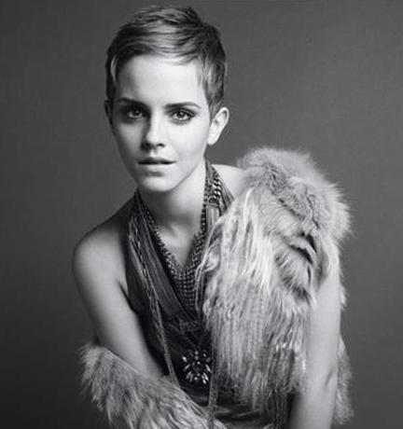
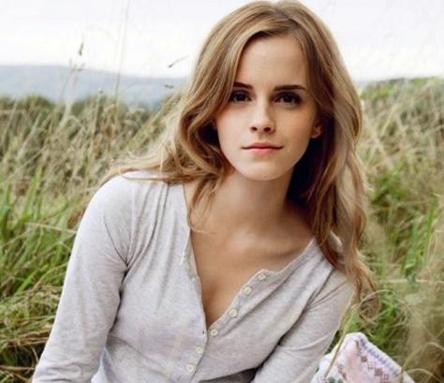
Let’s compare “Then & Now”
Then
Now

