Slide 1
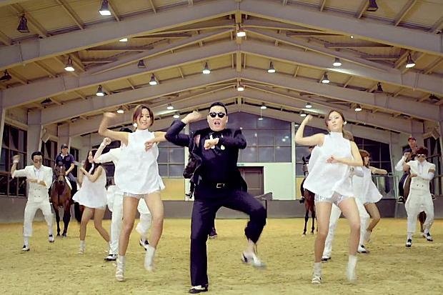
Korean rapper PSY makes it to No1.

Slide 2
The Korean rapper is PSY who made Gangnam Style has reached No1. in the UK chart.
-
-
The Korean rapper PSY has Gangnam Style song which is No. 1. in the UK chart.
-
-
PSY has a dog which has curly hair.

Slide 3
A. Select something ALL
1. I want to marry a man (that/ which/ who) looks like my father.
2. A palm is a tree (that/ which/ who) grows in tropical climates.
3. There are many people (that/ which/ who) want to learn English.
4. Most students like teachers (that/ which/ who) are kind and generous.

Slide 4
B. Make one sentence by having who or which.
She is the only person.(She can help me.)
-
You can see the store.(It sells spots clothing.)
-

Slide 5
Mozart
Music

Slide 6
Human (Man, woman, I, you, we, she, he, they) | who
Thing and animals (car, song, store, tree, dog…) | which
Human, thing, and animals | that

