Slide 1
Grammar Lesson Plan
Present Continuous

Slide 2
Hiking/Trekking
Video clip

Slide 3
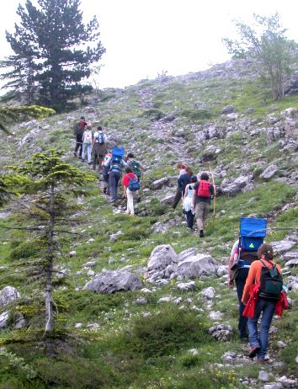
They are climbing up the mountain

Slide 4
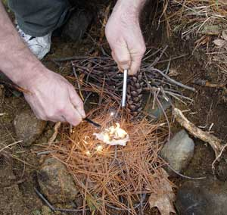
He is building a fire

Slide 5
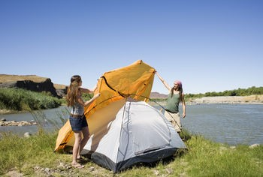
They are building a tent

Slide 6
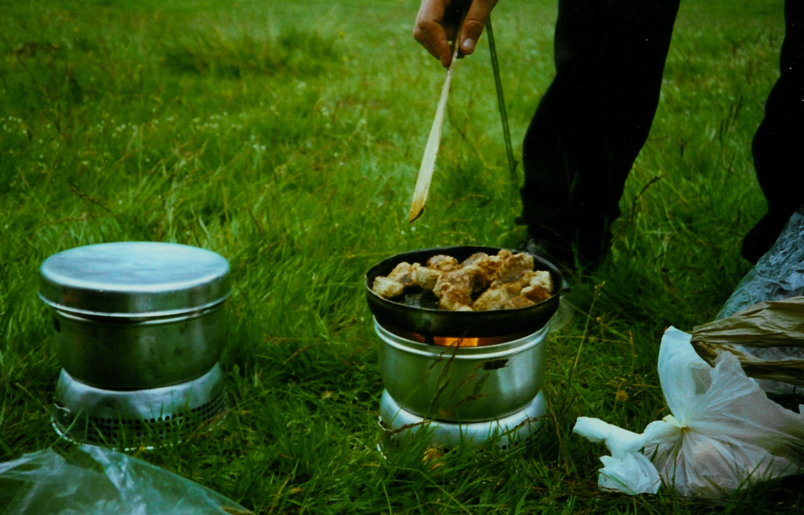
He is cooking / He is making some food

Slide 7
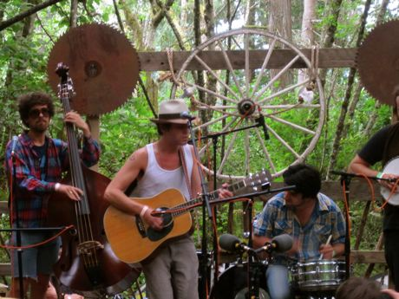
He is singing/
He is playing the guitar

Slide 8
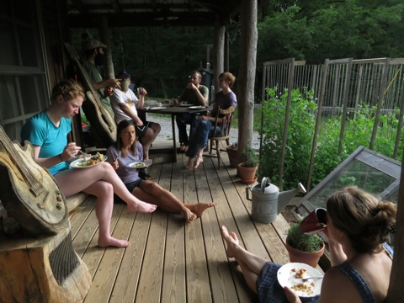
They are eating some food

Slide 10
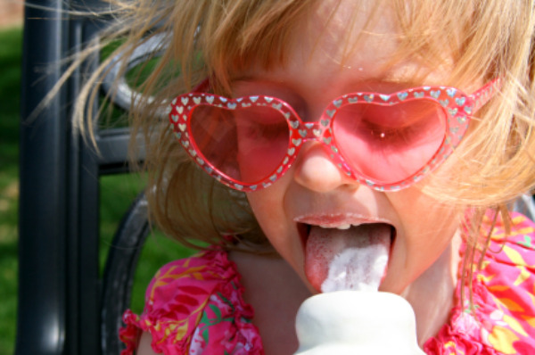
She is eating ice cream

Slide 11
Present Continuous
He is singing
He is plying the guitar
She is making some food
He is cooking
They are building a tent
They are building a fire
They are eating some food

Slide 12
Form
Be + ~ing
(am/is/are)

Slide 13
Drilling
I | am | driving working singing
You/We/They | are
He/She/It | is

Slide 14
Meaning
Past Present Future

