Slide 1
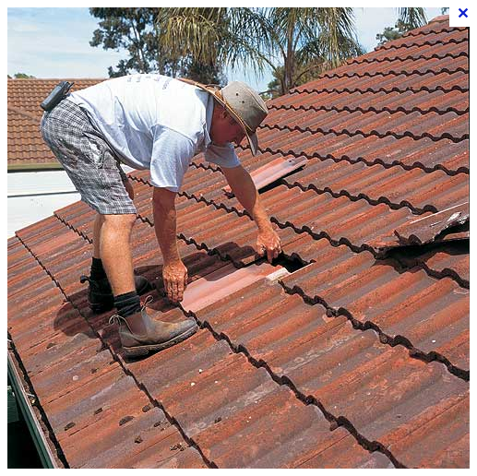

Slide 2
<Have +Object + Past Participle>
Have | Object | Past Participle
Lisa had | the roof | repaired yesterday
Where did you have | your hair | cut
We are having | the house | painted at the moment
I don’t like having | my photograph | taken

