Slide 1
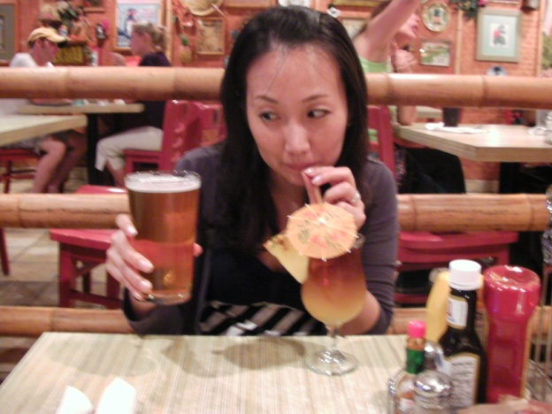
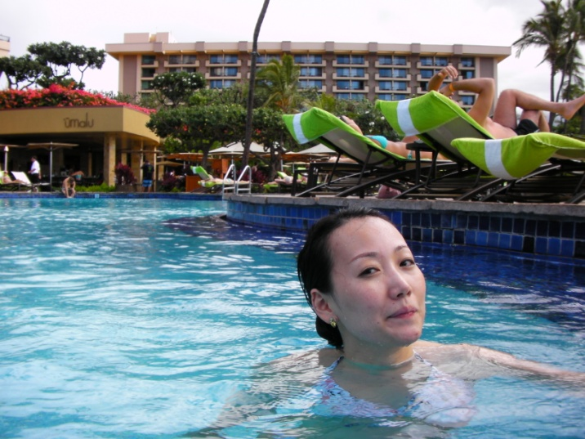
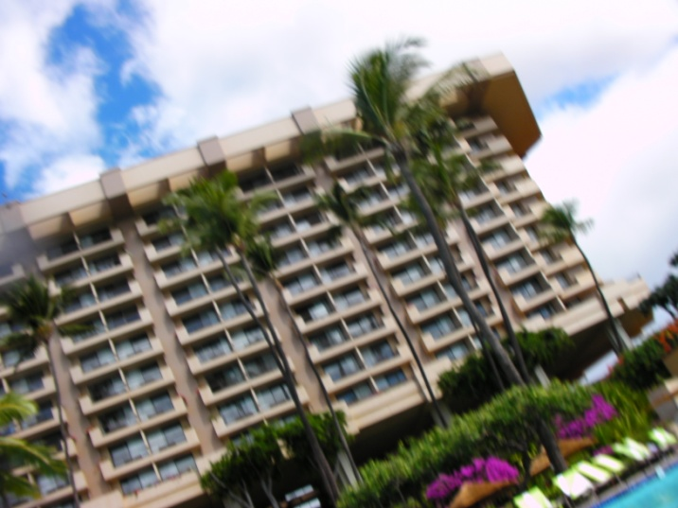
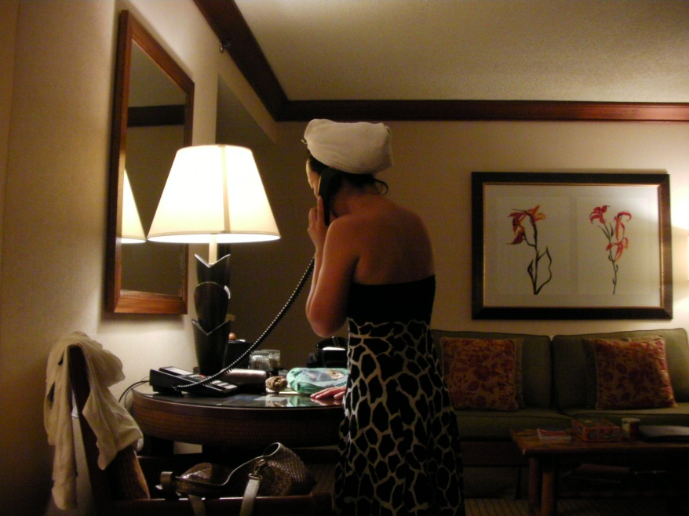
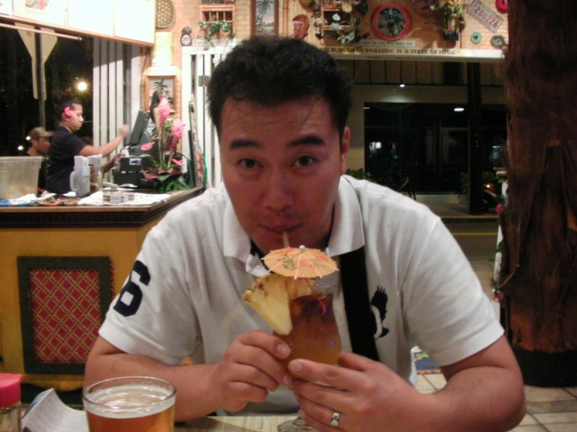

Slide 2
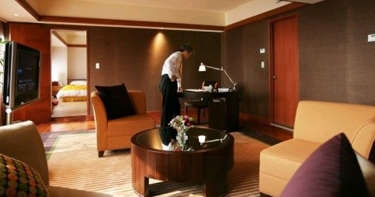
I'd like to make a reservation for three nights next week.
I need a room for the night.
I want a single room with a bath.
I want to have no smoking room.
My name is Juni Lee.

Slide 3
My name is juni Lee .
I have a reservation.
Three rooms were booked yesterday by the name of Jay.

Slide 4
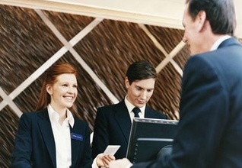
I'd like to check in now. / Can I check in now? Would you fill out this, please. / Just fill this out. What's the rate for a room per night? Does this rate include breakfast? Do you have anything cheaper?
Can I have a morning call at 8 a.m.?
Will you wake me up at 8?

Slide 5
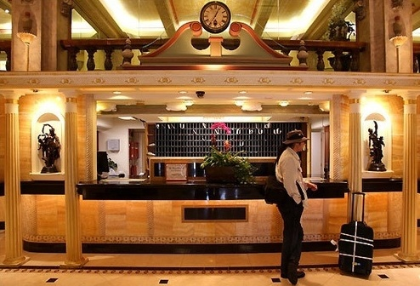
I'm going to checkout at 12 o'clock.
I'm ready to checkout.
Could you give me the bill?

Slide 6
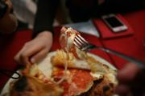
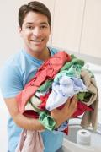
H:May I help you ?
C: yes I want to have a change my room.
H: Do you have a problem with your room?
C: Yes, The bed is not made up set.
It’s dirty room
....( you need to make a story and solve this problem
but customer really angry and she/he on the blacklist guest )
H: what would you like to have?
C: I want a grilled beef steak
H: How would like your steak?
C: medium please
H: I will bring soon
( after few minutes the steak in not coming and
the server brought different food, the guest really upset
the customer say : “I’ll never come this restaurant”)
C: Is my laundry readay?
H: You will have it in the afternoon.
( after few hours)
C: I’m still waiting for my laundry
I need them now.
H: I will check that for you
( this guest is VVIP, but his laundry was burn
a hole )

Slide 7
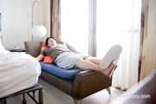
C: I’d like a wake – up call please
H: what time sir?
C: 7 o’clock tomorrow morning
( tomorrow morning this officer totally forgot so, the guest
Missed his plain he is very angry.)

