Slide 1
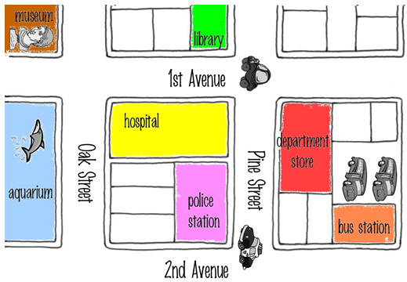
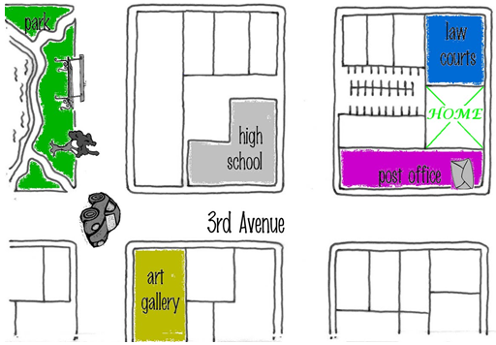

Slide 2
Jane
Jennifer
Esther
Ian
Lina
Tina
Jenise
Jenny
Kate
Jade
Jane
Jennifer
Esther
Ian
Lina
Tina
Jenise
Jenny
Kate
Jade
Jane
Jennifer
Esther
Ian
Lina
Tina
Jenise
Jenny
Kate
Jade

Slide 3
Jane
Jennifer
Esther
Ian
Lina
Tina
Jenise
Jenny
Kate
Jade

Slide 4
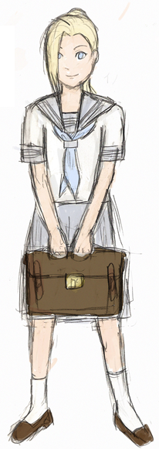
Walk to school
Start
Start
Start
Start
Start
Start
Start
Start
Start
Start
Start

Slide 6
Right
Left

Slide 7
Up
Down

Slide 8
Straight

Slide 10
Turn Right
Turn
Left

Slide 11
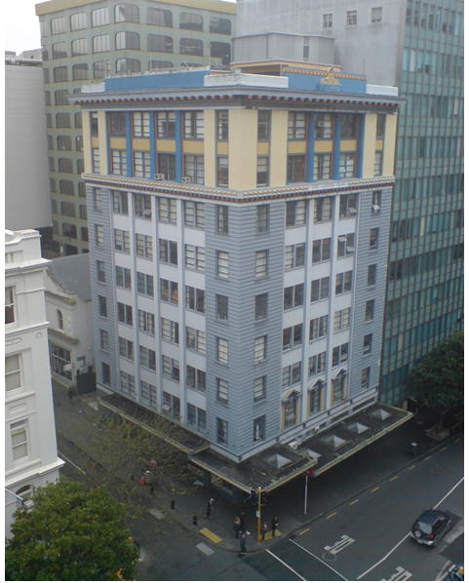

Slide 15
Right
Left
U Turn
Up
Down
Change
Straight
Turn right
Turn
left

Slide 18
sweet
clever
shy
Personality Adjectives
honest
quiet
kind
generous
brave

