Slide 1
What a Wonderful World!
Instructor
Emily

Slide 2
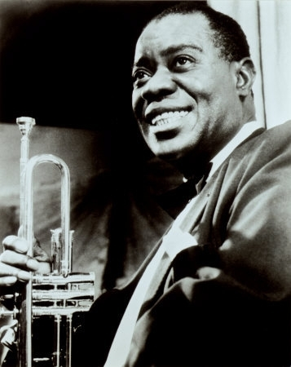
I’m Louis Armstrong!

Slide 3
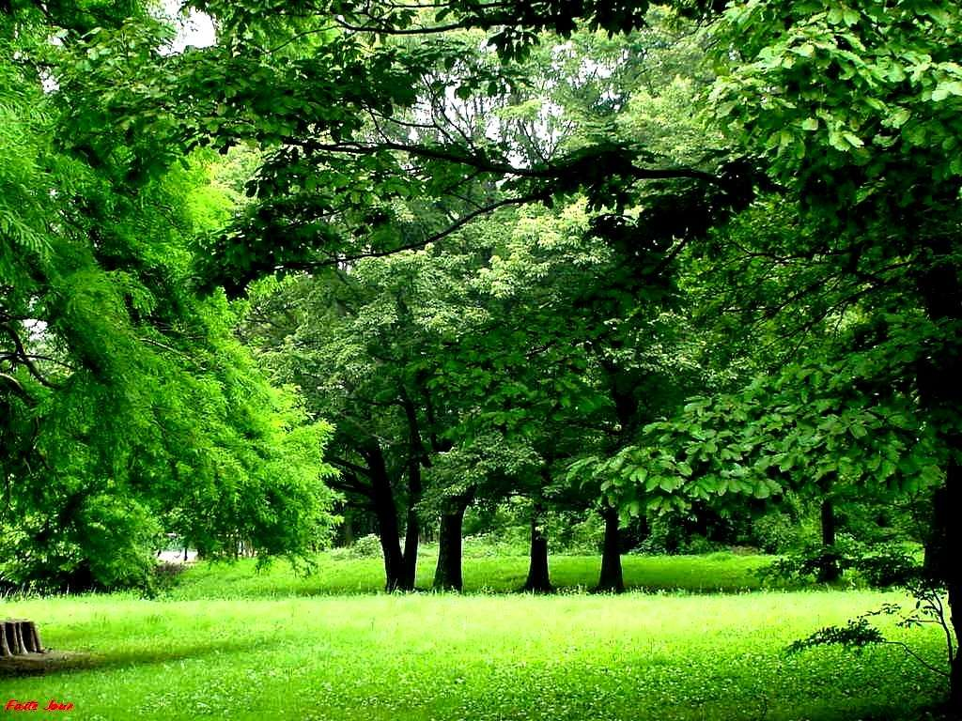
What green trees!

Slide 4
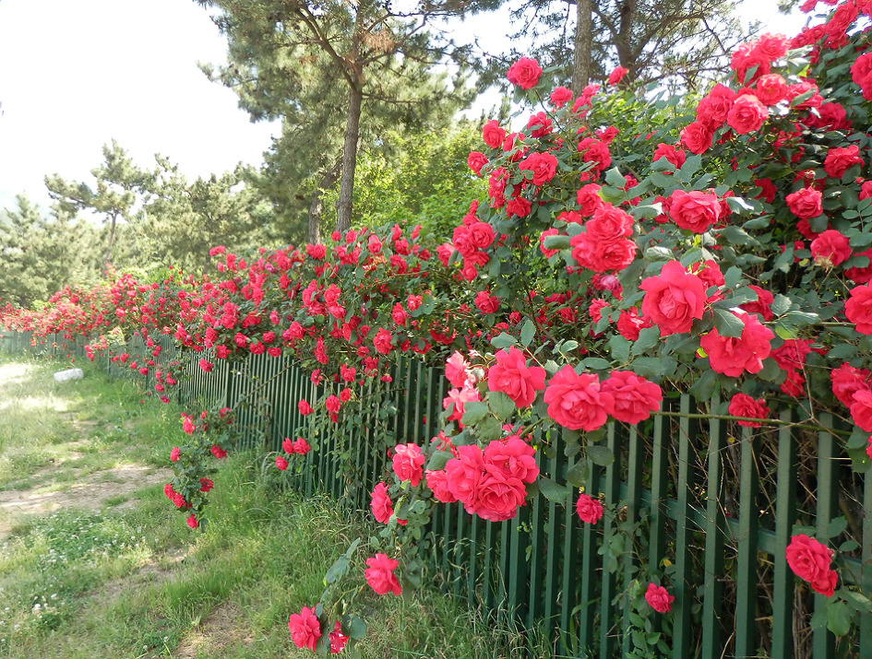
What red roses!

Slide 5
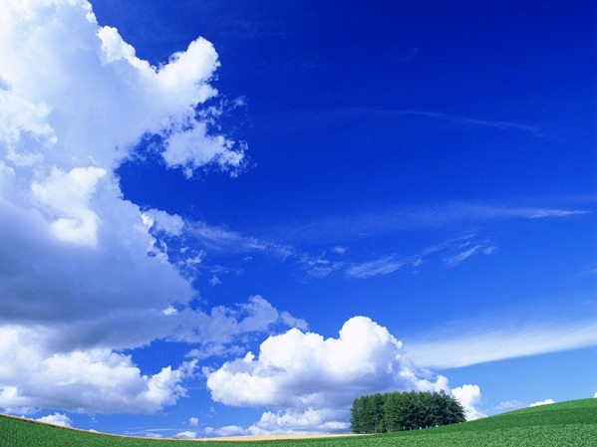
What a blue sky it is!

Slide 6
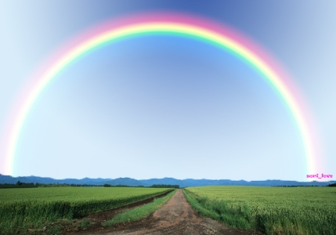
What a pretty rainbow it is!

Slide 7
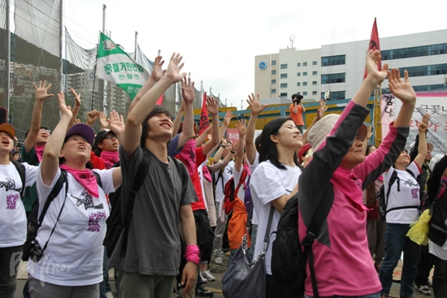
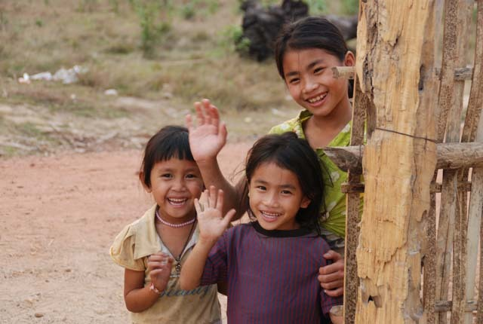
What friendly people shaking hands!

Slide 8
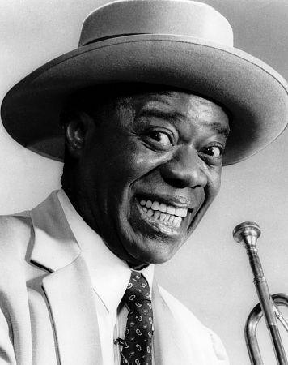
What a wonderful world!

Slide 9
Look at the sentence!
What a wonderful world!
* What Exclamation *
It’s used to show strong emphasis and emotion.

Slide 10
Form
If a noun is countable singular,
☞ What + a/an + adjective + noun + S + V!
If a noun is uncountable,
☞ What + adjective + noun + S + V!
If plural noun,
☞ What + adjective + plural noun!

Slide 11
Substitution Table
What + (a/an) + adjective + noun + S + V! |  |  |  |  | Meaning
What | a | wonderful | world | (it is)! | It is a very wonderful world.
 | (an) | excellent | weather | it is! | It is very excellent weather.
 |  | lovely | girls | (They are)! | They are very lovely girls.

