Slide 1
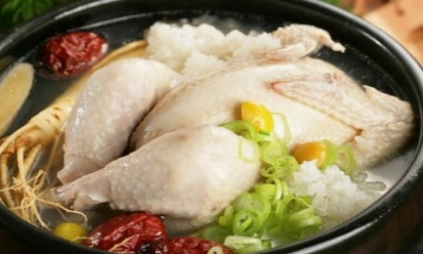
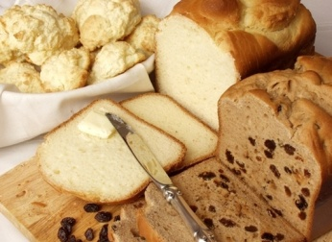
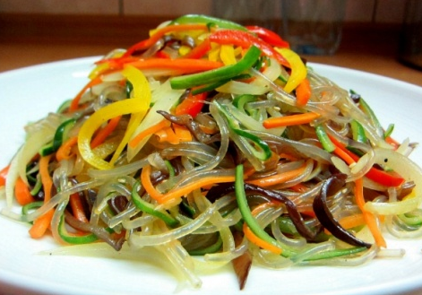
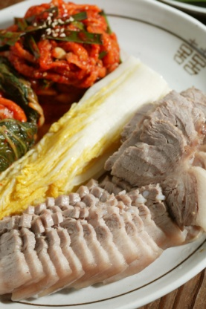
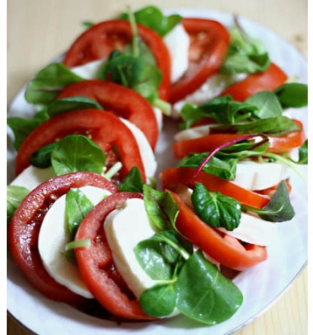
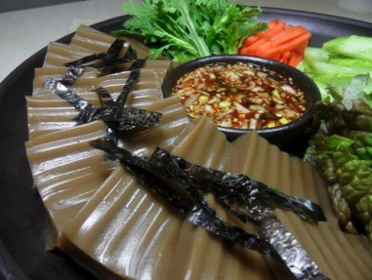
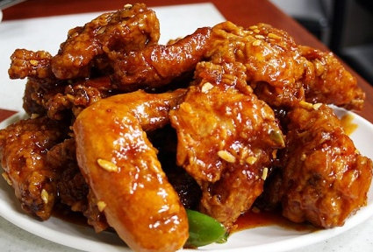
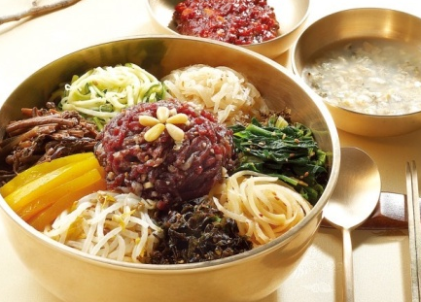
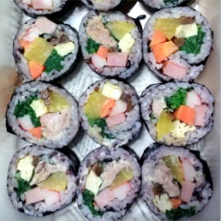
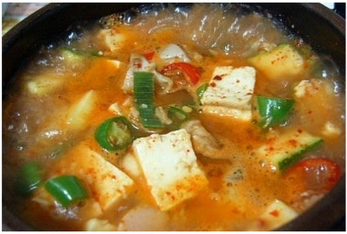
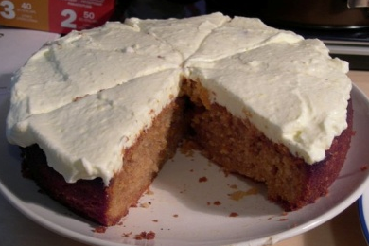

Slide 2
Student A You are making . You have… A lot of raddish Some cream cheese Some mozzarella A bunch of tomatoes Some butter A lot of milk A few lemons Some eggs You need… ____________________ ________________________________________ ____________________ ____________________ ____________________ ____________________ ____________________
Student B You are making . You have… A lot of beef Some spinach A few onions A bunch of bean sprouts Some pepper A lot of rice A few carrots You need… ____________________ ________________________________________ ____________________ ____________________ ____________________ ____________________ ____________________
Student C You are making . You have… A bunch of sugar Some salt A few ginseng Some green onion A lot of chicken A few sesame oil Some cream cheese Some flour You need… ____________________ ________________________________________ ____________________ ____________________ ____________________ ____________________ ____________________
Notes:
2

Slide 3
Student A You are making . You have… A lot of nuts Some beef A few vinegar A bunch of potatoes Some butter A lot of milk A few apples A lot of olive oils A bunch of beans You need… ____________________ ________________________________________ ____________________ ____________________ ____________________ ____________________ ____________________
Student B You are making . You have… A lot of pork Some olives A few onions A bunch of bean sprouts Some pepper A lot of rice Some nooddle A bunch of garlic You need… ____________________ ________________________________________ ____________________ ____________________ ____________________ ____________________ ____________________
Student C You are making . You have… A bunch of sugar Some salt A few herbs Some green onion A lot of ham A few egss Some cream cheese A few vegetable oil Some soy sauce You need… ____________________ ________________________________________ ____________________ ____________________ ____________________ ____________________ ____________________

Slide 4
Student A You are making . You have… A lot of pears Some beef A few cucumbers A bunch of potatoes Some butter A lot of milk A few bananas A lot of olive oils A bunch of beans You need… ____________________ ________________________________________ ____________________ ____________________ ____________________ ____________________ ____________________
Student B You are making . You have… A lot of pork Some red chilly peppers A few onions A bunch of sesame A lot of rice Some nooddles A bunch of garlic Some honey You need… ____________________ ________________________________________ ____________________ ____________________ ____________________ ____________________ ____________________
Student C You are making . You have… A bunch of sugar Some salt A few herbs Some vinegar A lot of chicken A few sesame oil Some ham A few vegetable oil Some seaweed You need… ____________________ ________________________________________ ____________________ ____________________ ____________________ ____________________ ____________________

Slide 5
 Work in groups of three. Ask your partners for the things you need. Just ask for one thing at a time.
Example:
A: I’m making chicken soup. Does anyone have some salt?
B: Not me. I don’t have any salt.
C: I’ve got some salt. How much do you need?
A: Just a little.
C: Here you go.
A: Thanks. (Students A ✓s off ‘salt’.)
B: I’m making a carrot cake, so I need some milk. Does anyone have any milk?

Slide 6
Student A You are making chicken soup. You have… A lot of nuts Some cream cheese A few mozzarella A bunch of tomatoes Some butter A lot of milk A few lemons Some eggs You need…  chicken  green onion  ginseng  salt  rice  sesame oil  Pepper
Student B You are making carrot cake. You have… A lot of beef Some spinach A few onions A bunch of bean sprouts Some pepper A lot of rice A few carrots You need…  milk  sugar  butter  salt  flour  cream cheese  lemon
Student C You are making bibimbap. You have… A bunch of sugar Some salt A few ginseng Some green onion A lot of chicken A few sesame oil Some cream cheese Some flour You need…  rice  nuts bean sprouts  salt  egg  spinach  beef

