Slide 1
???

Slide 2
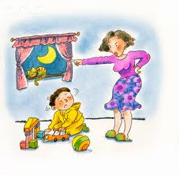
go to your bed

Slide 3
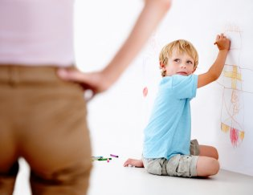
don't write on the wall

Slide 4
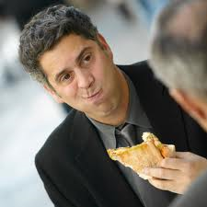
Your mouth full

Slide 5
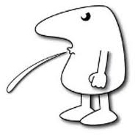
Spit

Slide 6
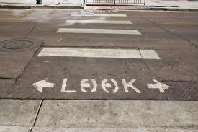
Look both ways

Slide 7
Your set to the elderly

