Slide 1
Summining-up
After reading the story,
Summing-up and
drawing a summary

Slide 2
The chubby chihuahua.
Billy has a pet Chihuahua named
Chico. A Chihuahua a little dog.
But he is also very chubby. Billy likes
to play viedo games.
He plays all day long.
He doesn’t take Chico out for walks,
ever. Chico gets no exercise.
Also, Billy doesn’t know how much to
feed his pet. Chico’s bowl is always
full. So he gets chubby.
<Vocabulary>
Chubby
-A little bit fat
Exercise
-using your body to get stronger
Feed
-to give food to animaks or people

Slide 3
Summary
Because Billy plays all day long, his pet Chico gets chubby.

Slide 4
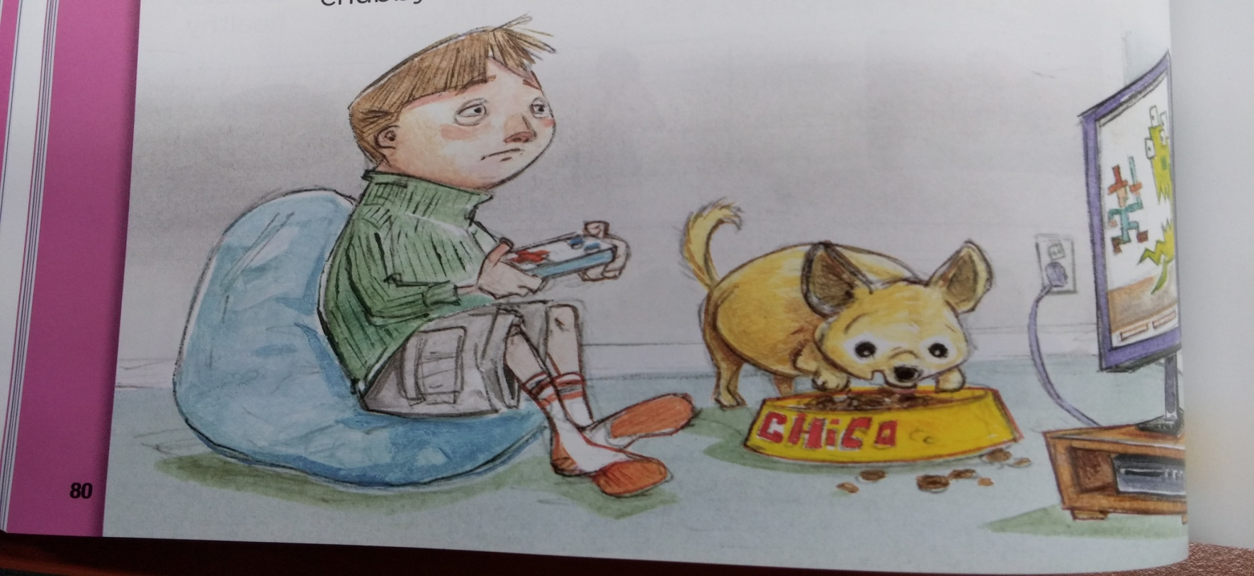
Drawing

