Slide 1
Always Happy in the class
I am
Youare?
Kelly Nayoung Kang

Slide 2
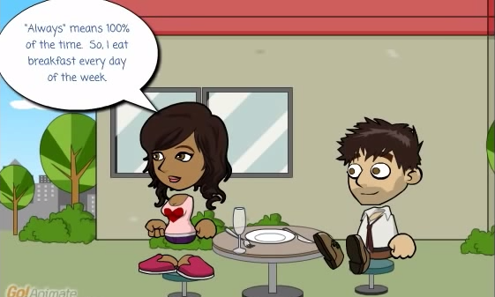
Always
“Always” means 100% of the time

Slide 3
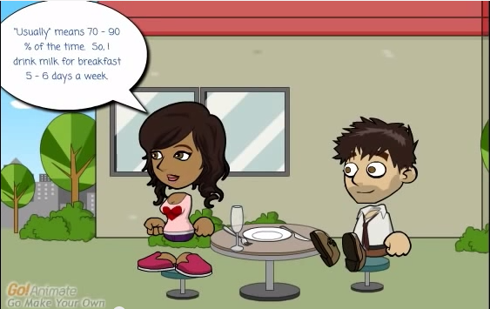
Usually
“Usually” means 70-90% of the time

Slide 4
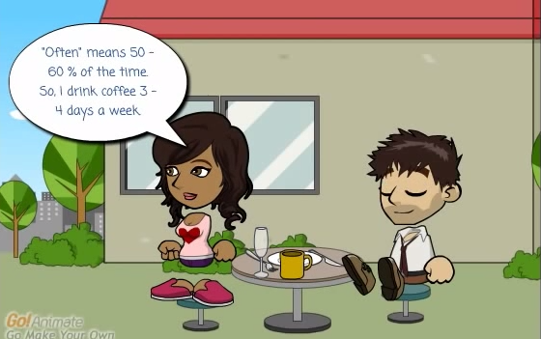
Often
“Often” means 50-60% of the time

Slide 5
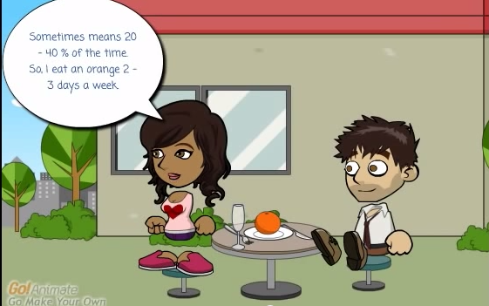
Sometimes
“Sometime” means 20-40% of the time

Slide 6
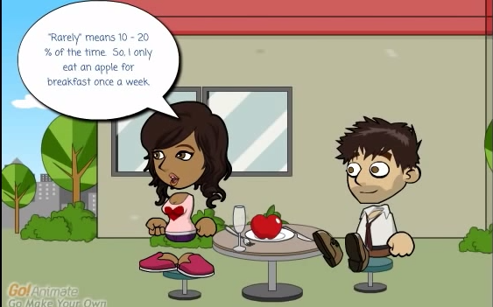
Rarely
“Rarely” means 10-20% of the time

Slide 7
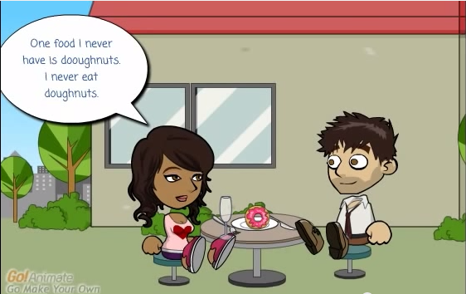
Never
“Never” means ?????% of the time

Slide 8
Always
Usually
Often
Sometimes
Rarely
Never

Slide 9
I | am | always usually often sometimes rarely never | happy sad kind mean late early sick healthy
You | are
We
They
He | is
She

Slide 10
I’m always happy.
I’m always kind.
I’m always shy
Continue
1. She :
2. Relaxed :
3. Yuna Kim:
4. Hardworking :
5. We :

Slide 11
We’re always hardworking.
Continue
6. healthy :
7. usually :
8. He :
9. diligent :
10. they :

Slide 12
They’re usually diligent.
Continue
11. cheerful :
12. never :
13. bored :
14. Mr. King :
15. free:

Slide 13
Mr. King never free.
Continue
16. satisfied:
17. usually:
18. careful:
19. outgoing:
20. often:

