Slide 1
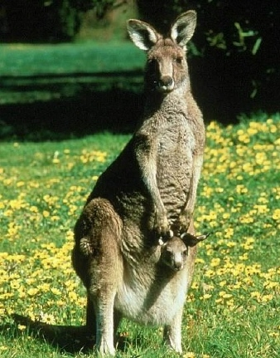
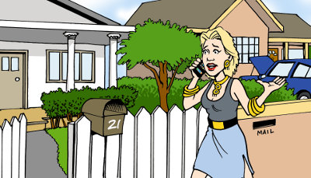
97th WD – Grammar Lesson Plan
Say it in a sentence – Relative Clause
Mom sentence
The Woman is a doctor
Mom
The woman who lives next door is a doctor
Baby
Baby sentence
A Woman lives next door.
Matt (Jaeyong Chung)

Slide 2
97th WD – Grammar Lesson Plan
Say it in a sentence – Relative Clause
A Woman lives next door.
The woman is a doctor.
Say it in a sentence using relative clause | Possible relative pronouns | Relative pronoun removable?
 |  | Y / N
* possible relative pronouns : who / that / which / whose / whom / where / why / what
Matt (Jaeyong Chung)

Slide 3
97th WD – Grammar Lesson Plan
Say it in a sentence – Relative Clause
#1
A person called you.
Who was the name of the person?
Say it in a sentence using relative clause | Possible relative pronouns | Relative pronoun removable?
 |  | Y / N
* possible relative pronouns : who / that / which / whose / whom / where / why / what
Matt (Jaeyong Chung)

Slide 4
97th WD – Grammar Lesson Plan
Say it in a sentence – Relative Clause
#2
Barbra works for a company.
The company makes furniture.
Say it in a sentence using relative clause | Possible relative pronouns | Relative pronoun removable?
 |  | Y / N
* possible relative pronouns : who / that / which / whose / whom / where / why / what
Matt (Jaeyong Chung)

Slide 5
97th WD – Grammar Lesson Plan
Say it in a sentence – Relative Clause
#3
A machine broke down.
The machine is working again now.
Say it in a sentence using relative clause | Possible relative pronouns | Relative pronoun removable?
 |  | Y / N
* possible relative pronouns : who / that / which / whose / whom / where / why / what
Matt (Jaeyong Chung)

Slide 6
97th WD – Grammar Lesson Plan
Say it in a sentence – Relative Clause
#4
I wanted to see a woman.
The woman was away.
Say it in a sentence using relative clause | Possible relative pronouns | Relative pronoun removable?
 |  | Y / N
* possible relative pronouns : who / that / which / whose / whom / where / why / what
Matt (Jaeyong Chung)

Slide 7
97th WD – Grammar Lesson Plan
Say it in a sentence – Relative Clause
#5
Ann bought a dress.
The dress doesn’t fit her very well.
Say it in a sentence using relative clause | Possible relative pronouns | Relative pronoun removable?
 |  | Y / N
* possible relative pronouns : who / that / which / whose / whom / where / why / what
Matt (Jaeyong Chung)

Slide 8
97th WD – Grammar Lesson Plan
Say it in a sentence – Relative Clause
#6
I slept in a bed last night.
The bed wasn’t very comfortable.
Say it in a sentence using relative clause | Possible relative pronouns | Relative pronoun removable?
 |  | Y / N
* possible relative pronouns : who / that / which / whose / whom / where / why / what
Matt (Jaeyong Chung)

Slide 9
97th WD – Grammar Lesson Plan
Say it in a sentence – Relative Clause
#7
You borrowed his car.
What’s the name of the man?
Say it in a sentence using relative clause | Possible relative pronouns | Relative pronoun removable?
 |  | Y / N
* possible relative pronouns : who / that / which / whose / whom / where / why / what
Matt (Jaeyong Chung)

Slide 10
97th WD – Grammar Lesson Plan
Say it in a sentence – Relative Clause
#8
I recently went back to the town.
There, I grew up.
Say it in a sentence using relative clause | Possible relative pronouns | Relative pronoun removable?
 |  | Y / N
* possible relative pronouns : who / that / which / whose / whom / where / why / what
Matt (Jaeyong Chung)

Slide 11
97th WD – Grammar Lesson Plan
Say it in a sentence – Relative Clause
#9
I’m calling you.
The reason is to ask your advice.
Say it in a sentence using relative clause | Possible relative pronouns | Relative pronoun removable?
 |  | Y / N
* possible relative pronouns : who / that / which / whose / whom / where / why / what
Matt (Jaeyong Chung)

Slide 12
97th WD – Grammar Lesson Plan
Say it in a sentence – Relative Clause (Summary)
# | Say it in a sentence using relative clause | Possible relative pronouns | Removable? | Remarks
1) | A person called you. Who was the name of the person?
2) | Barbra works for a company. The company makes furniture
3) | A machine broke down. The machine is working again now.
4) | I wanted to see a woman. The woman was away.
5) | Ann bought a dress. The dress doesn’t fit her very well.
6) | I slept in a bed last night. The bed wasn’t very comfortable
7) | You borrowed his car. What’s the name of the man?
8) | I recently went back to the town. There, I grew up.
9) | I’m calling you. The reason is to ask your advice

Slide 13
97th WD – Grammar Lesson Plan
Say it in a sentence – Relative Clause (Summary)
Say it in a sentence using relative clause | Possible relative pronouns | Removable? | Remarks
A person called you. Who was the name of the person? | who, that | No
Barbra works for a company. The company makes furniture | which, that | No
A machine broke down. The machine is working again now. | which, that | No
I wanted to see a woman. The woman was away. | who, that | Yes
Ann bought a dress. The dress doesn’t fit her very well. | which, that | Yes
I slept in a bed last night. The bed wasn’t very comfortable | which, that | Yes
You borrowed his car. What’s the name of the man? | whose | No
I recently went back to the town. There, I grew up. | where (which, that) | No (Yes)
I’m calling you. The reason is to ask your advice | why, that | Yes
Human? or Things?
Subject in the baby sentence?
Can it be “that”?
Matt (Jaeyong Chung)

