Slide 1
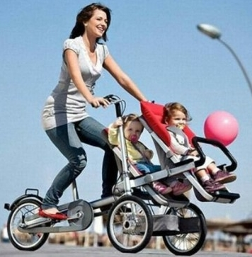
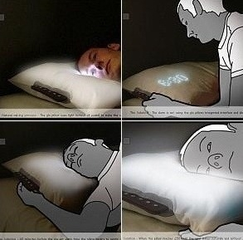
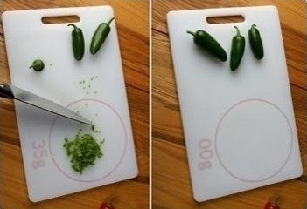

Slide 2
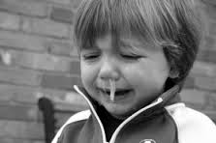
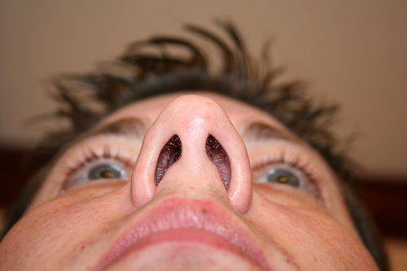
snot
nostril

Slide 3
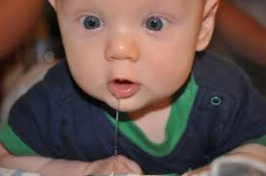
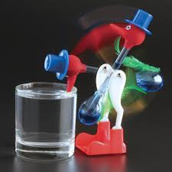
drool
The bird is "bobbing."

Slide 4
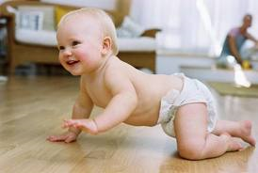
A "crawling" baby in "diaper."
There must be "bodily fluids" inside the diaper.

Slide 5
Commuter's Napcap
Full-body Umbrella
Toilet Roll Hat
Baby Mop

Slide 6
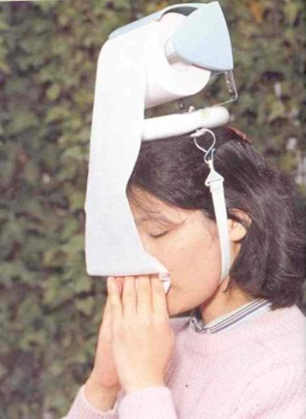
Toilet Roll Hat

Slide 7
Commuter's Napcap

Slide 8
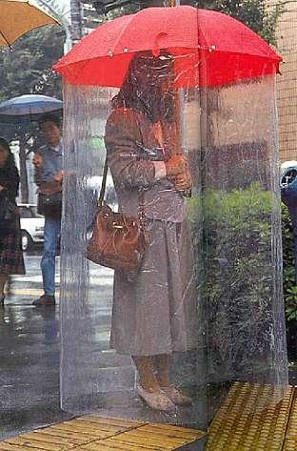
Full-body Umbrella

Slide 9
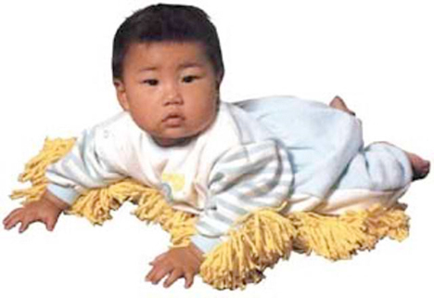
Baby Mop

