Slide 2
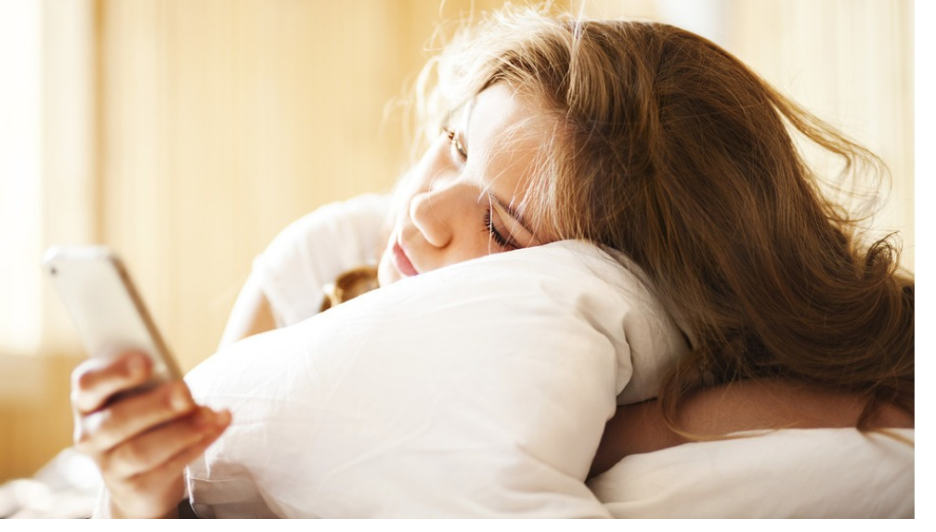
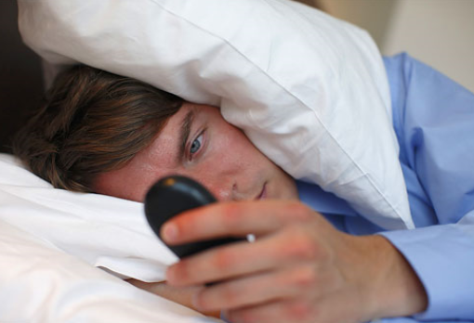

Slide 4
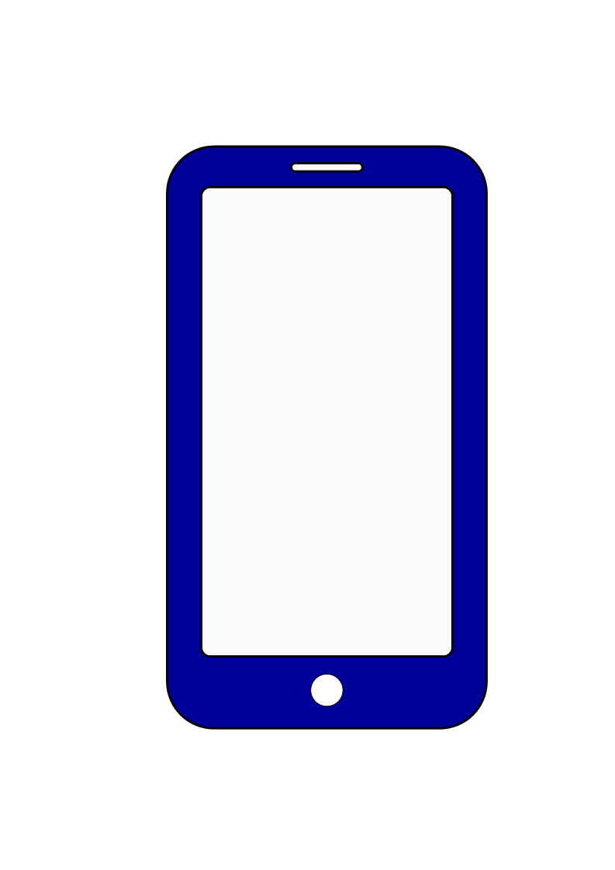
Introduce your smartphone!
Brand? Model?
Color? Shape?
2 good things.
2 bad things.

Slide 5
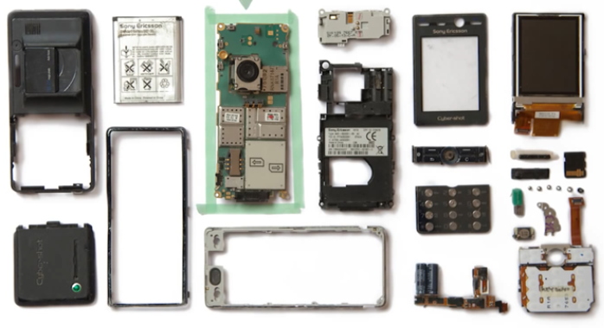
DIY smarphone (*DIY : Do It Yourself)

Slide 6
New Vocabulary
Endoskeleton:
Leeway:
Tweak:
Throwback:
an internal skeleton or supporting framework in an animal
freedom to do something the way you want to do it.
to change or adjust something slightly in order to improve it.
a person or thing that is similar to one that existed in the past.

Slide 7
If I would develop a phone…
☞ It would be like …
☞ I would put/add/get/have …
Describe the appearance and functions!

