Slide 1
TESOL 101
Grammar Lesson Plan
Instructor : Jina

Slide 2
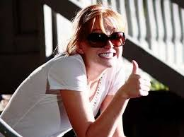
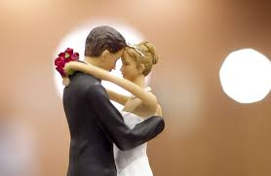
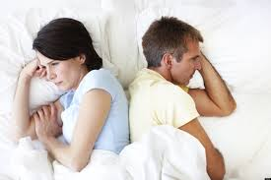
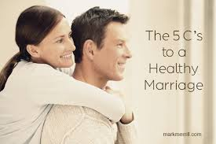

Slide 3
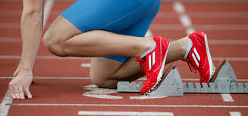
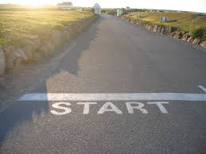

Slide 4
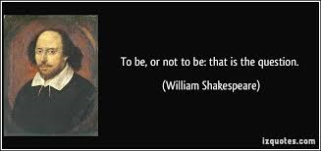
“To be, or not to be: that is the question.”

Slide 5
What is the infinitive?
The infinitive of a verb is its basic form with or without the particle to:

Slide 6
INFINITIVE
After certain other verbs, such as : afford help agree learn arrange manage choose offer fail refuse happen seem .............. to do

Slide 7
INFINITIVE
After verbs that refer to a future event : want, hope, intend would like, promise
......... to do

Slide 8
INFINITIVE
After "too" & "enough": too difficult easy enough
..................... to do

Slide 9
INFINITIVE
The verbs : stop/try/remember/forget can also take both,
but the meaning changes

Slide 10
INFINITIVE
I’ve stopped watching cartoons.
Meaning: Stop an activity
We stopped to go to the toilets at the petrol station.
Meaning: Stop in order to

Slide 11
INFINITIVE
I ‘ve tried to understand his English, but I was unsuccessful.
Meaning: Make an effort
Let’s try restarting the computer.
Meaning: See if it works

Slide 12
INFINITIVE
The verbs : begin/start/continue/like/love/hate/prefer can be followed by the gerund or the infinitive
with little or no change in meaning

Slide 15
Sara thinks that she’ll be a model when she’s older. (expect)
Sara __________ a model when she’s older.
expects to be

Slide 16
He says he won’t eat food that is bad for him. (refuse)
He __________ food that is bad for him.
refuses to eat

Slide 17
Vivienne didn’t manage to keep her contact with Max Factor. (fail)
Vivienne _________ her contact with Max Factor.
failed to keep

Slide 18
Will you start eating healthy food for sure? (promise)
Will you ____________ eating healthy food?
promise to start

Slide 19
Fill in the blanks below with the correct form of the verb in brackets.
1. It's obvious he's only interested in (make) ______________ money.
2. Anne couldn't find a taxi so I offered (drive) ________________ her to the station.
3. I managed (book) ________________ two seats on the morning flight.
4. I promise (send) _______________ you our new brochure as soon as it's available.
5. Peter was delighted (meet) _______________ a former colleague at the conference.
making
to drive
to book
to send
to meet

Slide 20
Fill in the blanks below with the correct form of the verb in brackets.
taking
6. I avoid (take) _______________ the car whenever possible, especially in big cities.
7. We finished the job by (work) _______________ 12 hours a day.
8. Bob sent a report to the Chairman instead of (attend) _______________ the meeting.
9. A lot of people dislike (drive) _______________ at night.
10. I intend (speak) _______________ to my boss about your complaint.
working
attending
driving
to speak

Slide 21
"I Will Survive" is a hit song first performed by American singer Gloria Gaynor, released in October 1978. Before you listen to the song, complete the blanks using the verbs in brackets in the correct form. Then listen to the song and check your answers.

Slide 22
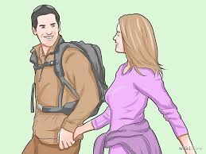
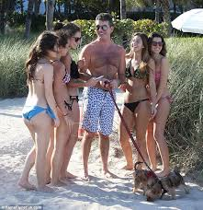

Slide 23
Love Story of a Modern Era
Max and Tara were high school classmates. They didn´t know each other very well but Max found Tara really beautiful. Too beautiful for him. He couldn´t imagine __________________ (ask) her out. But he wasn´t planning to give up.
Max decided ________________ (send) Tara a friend request on Facebook. She soon confirmed him as a friend. Happy Max tried _______________ (write) her a message but Tara didn´t want _________________ (reply). So he looked at all her likes and started __________________ (post) interesting things on her wall. Tara enjoyed ___________________ (read) his posts and comments and they soon started _________________ (chat) with each other.
One day Tara had a problem with the project to school and Max gladly offered _____________ (help) her. Max didn´t forget ________________ (bring) CDs with her favorite band. They had a good time so Tara promised ___________________ (go) to the cinema with Max when he asked her. Soon they started _________________ (go) out with each other and their relationship became public when they changed their Facebook status.

Slide 24
Love Story of a Modern Era
Max and Tara were high school classmates. They didn´t know each other very well but Max found Tara really beautiful. Too beautiful for him. He couldn´t imagine ___asking_______________ (ask) her out. But he wasn´t planning to give up.
Max decided ____to send______ (send) Tara a friend request on Facebook. She soon confirmed him as a friend. Happy Max tried ______to write____ (write) her a message but Tara didn´t want ___________to reply__ (reply). So he looked at all her likes and started __to post____ (post) interesting things on her wall. Tara enjoyed _____reading__________ (read) his posts and comments and they soon started __to chat/chatting_______________ (chat) with each other.
One day Tara had a problem with the project to school and Max gladly offered ____to help_________ (help) her. Max didn´t forget ____to bring______ (bring) CDs with her favorite band. They had a good time so Tara promised ________to go____ (go) to the cinema with Max when he asked her. Soon they started _to go/going out___(go) out with each other and their relationship became public when they changed their Facebook status.

Slide 25
Activity :Get Four

Slide 27
This Love – Maroon 5

Slide 28
This Love – Maroon 5
I was so high I did not ....................(recognize)
The fire ....................(burning) in her eyes,
(Nor) The chaos that controlled my mind.
(She) Whispered 'goodbye' and she got on a plane;
Never ....................(return) again,
But always in my heart

Slide 29
This Love – Maroon 5
This love has ....................(take) its toll on me;
She said 'goodbye' too many times before
And her heart is ....................(breaking) in front of me.
I have no choice, 'cause I
Won't ....................(say) 'goodbye' anymore.

Slide 30
This Love – Maroon 5
I tried my best ....................(feed) her appetite,
Keep her ....................(come) every night.
(It was) So hard to keep her ....................(satisfy);
(She) Kept ....................(play) love like it was just a game,
....................(pretend) to feel the same,
Then ....................(turn) around and ....................(leave) again.

Slide 31
This Love – Maroon 5
This love has ....................(take) its toll on me;
She said 'goodbye' too many times before
And her heart is ....................(break) in front of me.
I have no choice, 'cause
I won't ....................(say) 'goodbye' anymore.

Slide 32
This Love – Maroon 5
I'll ....................(fix) these broken things;
(I'll) ....................(repair) your broken wings
And make sure everything's alright.
My pressure on your hips,
....................(sinking) my fingertips
Into every inch of you,
'Cause I know that's what you want me ....................(do).

