Slide 1
Alright mate?
TESOL 101
Speaking Lesson
Instructor : Jina

Slide 3
Where is the word scouse originated from?

Slide 4
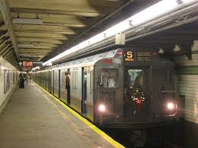
British English
1. favour, flavour, neighbour…
2.

Slide 5
UK | USA
1-autumn
2-the cinema
3-lorry
4-main road
5-motorway
6-tube/underground
7-chemist’s
8-flat
9-lift
10-sweets

Slide 6
11- chips
12-crisps
13-tin
14-fridge
15-wardrobe
16-holiday
17-jumper
18- rubbish
19-nappies
20-petrol

Slide 7
British English
1. How was your football game?
Oh, we won. I feel so _knackered__though.
2. Where are you going?
I’m off to buy a packet of __fags____.
3. Mommy I need to pee now.
Hang on, I’m looking for the ___loo_____.
4. What does your father do for living?
He’s a ___barrister_________________.
5. Here is your birthday present.
___Cheers/Ta._______________________.

Slide 8
British English
6. Please come home by 5pm for _ tea________.
Can I just get a big mac instead?
7. This __queue________ is very long.
I know, I’ve been waiting for over 40 minutes.
8. How much was your necklace?
It wasn’t that __dear____, only about 30 quids_.
9. Good morning _love___, what can I get for you?
Can I have a cup of tea and a scone please?
10. Is Sam still in bed?
Yeah, he came home at 4am totally _pissed______.
Where was he all night?
Probably one of the _pubs____ across the street.

Slide 9
British English
11. Blimey____, can you please watch where you’re going?
Sorry, I didn’t see you.
12. How old is your baby? Can you bring him for lunch?
Yeah, sure. He stays pretty calm in his __pram___.
13. Did your husband get promoted?
No, he didn’t. I didn’t say anything he looked so _gutted_____.
14. What would you like to drink?
Can I get a pint of ___lager_____ please?
15. Here’s your book back.
____Ta/Cheers___.
16. My goodness, did you see that girl?
Yeah, she was so __fit_______.
17. I only studies 30 minutes for the exam.
Oh stop talking _rubbish___.
18. Why is the bus always ___bloody___ late?
I know. That’s why I leave home early every morning.

Slide 10
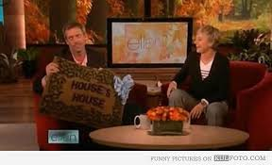
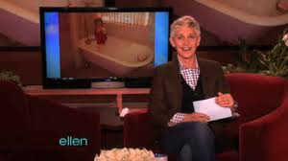
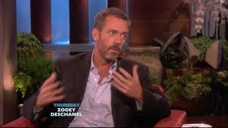

Slide 11
Hugh Laurie : the British accent vs the American
slang:
flossing
we’re tied…..at nothing
to rub it in :
That’s what I meant:
Blundering
Close-fitting

Slide 12
Hugh Laurie : the British accent vs the American
American slang | Explanation / synonym
flossing
ba-donka-donk
shawty
British slang
to chin wag
chuffed to bits

Slide 13
Hugh Laurie : the British accent vs the American
Both Ellen and Hugh are native English speakers. But why did they find it difficult to understand their questions?
What accent or what person did you understand better? Why?

Slide 14
The Perfect Match

Slide 15
What’s your name?
How old are you?
What do you think is the most important thing in a relationship?
Do you want to marry or have you ever been married?
Do you want/do you have any children?
Do you believe in love at first sight?
What are your negative points?
What do you do for fun?
Do you follow politics?
Do you like travelling?
What is your favourite month of the year and why?
How do you spend your spare time?
Where do you see yourself in five years’ time?
If you were an animal, what would you be and why?
Are you a morning person or a night person?
What adjective would a close friend use to describe you?
If you could live anywhere in the world, where would it be?

Slide 17
Dear Abby
1. My girlfriend and I are in love and we have been living together for 2 years. I would like to propose to her, however, she told me that she does not want an engagement ring. I would like to give her something as an engagement gift. Do you have any ideas?

Slide 18
Dear Abby
2. My husband wants to go on a dangerous trip with a group. I am so afraid he will never come home. He has always loved sports and outdoor activities and has taken many trips but this trip will be very different, because it will be so dangerous. People have died. He says he wants to go now before we have children. What can I do to stop him?

Slide 19
Dear Abby
3. I am 32 years old. My family does not like my new boyfriend. They think he is weird and refuse to have him around. They want me to come alone when I visit them. I do not want to tell him that he is not invited to my family's house because no one likes him. I am tired of making up excuses for why he is not included. If my family really got to know him they would like him. He comes from a good family, he does not drink, and he is a nice person. When I am with him I feel good about myself. We like doing the same things and he makes me laugh. I have never been closer to anyone in my life. What should I do?

