Slide 1
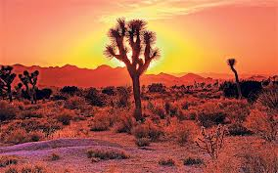
O X

Slide 2
If a place is barren, it is worthless for cultivation.
X

Slide 3
Someone who tries to save water conserves it.
O

Slide 4
Scientists believe that a rain forest is a desolate place.
X

Slide 5
Cooks gauge how long something will take to bake.
O

Slide 6
Your actions never, ever have consequences.
X

Slide 7
Someone who has a lot of generosity gives a lot.
O

Slide 8
An exceptional athlete is usually a lazy one.
X

Slide 9
Scientists like to hazard guesses all the time.
X

Slide 10
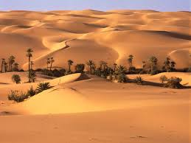
Comprehension Questions

Slide 11
Q: Why might the desert seem more desolate if you are lost or stuck?
A: Because I would feel more desperate and have much more fear.

Slide 12
Q: What are the consequences of not being prepared in the desert?
A1: We might run the risk of dehydration if we didn’t have enough water to drink.
A2: We might get burned if we don’t wear proper clothes.

Slide 13
Q: Why do we need to conserve our body’s moisture?
A1: Our body is consist of 80% of water,
so keeping our body’s moisture is very important.

Slide 14
Q: What sort of documents might you leave with your friends and family?
A: Details of the whole route of my trip.

Slide 15
Q : If you got injured, what might you need?
A : A first aid kit.

Slide 16
Q: If you go on a trip to the desert, what do you think is the most import thing?

