Slide 1
Who are they?
by Hyeueon Bek

Slide 2
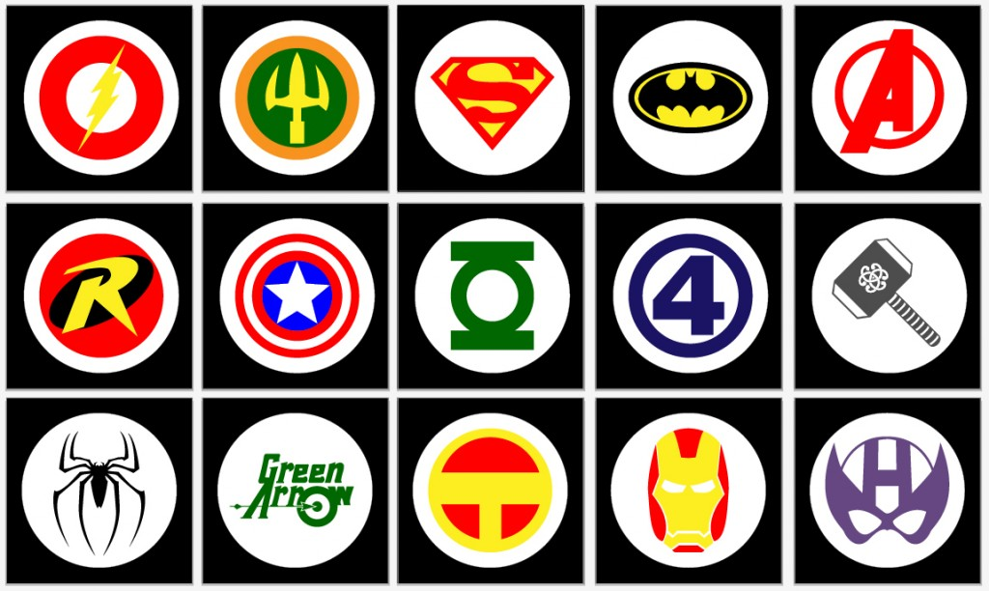
Symbol / Logo

Slide 3
Superhero / Superheroine

Slide 4
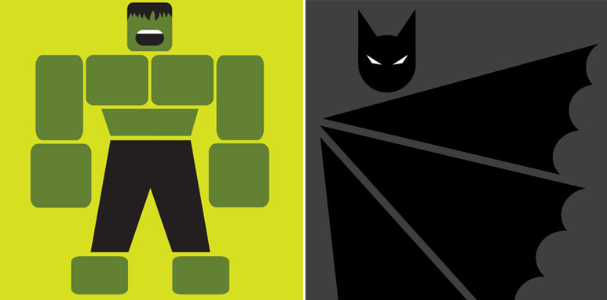
Secret Identity vs Public Figure
Secret Identity
Superman
Batman & Robin
Spider-Man
Catwoman
Wonder Woman
Public Figure
Iron Man
Captain America
X-men
Fantastic Four

Slide 5
Super Powers
Flight
Invisibility
Strength
Transformation
Mentalist
Healer
Acrobat
Robot
Elementalist: water, fire, weather, ice, electricity…

Slide 6
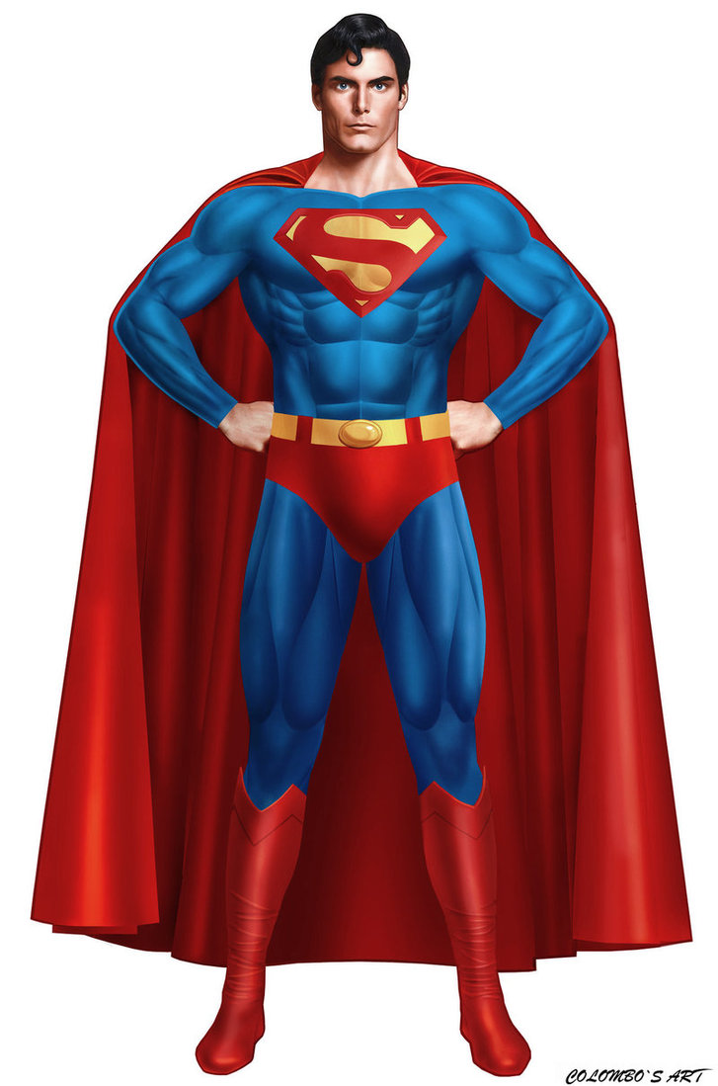
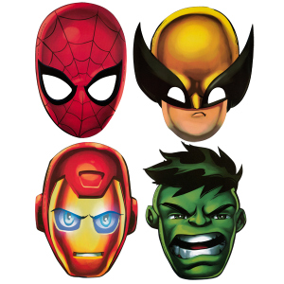
Costume
Mask
Cape
Belt
Helmet
Armor

Slide 7
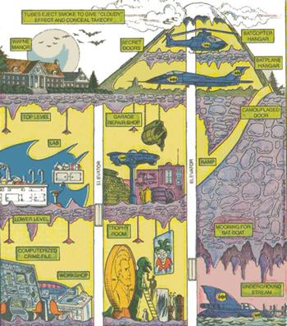
Headquarters
Hidden
Safe house
Weapons
Laboratory
Garage

Slide 8
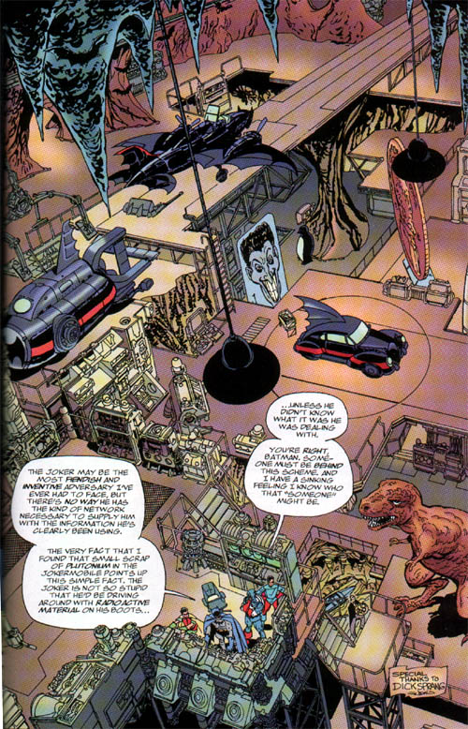
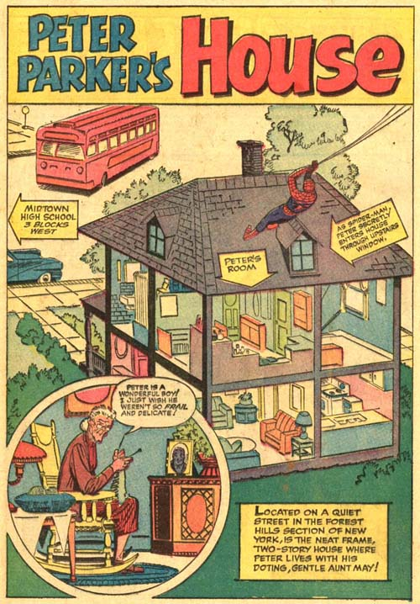

Slide 9
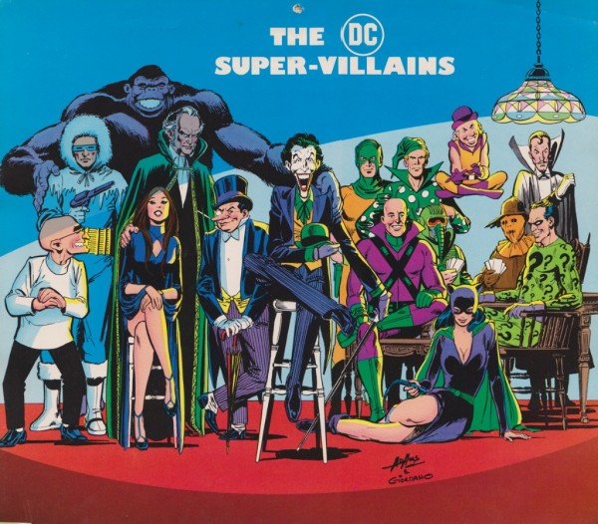
Supervillains
Aliens
Demons
Criminals
Nazi
Communist

Slide 10
