Slide 1
Candy & Hazel

Slide 2
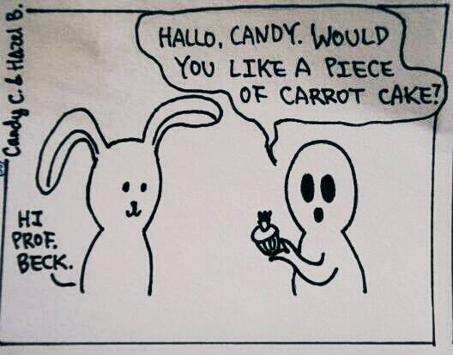

Slide 3
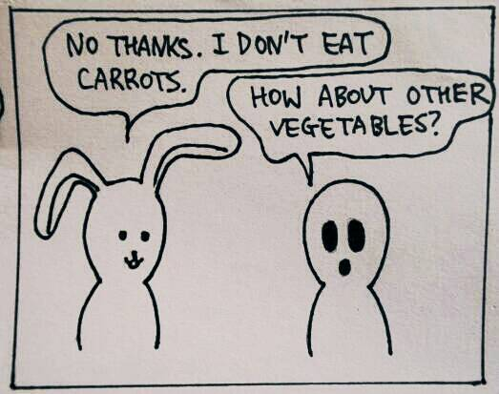

Slide 4
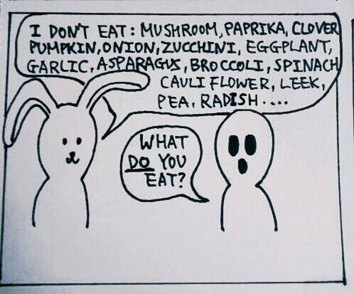

Slide 5
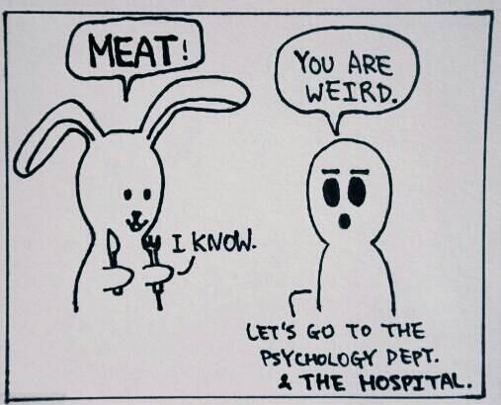

Slide 6
Toast

Slide 7
Important Verbs
Grumble
Clank
Wiggle
Wag
Munch

Slide 8
Reading Comprehension
Who is Tom and why is he with Berry?
Why is Berry preparing toast and orange juice for Tom?
Which words (or phrases) show that Berry and his parents are not humans?

Slide 9
Reading Comprehension - Extended
What do you think happend to the human race and will dogs be nice owners?
Main idea
3 supporting reasons

