Slide 1
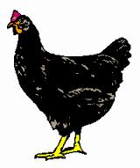
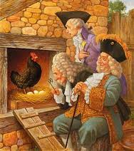
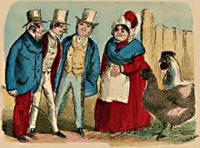
Poster-
Hickely, Pickely, My Black Hen
Hickely, pickely, my black hen
She lays eggs for gentlemen
Gentlemen come everyday
To see what my black hen doth Jay
Sometimes nine and sometimes ten,
Hickely, pickely, my black hen

Slide 2
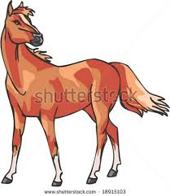
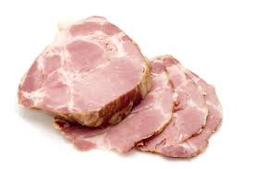
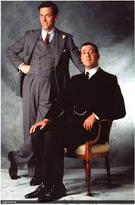
Worksheet
Class: Name:
Say the onset and the rime of the picture.
Circle the pictures that have the same onset or rime as in “hen”
Onset Rime
Onset-Rime Segmentation

