Slide 1
Speaking micro teaching
Irene< Kim Yoo Ry>

Slide 2

Do you find out pair words following rule?
The Glove falls in love.

Slide 3



Make a sentence including pair words
The snow falls now
Seven are seen.
The Stairs lead to stars.

Slide 4
Who is she?
What's she like?
->what she enjoys
What does she look like?
->general description
What does she like?
->physical description

Slide 5
Who is she?

Slide 6
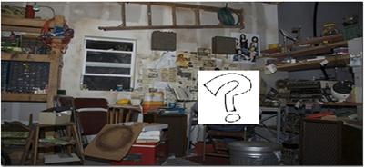
Guess whose room is this?
Wire bundle
Equipment
wood board machine material

Slide 7
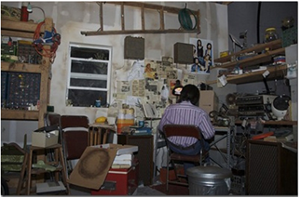
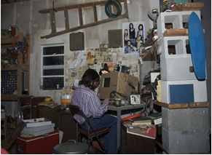
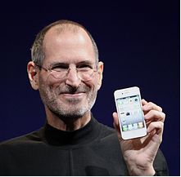
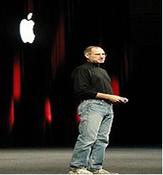
Guess whose room is this?
Steve Jobs

