Slide 1
The Romance with ESL Games
Grace Kim

Slide 2
English class is ?
What are ESL games?
How useful are they?
How do they affect on teacher and students?

Slide 3
What are ESL games?
Activities
Providing Fun
For learning English

Slide 4
How do they help students?
1. feel free & relaxed

Slide 5
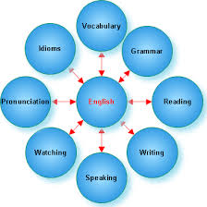
How do they help students?
2. Effect Value

Slide 6
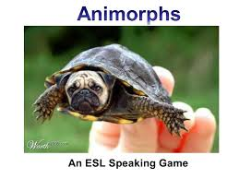
How do they help students?
3. Get creative

Slide 7
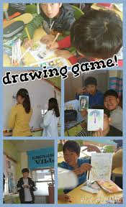
Advantages of ESL GAMES
Always get excited!

Slide 8
Advantages of ESL GAMES
Remember FAST & BETTER!
Before After

Slide 9
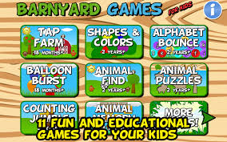
Disadvantages of ESL GAMES
Various factors must be taken into account?
No worries. Use websites to get you ESL games + tips!
Some don’t take games as a serious way to study.
Hey, you’re playing the leading role. You do study!

Slide 10
Therefore…
Feel the power of ESL games?
Yes! We’re loving it!

