Slide 1
The PRJECT MANAGEMENT “Job winner app”
Grace Kim

Slide 2
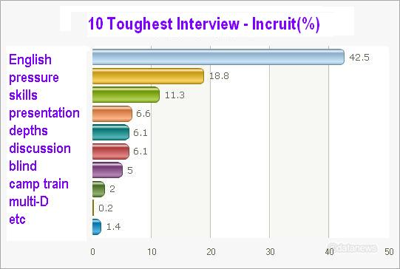
Why English interview?

Slide 3
Define SPECTIFICATION
Background : 42.5% of interviewees found English interview toughest
Objectives : Solve the speaking problem by mobile app game.
Scope: July 2015 ~ June 2016
Constraints: 1 year, 100 million, office in venture complex
Assumptions: Many ESL apps BUT few “game” apps for job interview
Report : Weekly meeting at 10 a.m on Mondays
Dependencies: research, strategy, plan, design, development, prototype test, inspection, marketing
Estimate: See constraints
Time : 12 months up to 14 months(cushions)

Slide 4
A Good Plan is Half Done
Timescales and costs : 1 year, 100 million won
Project management team: Grace(Games), Carol(Gamification), Mark(Simulation)
Development team : outsourcing
Design team : outsourcing
Tools? Pie chart, Critical Path, Gantt Chart ...

Slide 6
BACKUP PLAN

Slide 7
More steps to do
Communicate the plan to teams
Agree & delegate project actions
Manage, motivate, inform, encourage, enable the project team
Check, measure & review project performance to inform
Complete project : review& report; praise, thanks
Follow up - train, support, measure & report project results with benefits

Slide 8
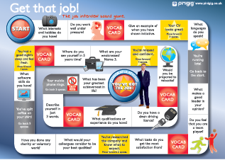
Job Winner Demo Game 1

Slide 9
Job Winner Demo Game 2

Slide 11
Let’s make our own history.
We don’t just sell a game.
We sell...
Thank you.

