Slide 1
The MARKETING PROJECT “Win Flight Attendant”
Grace Kim

Slide 2
What is Win Flight Attendant?
A game app for a flight attendant interview
How much? 5,000 won ($4.57) a download
Comment? One of Job Winner series!
Who buys? Those who want to prepare for an English interview to be a cabin crew

Slide 3
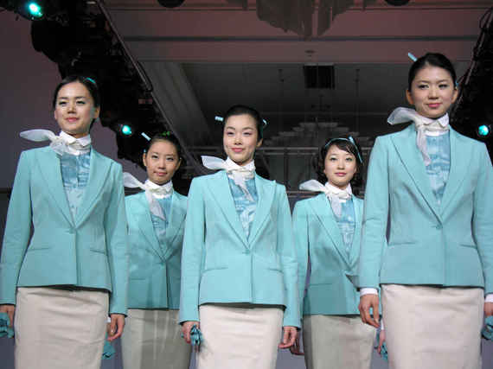
Segmentation
Geographic – in Korea
Psychographic – Keen on make up, fashion and manners
Behavioral – Keen on mobile app
Demographic – early or mid 20s Korean female candidates applying for airlines

Slide 4
Perceptual Map
High Low | Cost x Nitendo DS (Let’s play Flight Attendant) X First Class Flurry High
Quality Low | Quality WIN FLIGHT ATTENDANT x Cost

Slide 5
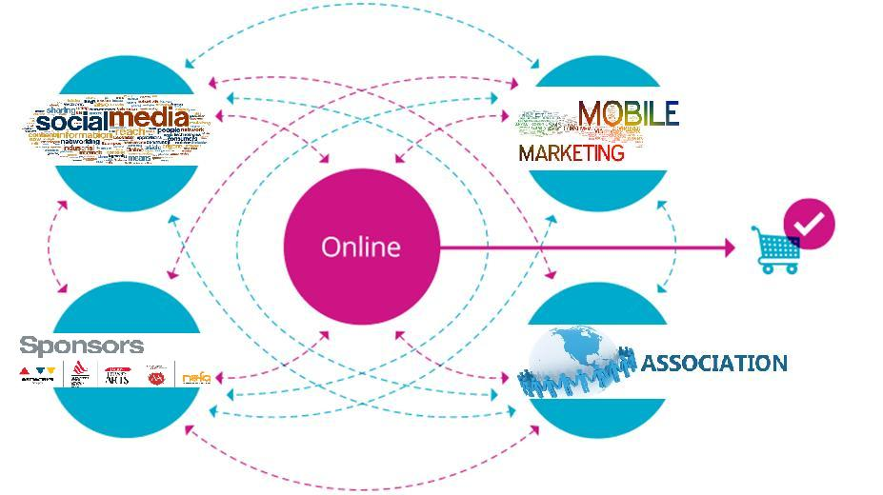
Who, What, Where & Which

Slide 6
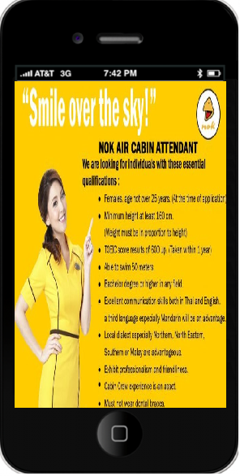
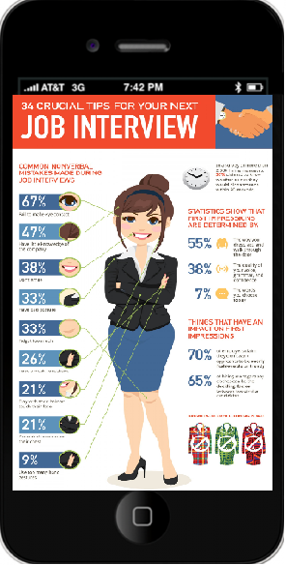
Mobile Ads

Slide 7
Social medias

Slide 8
Associations

Slide 9
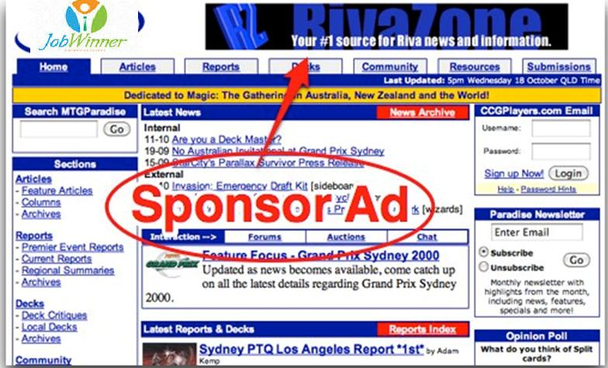
Sponsors

Slide 10
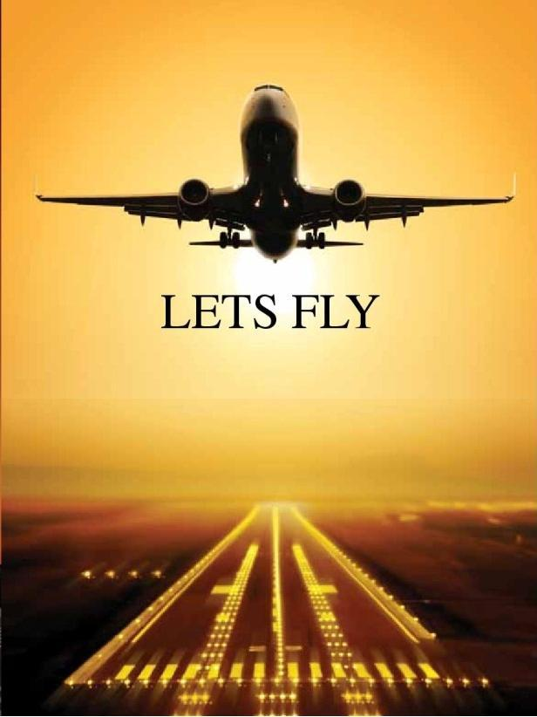
.
So…

