Slide 1
Gamification Mobile App. Marketing Strategy

Slide 2
Marketing Basics
Product: Mobile App. for English Interview Practice
Segmentation : Adult English Education
Targeting : New Graduates / Potential Job Seekers
who are preparing for English Job interview
Positioning : Open a new niche market and leading the service

Slide 3
Product (Marketing Mix – 4 P )
App. Branding & Logo
Product Quality
Notes:
Branding/Brand Name.
Intended quality of the product
Scope of the product line.
Warranty.
Packaging

Slide 4
Price (Marketing Mix – 4 P)
Price setting : Free Service → Paid Service
Discounts : point program, membership
Bundling Price: 1+1
Payment method: e-payment, traditional payment
Notes:
List price.
Discounts.
Bundling.
Payment terms.
Leasing options (if applicable)

Slide 5
Place (Marketing Mix – 4 P )
Distribution Channel : Apple App Store, Good Play store,
Windows Phone store
Notes:
Distribution channels (do you sell this product yourself, ship it to retailers or warehouses, etc).
Channel Motivations (what sort of margins should your distributors expect, if applicable?).
Criteria for evaluating your distributors.
Locations.
Logistics and Supply Chain.
Number of apps available in Google Play store1,300,000 Details → Number of apps available in Windows Phone store300,000 Details → Number of cumulative downloads from Apple App Store

Slide 6
Promotion (Marketing Mix – 4 P )
Online Advertising
Offline Advertising
Viral Marketing - SNS
PR – traditional media, New paper, leaflet
Joint program with University (Alumni, Career Center, Student’s group)
Develop a promotion program with Recruiting agency, Headhunting companies
- Customer Loyalty, New Customer Acquisition
Notes:
Advertising (what types? how much of each type? what type of advertising channels — TV, print, internet, etc. – do you plan to use?).
Public Relations.
Promotional programs.
Budget, including your break-even point.
Projected results of this promotional program (impact to customer loyalty, new customer acquisition, etc.).

Slide 7
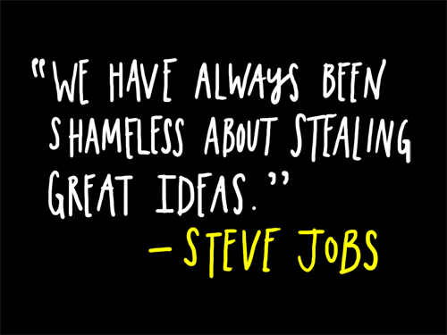
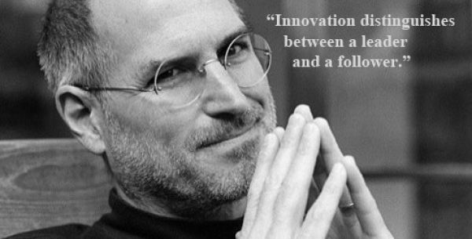
Timeless Marketing - Steve Jobs
Notes:
MAKE A GREAT PRODUCT.
DON’T SELL PRODUCTS, SELL DREAMS.
FOCUS ON THE EXPERIENCE.
TURN CONSUMERS INTO EVANGELISTS, NOT JUST CUSTOMERS.
MASTER THE MESSAGE, (and now that we’re on the subject, the delivery too).
DECISIONS SHOULD BE MADE BY A GROUP, NOT A COMMITTEE.
FIND AN ENEMY
KEEP THE DESIGN SIMPLE, AND WHEN YOU GET THERE, SIMPLIFY IT EVEN MORE
YOU DON’T HAVE TO BE THE FIRST, BUT YOU’VE GOT TO BE THE BEST
INNOVATE OR DIE.

Slide 8
Mr. Job’s Legacy
MAKE A GREAT PRODUCT.
DON’T SELL PRODUCTS, SELL DREAMS.
FOCUS ON THE EXPERIENCE.
YOU DON’T HAVE TO BE THE FIRST, BUT YOU’VE GOT TO BE THE BEST
INNOVATE OR DIE.

Slide 9
For the successful App. launch

