Slide 1
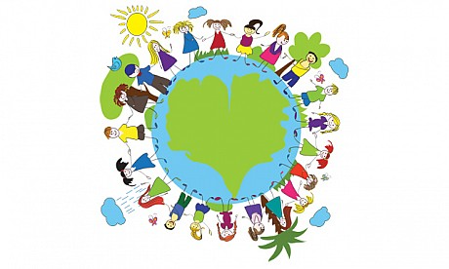

Slide 2
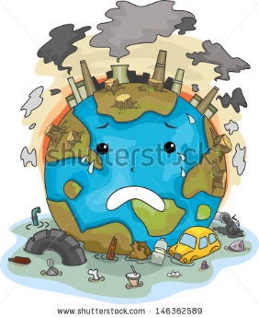

Slide 4
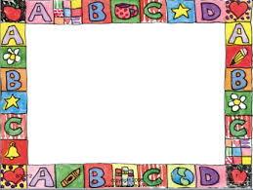
Quotations

Slide 6
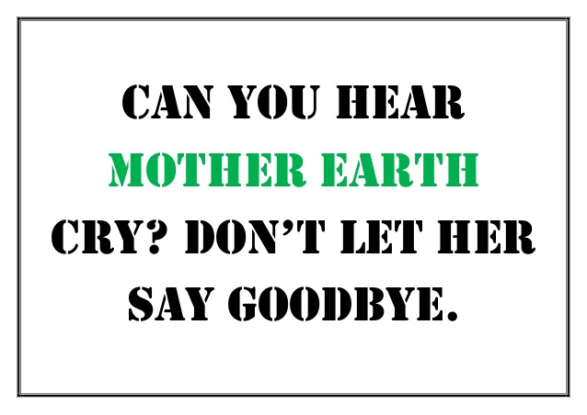

Slide 7
3 Simple Things You Can Do To Save The Mother Earth
TURN OFF THE LIGHTS.
RECYCLE
TURN OFF THE LIGHTS

Slide 8
