Slide 1
SPEAKING MICRO TEACHING

Slide 2
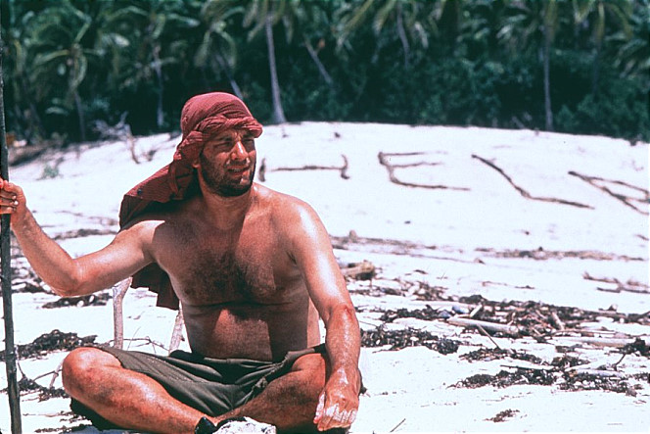
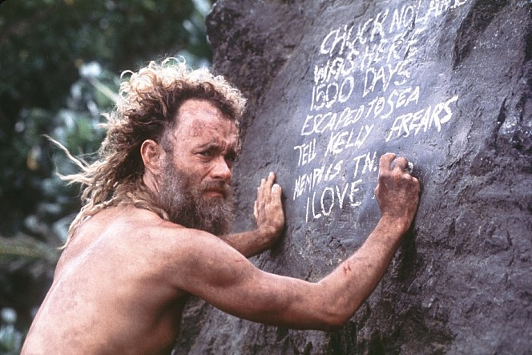
LEAD IN

Slide 3
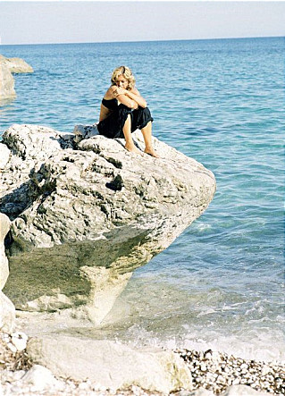
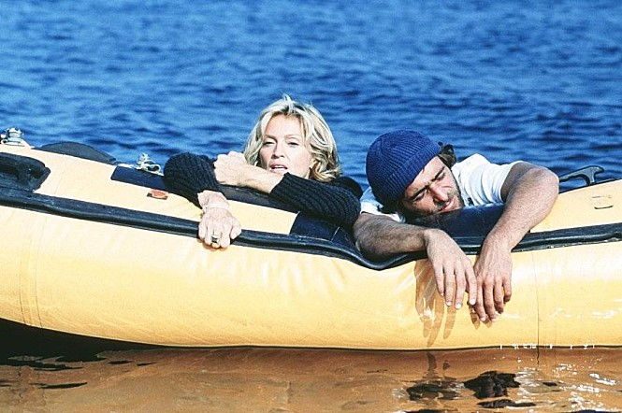
LEAD IN

Slide 4
Instructions
1. Cut them and you choose 2 materials.
You will work with your partner.
Stick on the paper and write down their name.
Write down the reasons that why do you choose it.
You have to write reasons at least 2-3 per materials.
4. Explain how to use them. Write down or think.

Slide 5
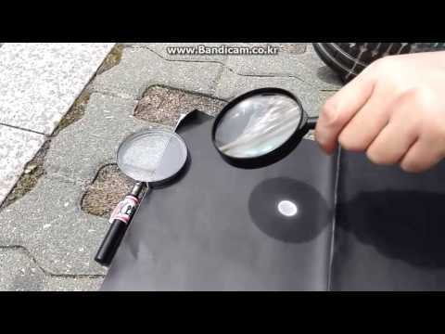
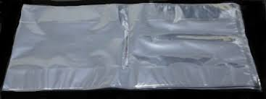
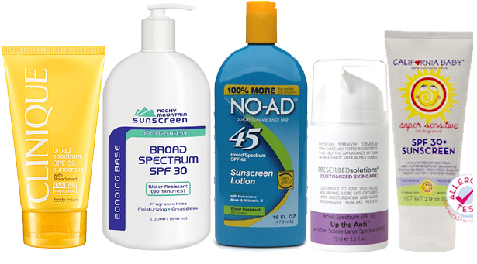
New words
Convex lens
Vinyl
Sun blocks

Slide 6
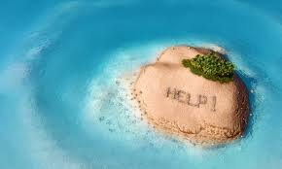
General techniques
1. Find a source of drinking water.
2. Find/build a shelter.
3. Build a fire.
4. Create rescue signals.
5. Find a source of food.
6. Create tools for catching food.
7. Fashion weapons for self defense.
8. Create a raft to leave the island.

Slide 7
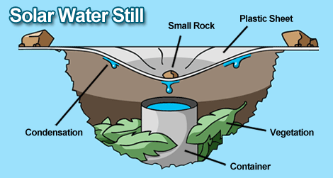
HOW TO GET IT?

Slide 8
Please do your homework. Class is over. BYE BYE ☺

