Slide 1
Mono (One) + Lingual (Ability to speak language)
= A person who can speak only language
Bi (Two) + Lingual (Ability to speak language)
= A person who can speak two languages
Tri (Three) + Lingual (Ability to speak language)
= A person who can speak three languages
Multi (Several) + Lingual (Ability to speak language)
= A person who can speak more than three languages

Slide 3
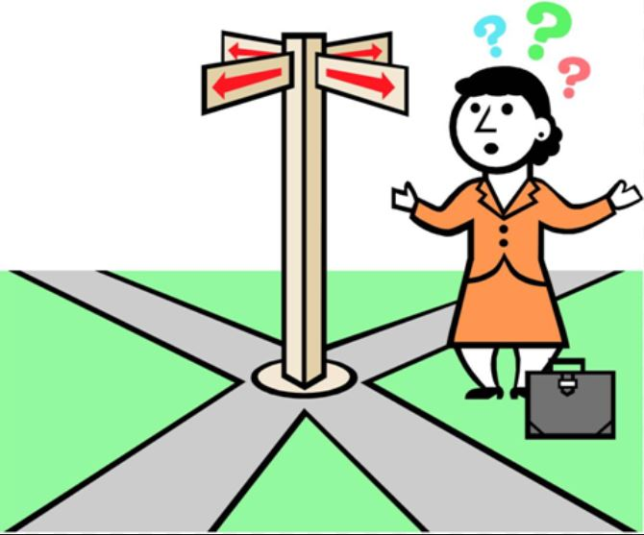
Literate = A person who can read and write
illiterate = A person who Unable to read or write:

Slide 4
Dementia : Alzheimer’s Disease (Brain)

