Slide 1
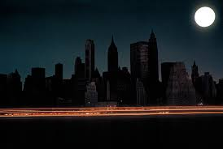
1

Slide 2
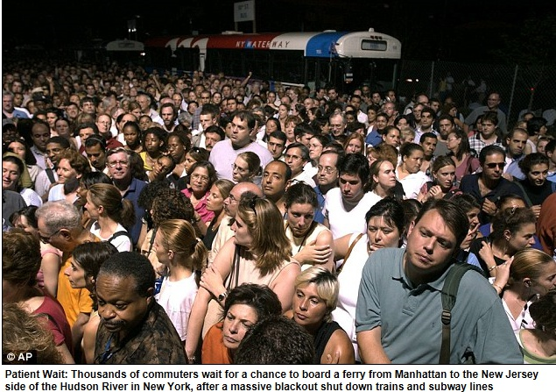
2

Slide 3
3

Slide 4
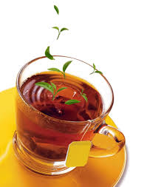
4

Slide 5
5
Black tea

Slide 6
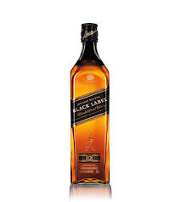
6

Slide 7
7
Black label

Slide 8
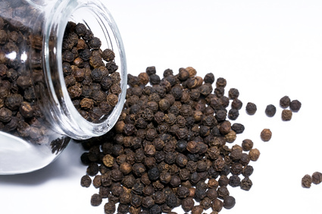
8

Slide 9
9
Black pepper

Slide 10
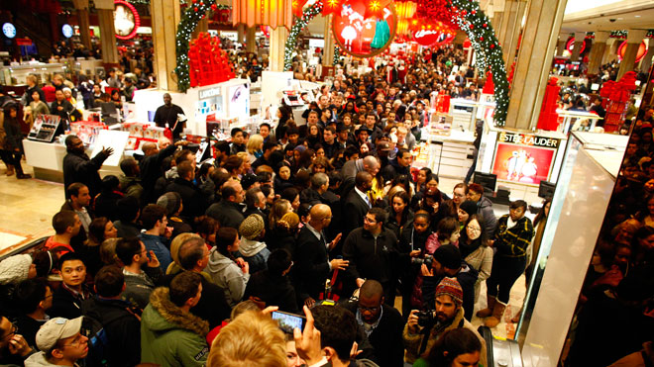
10

Slide 11
11
Black Friday

Slide 12
12
Q
Have you ever been in these blackout situations?
2. Where?
3. How did you feel at that time?
4. What did you do to find out solution to get out ?

Slide 13
13
I’m so __________ in the ___________.

