Slide 1
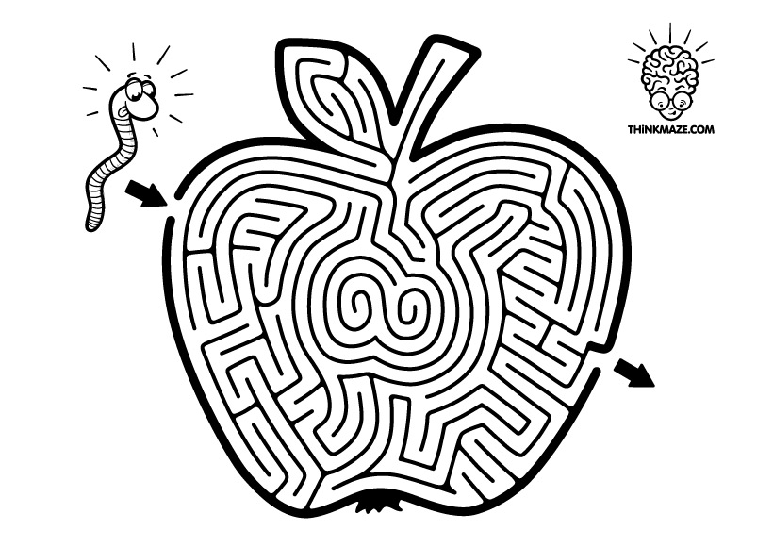
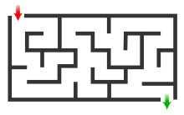

Slide 2
Maze
a complicated system of paths or passages that people try to find their way through for entertainment, puzzle

Slide 3
Sniff
to smell something by taking air in
through your nose

Slide 4
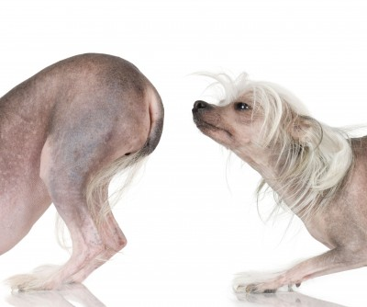

Slide 5
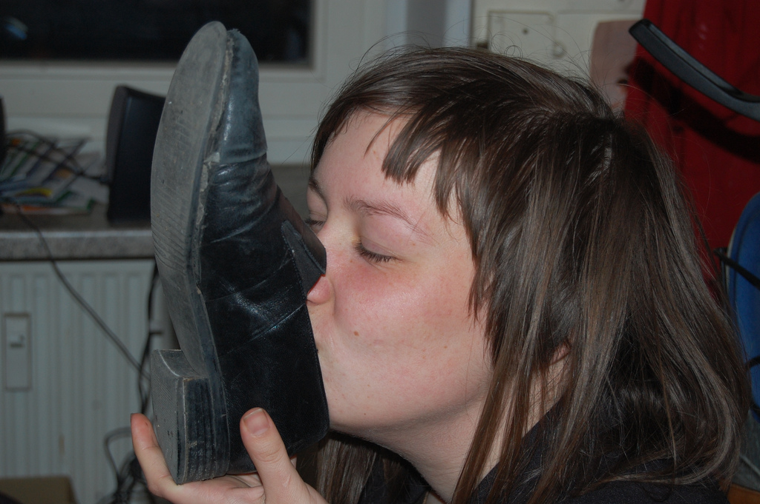

Slide 6
Scurry
to move quickly, with small , short steps
Ex)the mouse scurried across the floor

Slide 7
Hem and haw
to be uncertain and take a long time deciding something

Slide 9
Discuss after reading
What are they talking about?
What is the name of 4 characters? (Circle them)
What are the personalities of those 4 characters?
(Underline them)
What does the “Maze” in the story represent?
“cheese” being a metaphor for _______________

Slide 10
Talking about the story they heard, the story is about finding their “cheese” and seeing themselves in the “Maze”.
Sniff : who sniffs out change early
Scurry: who scurries into action
Hem: who denies and resists changes as he fears it will lead to something worse
Haw: who learns to adapt in time when he sees changing can lead to something better!
“cheese” being a metaphor for what we want to have in life, whether it is a job, a relationship, money so on.
“maze” represents where you spend time looking for what you want. It can be the organization you work in, the community you live in, or the relationships you have in your life.

Slide 11
Melanie says on p. 91 that, “old cheese is like old stuff you do all the time and don’t even think about…like old behavior that you need to stop.” What are some old behaviors (habits) or “cheese” that you want to stop doing?
If the company you are working for, its business had already fallen off so badly and there were a rumor that company decided to let people go. What would you do???

