Slide 1
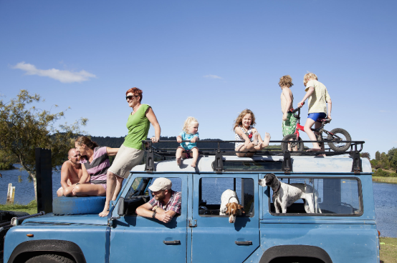
TRIP
TRAVEL
JOURNEY

Slide 2
trip
We took a 5-day ________ to Italy.
I’m going on a business ________ soon.
Round-________ ticket
trip
trip
*Trip (n.) : The act of going to another place (often for a short time) and returning.

Slide 3
travel
I really like to _________.
I _________ frequently for work.
I’m planning to _________ to the U.S.
travel
travel
*Travel (v.) : going to another place (in general)

Slide 4
journey
The ____________ takes 12 hours by car.
He made the 200-mile ____________ by bike.
journey
*Journey (n.) : one part of the travel process (often a long distance)

