Slide 1
British English
Teacher: kimmy

Slide 2
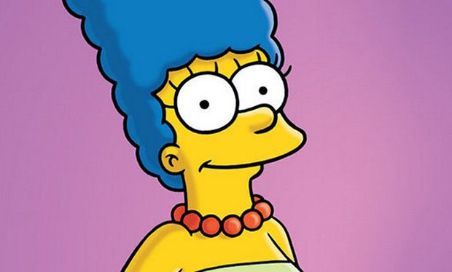
Mom
Mum

Slide 3
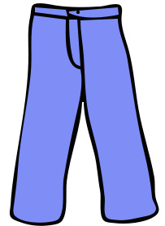
Pants
Trousers

Slide 4
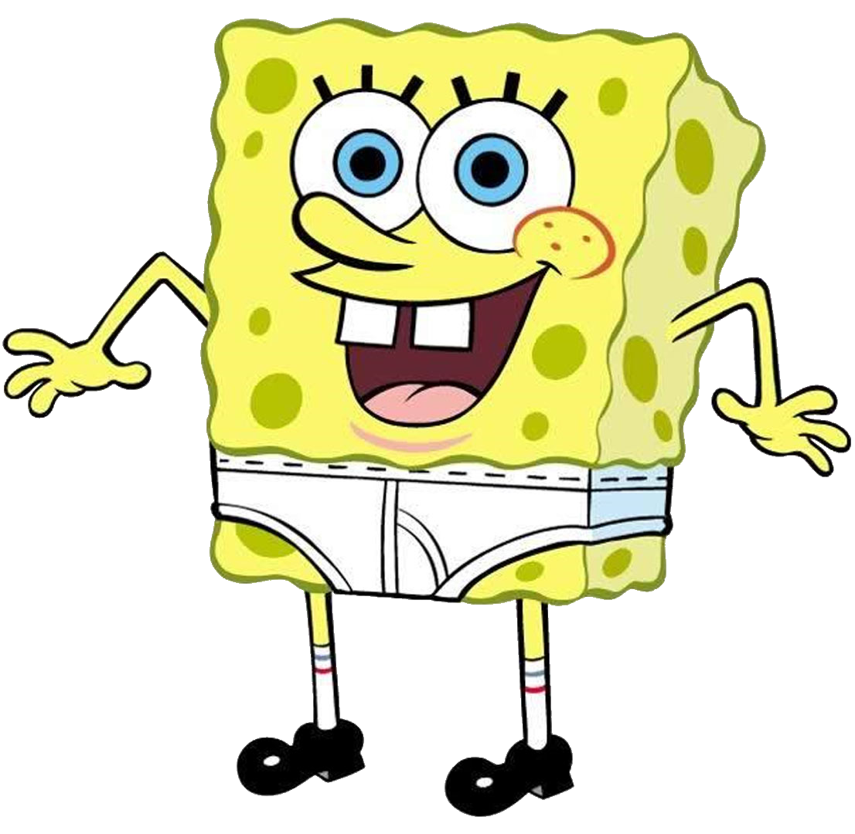
Underwear
Pants

Slide 5
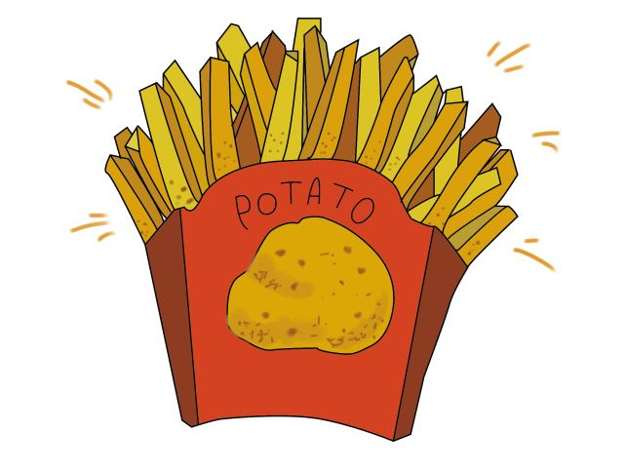
Fries
Chips

Slide 6
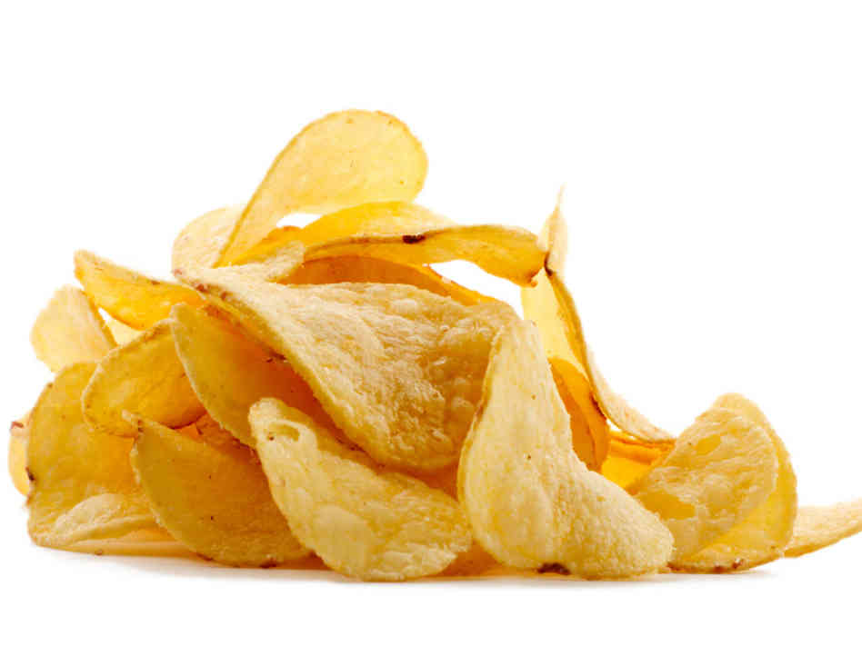
Chips
Crisps

Slide 7
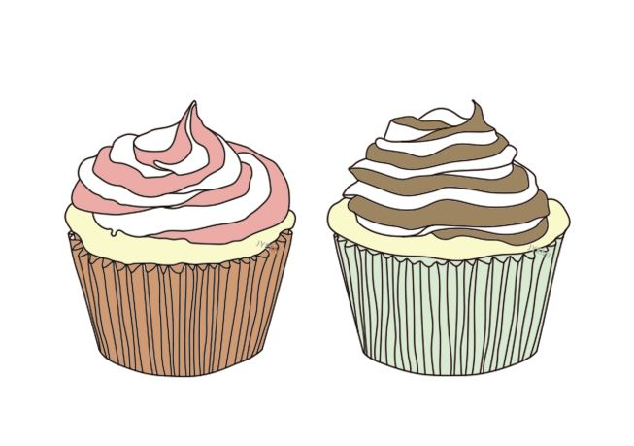
Cupcake
Fairy cake

Slide 8
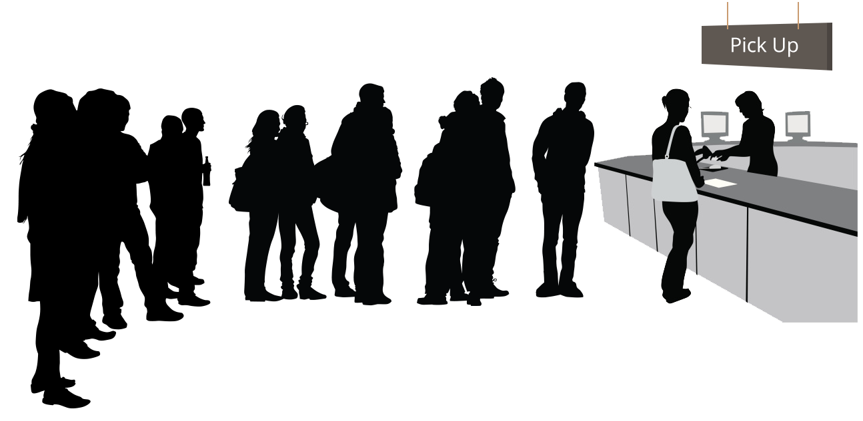
Line
Queue

Slide 9
Cotton candy
Candy floss

Slide 10
Bathroom
Loo

Slide 11
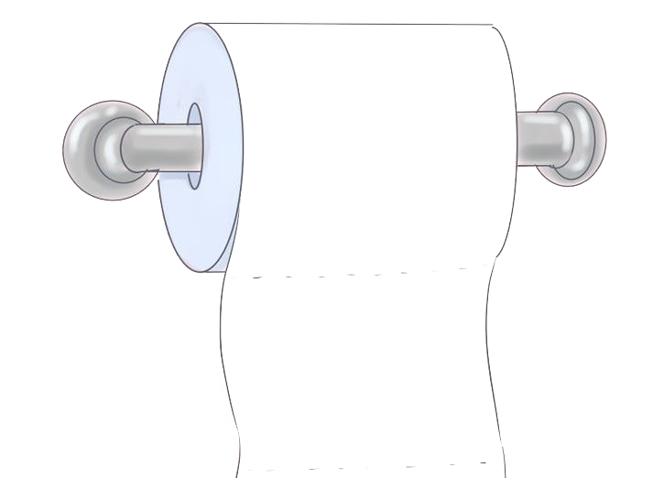
Toilet Paper
Bog Roll

Slide 12
Television
Telly

Slide 13
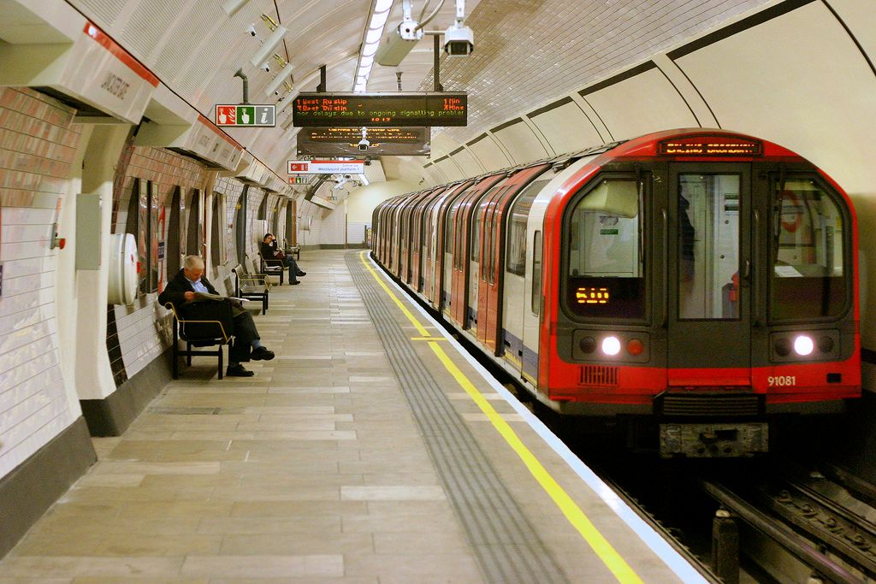
Subway
Underground/ Tube

Slide 14
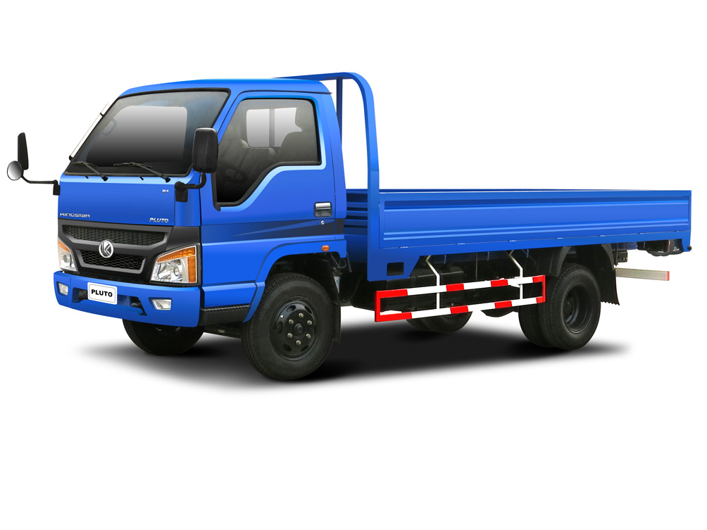
Truck
Lorry

Slide 15
Dictation
Check the Answer

Slide 16
Harry: So, I owe him. Your father was a brave man.
A good man And having read your files,
I think he’d in the
choices you’ve made.
be bitterly disappointed

Slide 17
Eggsy:
You can’t talk to me like that.
Eggsy:
Banging on about losing me as well as
my dad
Because my mum went mental.

Slide 18
Eggsy: We ain’t got much choice. You get me?
And if we was born with the same silver
spoon up our arses, we’d do just as well as
you.
If not better.

Slide 19
Hoodlum A: What the fuck you
doing here?
You taking the piss
Hoodlum B: ,
Dean says your fair game.
After you nicked his car

Slide 20
Harry: Umm... Listen boys.. I’ve had a rather
emotional day, so whatever your beef with
Eggsy is, and I’m sure it’s well-founded, I’d
appreciate it enormously if you could just
leave us in peace until
Guinness.
I finish this lovely pint of

Slide 21
Harry:
Manners…. maketh…. Man

