Slide 1
At the bank

Slide 2
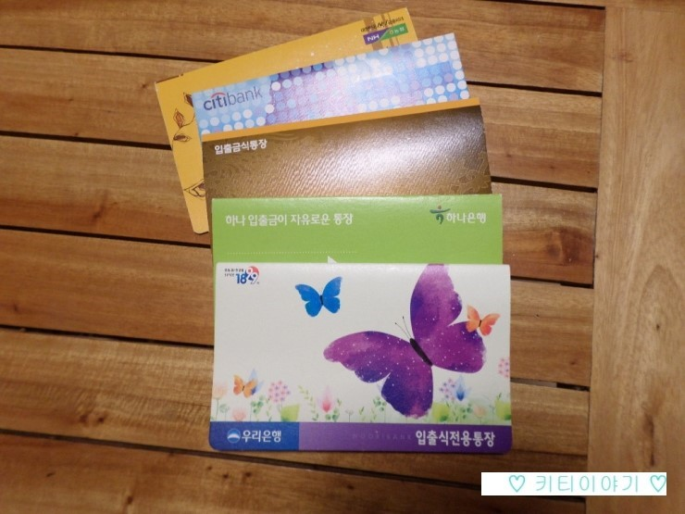
Vocab
Account
is a financial thing which is maintained by a financial institution for a customer.

Slide 3
Vocab
Deposit
is money placed in your own an account.

Slide 4
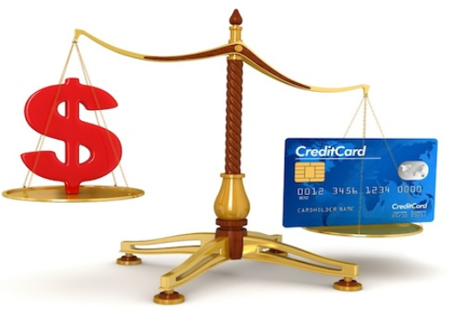
Vocab
Balance
is the amount of money that you have in your bank account at a particular time.

Slide 5
Vocab
A cash advance
is a service provided by most credit card you are allowed to withdraw cash usually through an ATM in the convenience store.

Slide 6
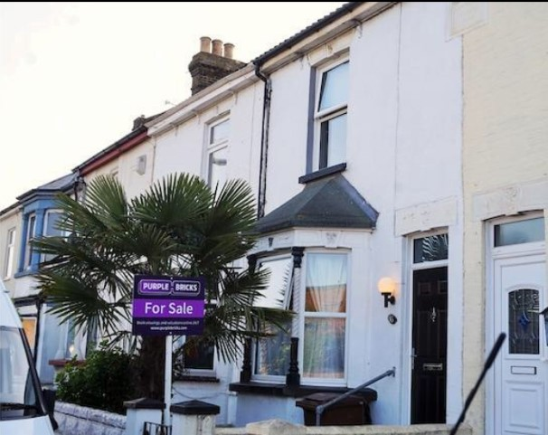
Vocab
Mortgages
is a loan money which you get from a bank to buy a house.

Slide 7
Vocab
Debt
is an amount of money borrowed by someone or a bank.

Slide 8
Vocab
Pay off
to finish paying money that you owe for something

Slide 9
Conversation Guide BE=Bank Employee, C=Client
BE: Please have a seat. How can I help you today?
C: Well, I’m interested in but I would like some information first
BE: I’d be happy to answer any questions you have. What would you like to know?
C: Well for starters, what kind of do you offer?
BE: We have and
C: Could you explain the difference please?
BE: Sure. (Explains Different Something).
BE: Do you have any questions regarding what I just told you?
C: No. I’d like to apply for
BE: So I’ll need to ask you some questions about your personal finances Can you spell your name for me?

Slide 10
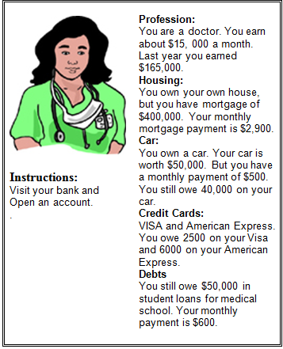
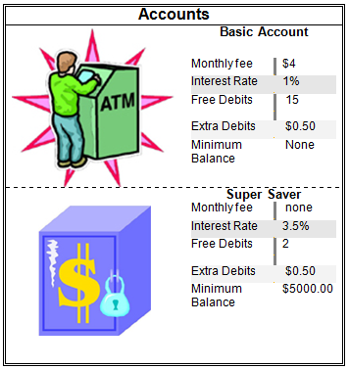
Role 1.

Slide 11
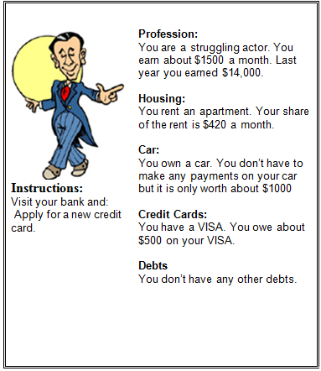
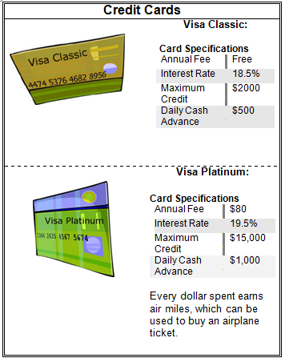
Role 2.

Slide 12
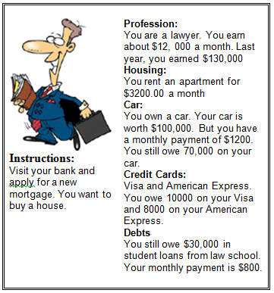
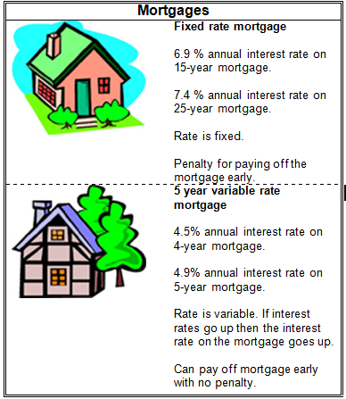
Role 3.

Slide 13
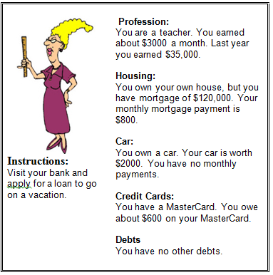
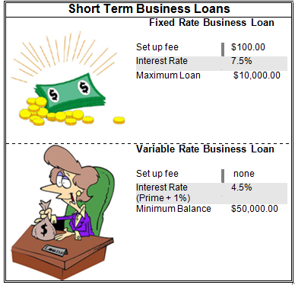
Role 4.

