Slide 1
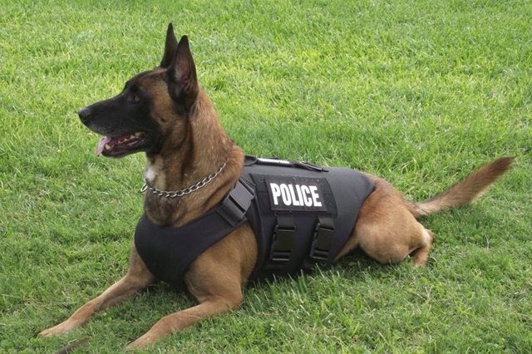
Police dog
This dogs need to be strong and fast
in order to help police in dangerous situations.

Slide 2
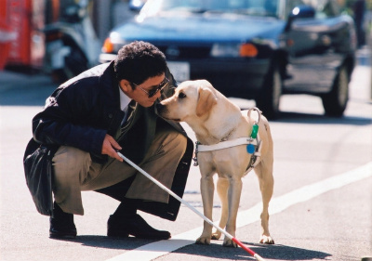
Guide dogs (dogs for disabled people)
Guide dogs are assistance trained to lead blind and visually impaired people around obstacles

Slide 3
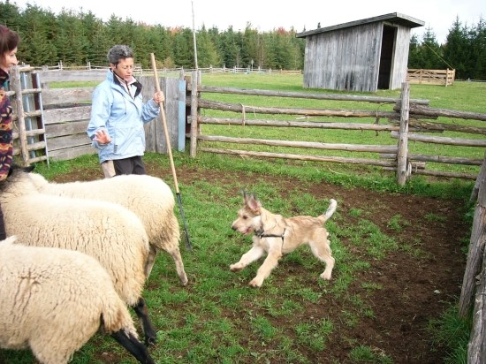
Shepherd dog
A shepherd dog is a type of working dog use by shepherds to herd and protect their flocks

Slide 4
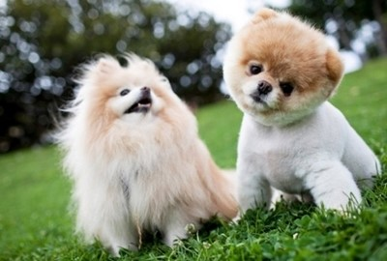
Pet dog
Normally it has been raised at home as one of a family member. Sometimes, it is outside to protect their family from a stranger.

