Slide 1
BIG, BIGGER, BIGGEST!
Chelcie / Nicky

Slide 2
https://youtu.be/872gqAJjc1g

Slide 3
Comparative
This computer is better than that one.
She's stronger at chess than I am.
It's much colder today than it was yesterday.
Our car is bigger than your car.

Slide 4
Comparative Forms
1-syllable adjectives: add -er to the adjective
My sister is much taller than me.†
2-syllable adjectives ending in -y: change the -y to -ier
She's looking happier today.
Adjectives with 3 or more syllables: use more with the unchanged adjective
Russian grammar is more difficult than English grammar.

Slide 5
Superlative
1-syllable adjectives: add -est to the adjective (plus the)
My sister is the tallest in our family.
2-syllable adjectives ending in -y: change the -y to –iest (plus the)
She's the luckiest person I know.
Adjectives with 3 or more syllables: use the most with the unchanged adjective (plus the)
Albert Einstein was the most intelligent person in history.

Slide 6
Irregulars
Good – Better - The best
Bad – Worse - The worst

Slide 7
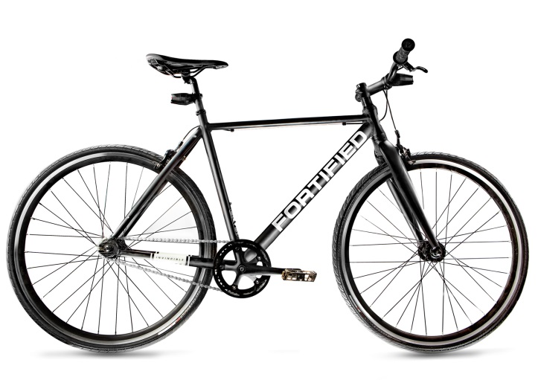
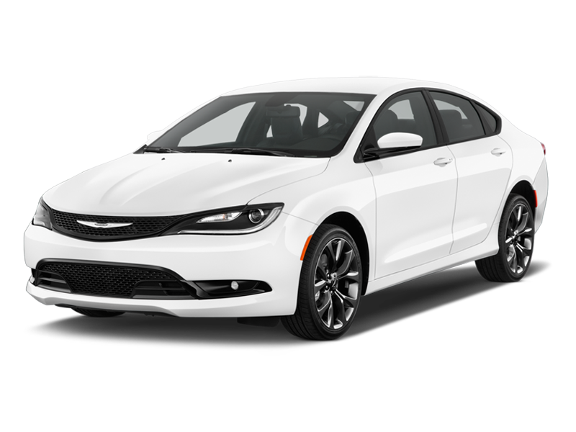
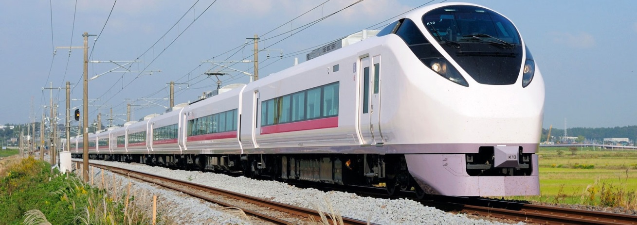
Guessing Game #1

Slide 8
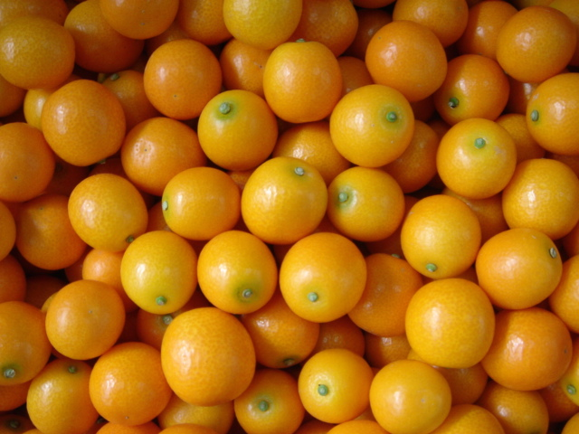
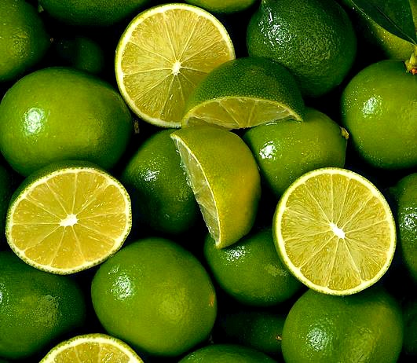
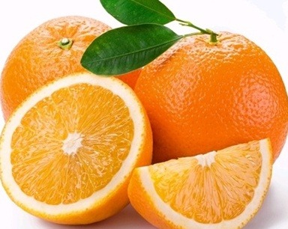
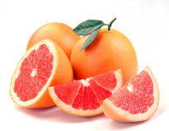
Guessing Game #2

Slide 9
Drills
She is tall
(Comparative - her mom)
She is taller than her mom
(Negative)
She is not taller than her mom
(Superlative - in the class)
She is not the tallest in the class
(Affirmative)
She is the tallest in the class
(happy - girl)
She is the happiest girl in the class
(Question)
Is she the happiest girl in the class?

