Slide 2
http://blog.naver.com/oorin_wow/220829981433

Slide 3
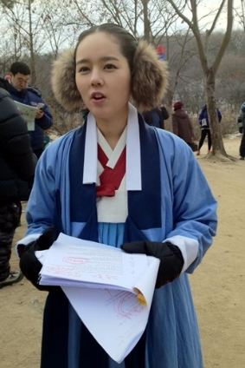

Slide 5
http://blog.naver.com/oorin_wow/220829983533

Slide 6
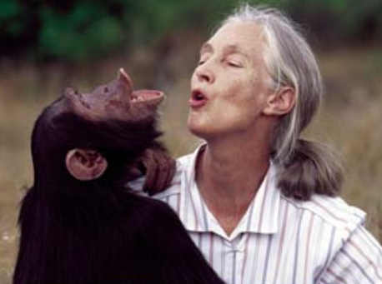
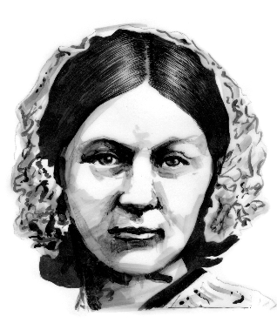
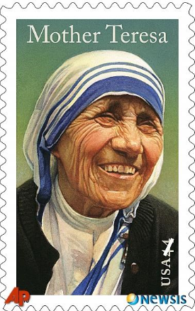
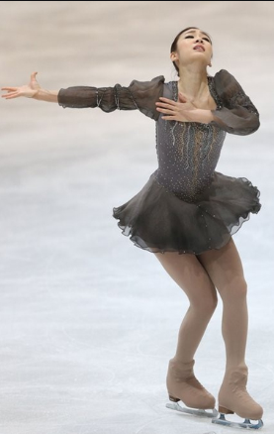

Slide 7
http://blog.naver.com/oorin_wow/220829982868

