Slide 1
******************************* CLASSIFIED ADS *******************************
DRIVER
SPEEDY CAB COMPANY
Be Your Own Boss!
Make up to $2,000/mo. No exp. nec.
We will train. Must be 25 or older.
Good driving record.
Call Louie 555-0319
MANAGER TRAINEE
$$$ BECOME RICH! $$$
Men/ women needed immediately
Once in a lifetime opportunity
Rapid advancement
Our product is the best!
Call Boston Blackie 555-2583
RECEPTIONIST
Looking for friendly, enthusiastic person to answer calls and greet customers. Light typing. PT & FT positions available. $8.00/hr.
Call Cornelius Rose 555-6925
RESTAURANT
Le Bistro is hiring waiters/ waitresses. Work evenings/ weekends PT & FT
Min. 2yrs. exp. Local ref.
Must have good appearance.
Call Pierre or Claudine 555-4510
SALES
Make Big Money!
Easily. Selling encyclopedias.
No exp. nec. Will train right person.
High comm. Earn $25-50k/yr.
Must have positive attitude.
Call: The Boss 555-7018
TRAVEL
See the World!
Sunshine Travel is hiring tour guides.
Must be friendly and have good appearance. Fluent in Spanish or French. Xlnt. Salary and benefits.
Call Janet 555-8931

Slide 2
SPEAKING | Activity 1: Asking about the job positions
Employer: (Company name). May I help you?
Applicant: I’m calling about the job for (Job position).
What are the qualifications?
Employer: We are looking for someone who is (Describe the qualifications in the classified ads)
Applicant: How can I apply for the job?
Employer: (Send resume by email, mail, visit…)
Applicant: Where are you located?
Employer: (Address)
Applicant: Thank you.

Slide 3
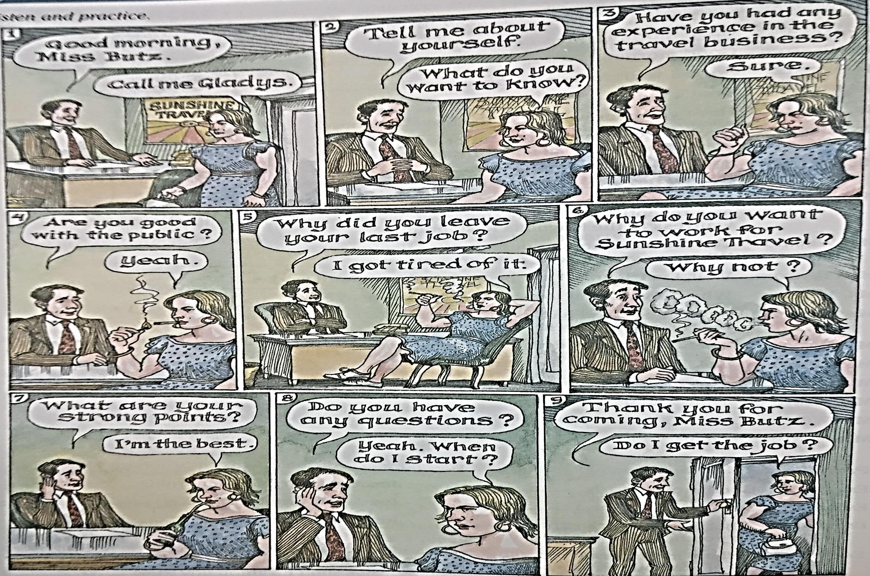
SPEAKING | Activity 2: Job Interview

Slide 4
SPEAKING | Activity 2: Job Interview
Employer: Good morning, ___________.
Employer: So you want to be a _____________?
Employer: What kind of work experience do you have?
Employer: Tell me more about yourself. What are your strong points?
Employer: Why do you want to work for this company?
Employer : Do you have any questions?
Employer : I’ll look over your application and call you in a few days.
Applicant: Good morning.
Applicant: __________________
Applicant: __________________
Applicant: __________________
Applicant: __________________
Applicant: __________________
Applicant: __________________

Slide 5
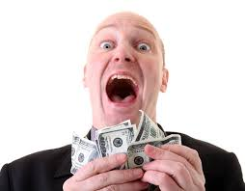
SPEAKING | Post Activity : Create my own classified ads that I want to find in newspaper

