Slide 1
SPEAKING LESSON
kate
9th Oct. 2016

Slide 2
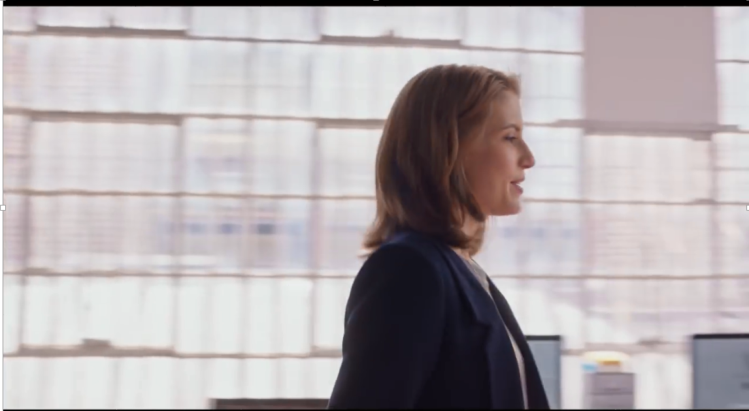
<Video Clip>

Slide 3
Strength
e.g.: strength and weakness

Slide 4
Procrastinate
Synonym: postpone, delay

Slide 5
Hire
Antonym: fire

Slide 6
SOS

Slide 7
<Video Clip>

