Slide 1
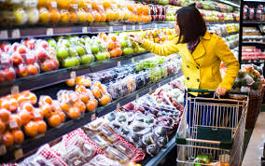

Slide 2
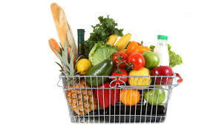

Slide 3
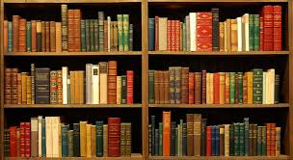
How many books?

Slide 4
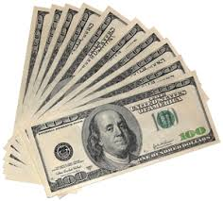
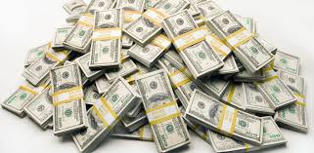
How much money?

Slide 5
Answer: Choose a few / a little
A few
A few
A little
A few
A little
6. A little
7. A few
8. A little
9. A few
10. A few

Slide 6
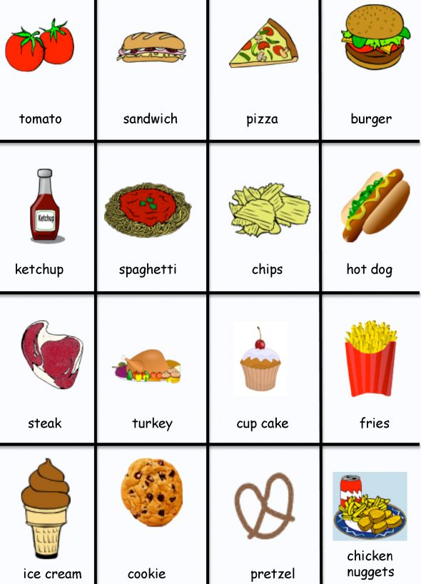
Foods list

Slide 7
Foods list

Slide 8
Answers:
A few | A little
Countable nouns | Uncountable nouns
Burger Fries Cookies Pancakes Orange candies | Rice Jam Meat Pasta Butter cheese

Slide 9
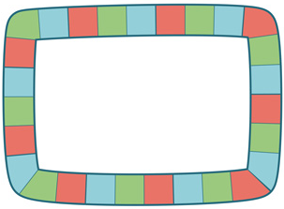
Board game a few / a little
Class
-room
Hospital
Hotel
Park
Theater
Kitchen
Cafe
Airport
Museum
Beauty-
salon
Beach
Living-
room
7-
eleven
Play-
ground
Office
Bus
Subway
Super-
market
Bank
Shopping
-mall
Bath-
room
TV-
station
Library
Taxi
Laundry
Bakery
Restaurant

