Slide 1
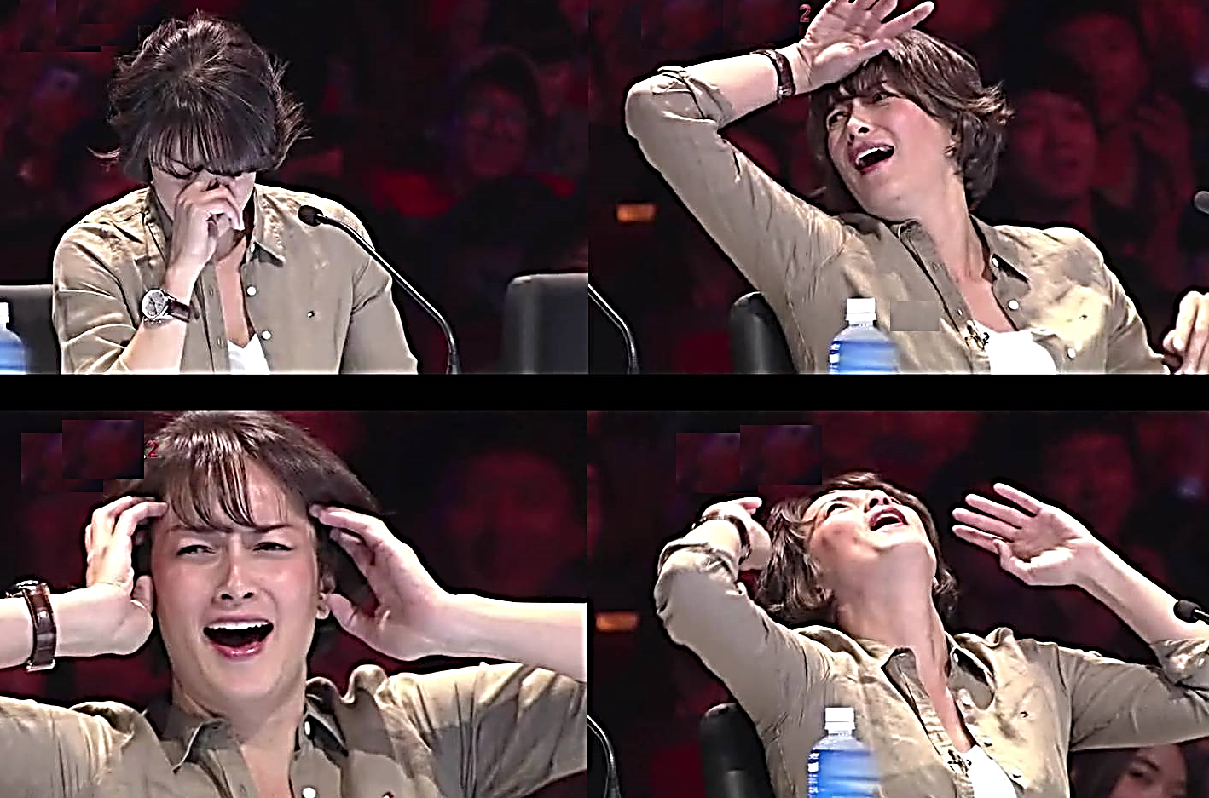

Slide 2
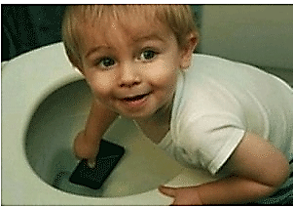
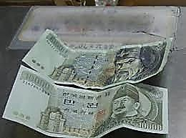
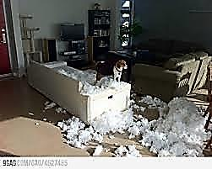
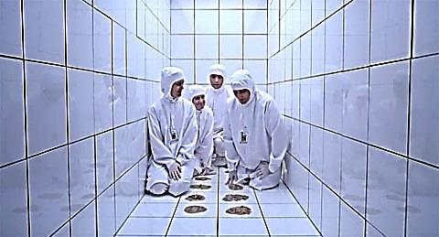

Slide 3
bomb / scare / passenger / timer / pilot / airport / device / false alarm / toilet / flight / passengers / questioned / police chief / airborne / investigations / crew / technical

Slide 4
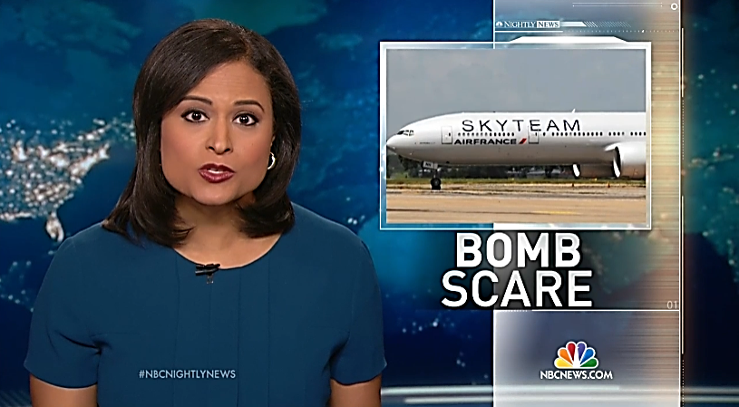

Slide 5
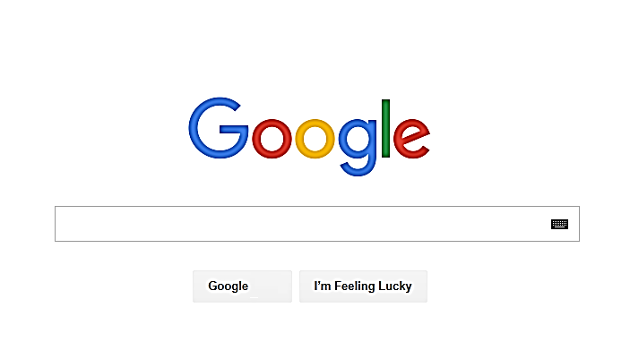
Air France plane in bomb scare

Slide 7
1. A passenger found a strange-looking device made from _____
a) A kitchen time
b) A kitchen timer
c) A kitchen timing
d) A kitchen timed

Slide 8
2. They alerted staff and the pilot decided to make an emergency landing in the Kenyan_____
a) Caused a falsely alarm
b) Caused a false alarm
c) Caused a falsify alarm
d) Caused a falsified alarm

Slide 9
3. The plane carrying 459 passengers and _____
a) 14 clue members
b) 14 crew members
c) 14 glue members
d) 14 grew members

Slide 10
4. Some of the passengers were put on alternative _____
a) Flightless to Paris
b) Flight to Paris
c) Flights to Paris
d) Frights to Paris

Slide 11
5. The crew of Air France were just great, just wonderful. They _____
a) Swept everybody calm
b) Kept everybody calmly
c) Kept everybody calm
d) Kept everybody calmed

