Slide 1
How are you today ?

Slide 2
What would you do when you are in pain or stress?

Slide 3
When I am in pain or stress (mentally or physically) 3min
Lena : silence/ music/ beer / friend
Kate :
Lizzie :
Jay :
Jen :
Jessica :
Jennine :
Julia :
Painkillers

Slide 4
For healing ourselves
Movies
A good book
A hot bath
A movie
Chocolate
Medicine
Sleep
A walk
A chat to friends
Romantic
Science fiction
Musical
Horror
Adventure
Documentary
Action
Comedy

Slide 5
How sad movies effect on pain

Slide 6
Sad Movies (Sad Stories) / Endorphins (Natural Painkillers)
How are they related?

Slide 7
Sad movies help reduce pain level 5
Articles from BBC / Sep24, 2016
Watching sad movies can be just what the doctor ordered. A new study reveals that watching distressing movies may boost our tolerance to pain. Researchers at Oxford University say that emotional movies can increase the amount of endorphins released by the brain. These are our body's natural painkillers - chemicals that relieve physical or psychological pain.
Dr. Dunbar explained that : “The emotional (distress) you get from tragedy triggers the endorphin system. The same areas in the brain that deal with physical pain also handle psychological pain.”
Dr. Dunbar and his colleagues conducted tests to find out the effect tragic stories have on us. One group of people in their experiment watched a traumatic drama about a disabled man battling homelessness, drugs and alcohol. Another group watched a film on Britain's geology and archaeology.
On average, the pain tolerance of those who watched the drama increased by 13.1 per cent, while the pain threshold for those who watched the documentary decreased by 4.6 per cent. Dr. Dunbar suggested one reason we like to watch sad movies is the natural high from the endorphins.
Britain’s Geology
: a science that deals with the history of the earth as recorded in rocks in Northwestern Europe.

Slide 8
Britain’s Geology the science that deals with the history of the earth as recorded in rocks

Slide 9
Share ideas about an article and guess the meaning of new vocabulary (5min)
Do you agree with this research ?
Why
Why not ?
Reveal
Distressing
Boost
Tolerance
Geology
Tragedy
Trigger
Conduct
Tragic
Experiment
Traumatic

Slide 10
Sad movies help reduce pain level 4
Articles from BBC / Sep24, 2016
Watching sad movies can be just what the doctor ordered. A study shows that sad movies may increase our patience to pain. Researchers say that sad movies can increase the amount of endorphins released by the brain. These chemicals are our body's natural painkillers. They save physical or emotional pain. Dr. Robin Dunbar said the unhappiness people get from trouble effects the endorphin system and relieves our pain.
Dr. Dunbar performed tests to find out the effect sad stories have on us. One group of people watched a sad movie about a incapable man fighting homelessness, drugs and alcohol. Another group watched a film on Britain's geology.
The pain endurance of those who watched the sad film increased by 13.1%, while the pain endurance for those who watched the documentary decreased by 4.6%. One reason we like sad movies is the natural high we get from the endorphins.
Geology
: a science that deals with the history of the earth as recorded in rocks

Slide 11
Match the words to its meaning
distressing
traumatic
experiment
boost
relieve
increase / contribute to the progress or growth of
causing distress or worry or anxiety / unpleasant / gloomy
provide physical relief, as from pain / free from a burden or distress
the testing of an idea
relating to a physical injury or wound to the body / psychologically painful

Slide 12
Truth or False
The article says a doctor ordered a patient to watch a sad movie. ( T / F )
People who watched a sad movie decreased their resistance to pain. ( T / F )
Endorphins are our body’s natural painkillers released by the brain. ( T / F )
A group of people watched a film about Disney’s animation. ( T / F )
People who watched Britain’s Geology became stronger to pain. ( T / F )
Synonym Match
Conducted
Tolerance
Battling
Increase
Psychological
Emotional
Carried out
Grow
Fighting
Endurance

Slide 13
Writing Prescription (5min)
Patient :
Doctor :
Symptoms | Prescription
Patient :
Doctor :
Symptoms | Prescription

Slide 14
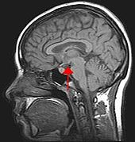
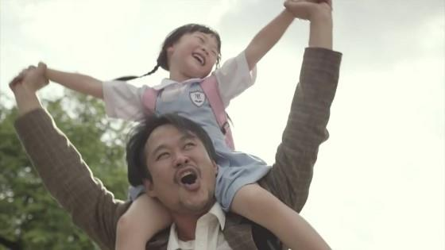
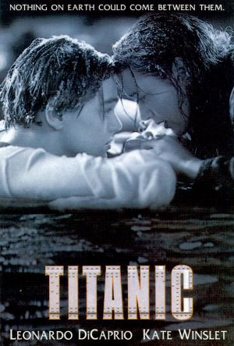
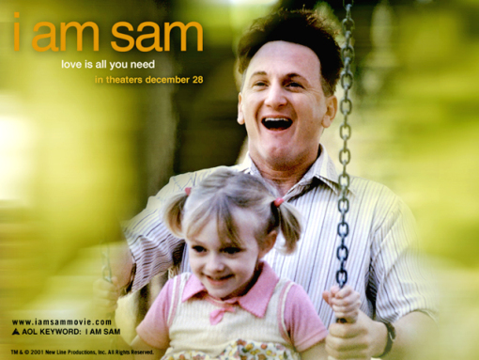
Where would you go to reduce your stress?
MEGA BOX
LOTTE CINEMA
Psychology
My dad
Psychology : the science of mental life
Geology : the science that deals with the history of the earth as recorded in rocks

Slide 15
Compare your feeling after watching both.
https://youtu.be/rAYiBSo3JKY
https://www.youtube.com/watch?v=3bdm4NBYxII
My dad

Slide 16
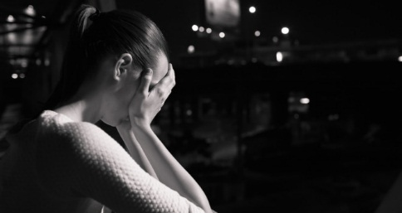
Share ideas in pairs. 5min
1. How did you feel about it?
2. Do you think this kind of movie help you feel relaxed and better?
3. Recommend the best movie you have watched to your friend.

Slide 17
Thank you ☺ My special class, Hope you all the best.

