Slide 2
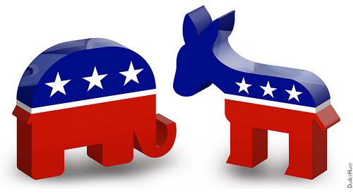
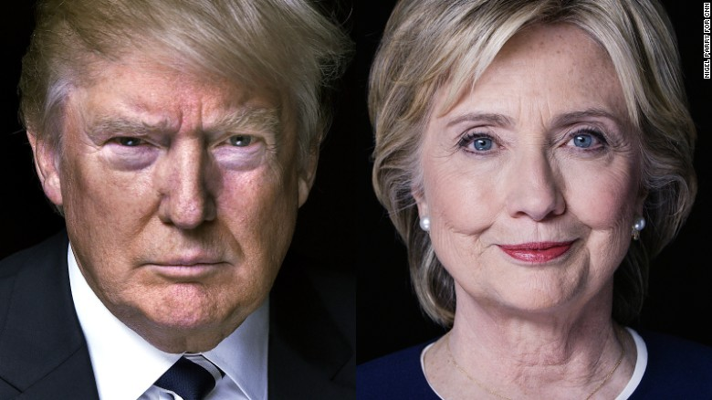
U.S. Election
Political Parties

Slide 3
Reading Time
Read the passage
Study vocabularies
3. Crosswords
4. Comprehension questions

Slide 4
political parties
: a group of people who have similar ideas
about what the government should do

Slide 5
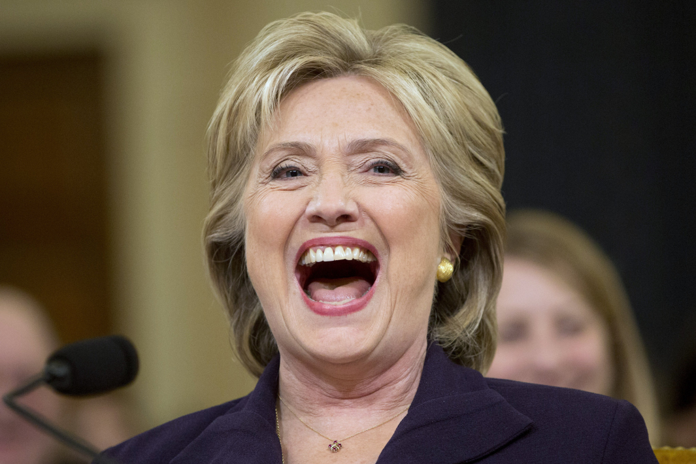
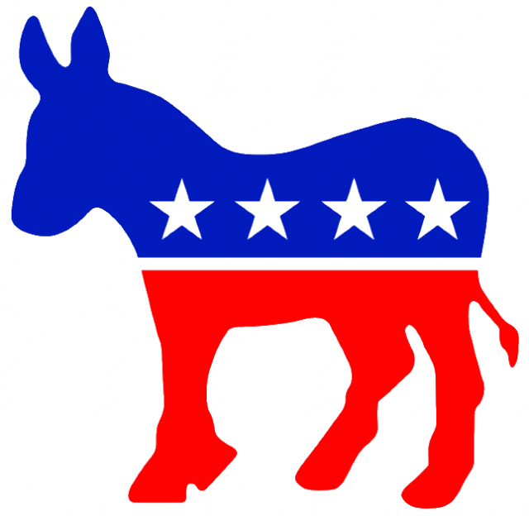
Democrats
The Democratic Party
: the US’s oldest party

Slide 6
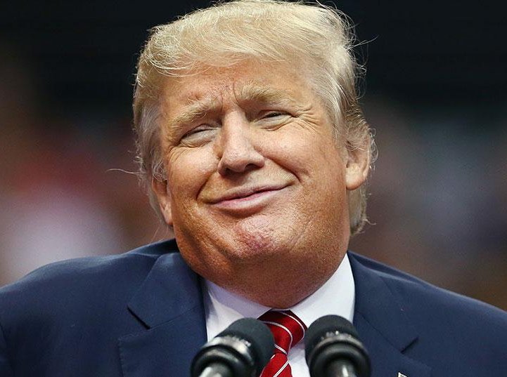
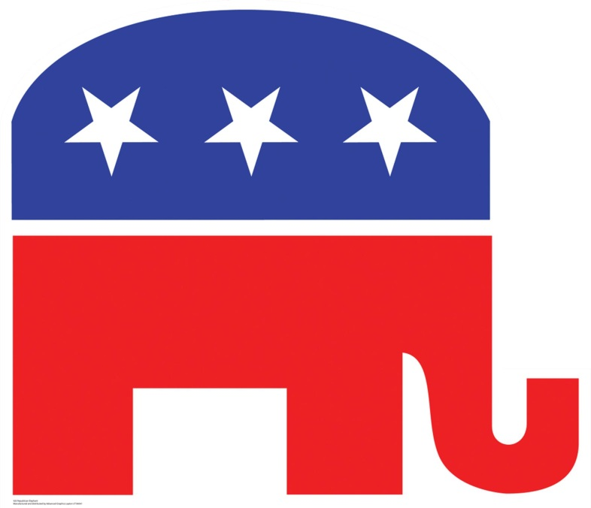
Republicans
The Republican Party
: one of the parties in US
that has a nickname of the "Grand Old Party"
Notes:
We are going to check out the difference b/t the 2 political parties later

Slide 7
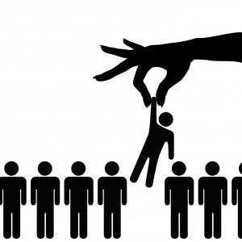
election
(to) elect
: to choose a person for a particular job, by voting

Slide 8
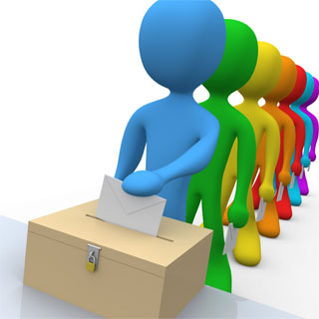
voter
vote
: (v.) to express your choice by officially writing a mark
: (n.) formal expression of opinion or choice,
made by individuals

Slide 9
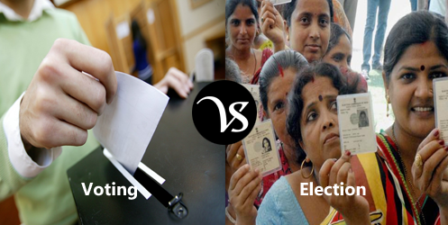
A formal expression of a choice
between two or more candidates
A formal decision making process
by people to choose a person for
political office or other position
action
process

Slide 10
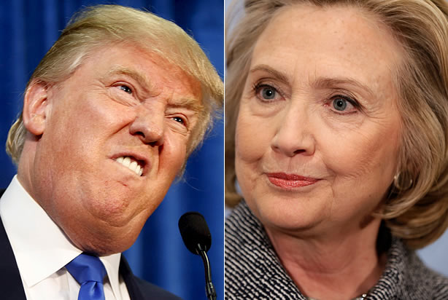
candidate
: a person who is competing to get a job or elected position

Slide 11
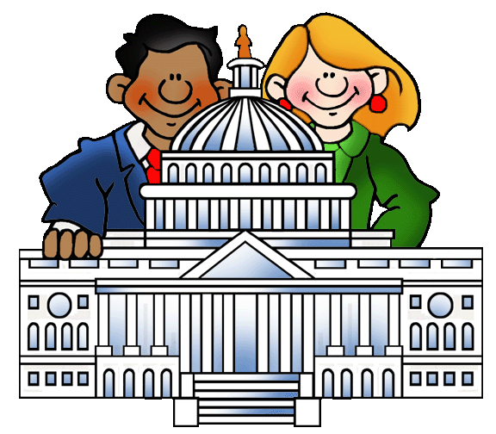
government
: a group of people who have similar ideas
about what the government should do

Slide 12
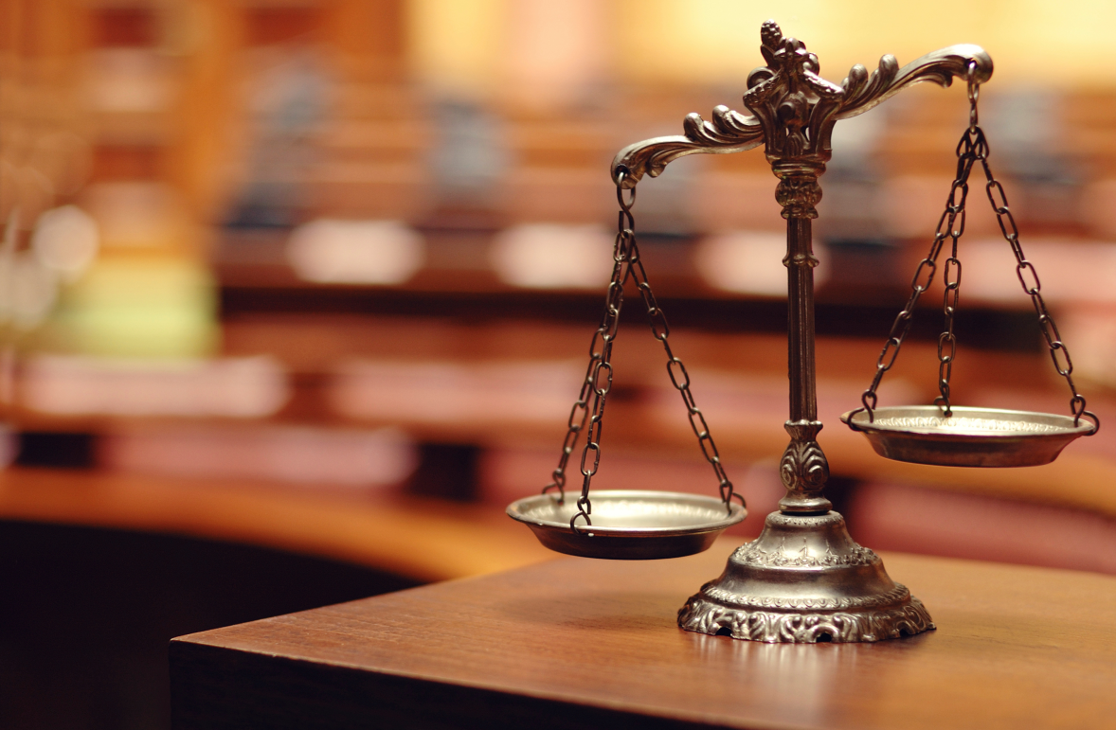
law
: a rule, usually made by a government,
that is used to order the way in which a society behaves

Slide 13
CROSSWORDS

Slide 14
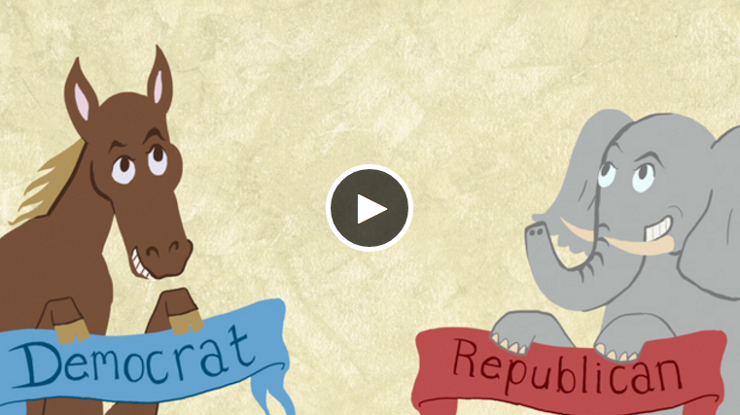
Difference between
the Democratic Party and the Republican Party
Watch a video
Watch again while filling out the questions in pairs
Check out the answers together

Slide 15
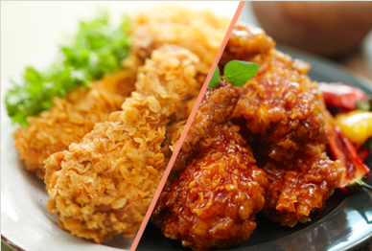
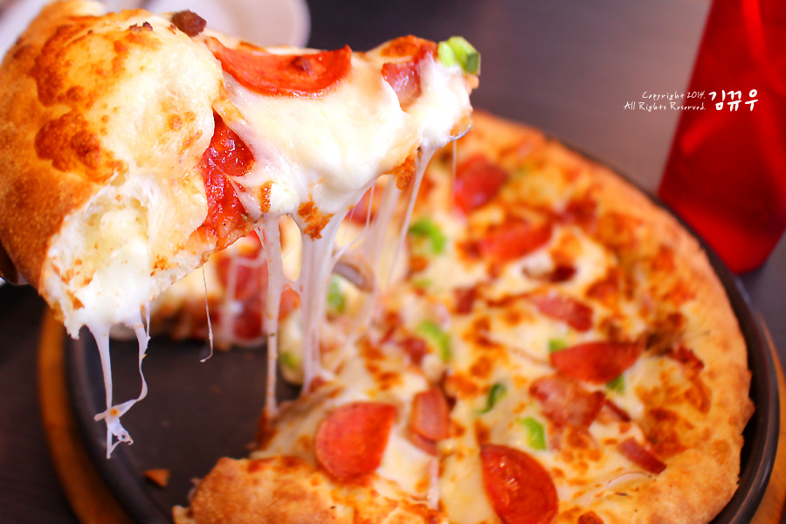
THE
C H I C K E N
PARTY
ELECTION for the Late-night Snack
V.S.
THE
P I Z Z A
PARTY

Slide 16
ELECTION for the Late-night Snack
THE
C H I C K E N
PARTY
THE
P I Z Z A
PARTY
V.S.
Make two different groups of the chicken party and the pizza party
Choose a leader in each parties
Each parties make reasons why they should have chicken or pizza as late night snack
Leaders in each parties make a short presentation ( 1 min.)
Vote for the person you liked
According to the person who is elected,
the late night snack is chosen

