Slide 1
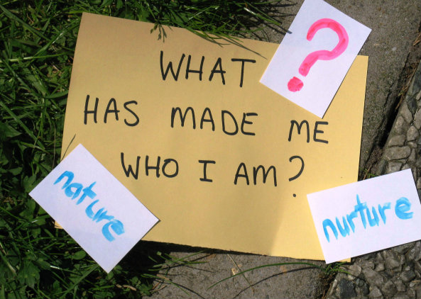
Nature VS Nurture

Slide 2
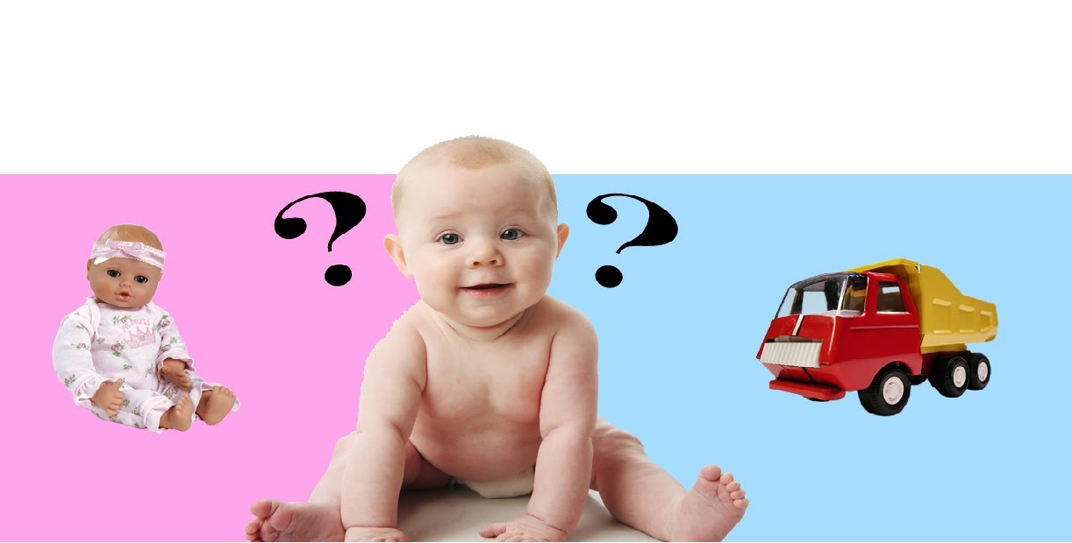
Why boys like a car and why girls like a doll?

Slide 3
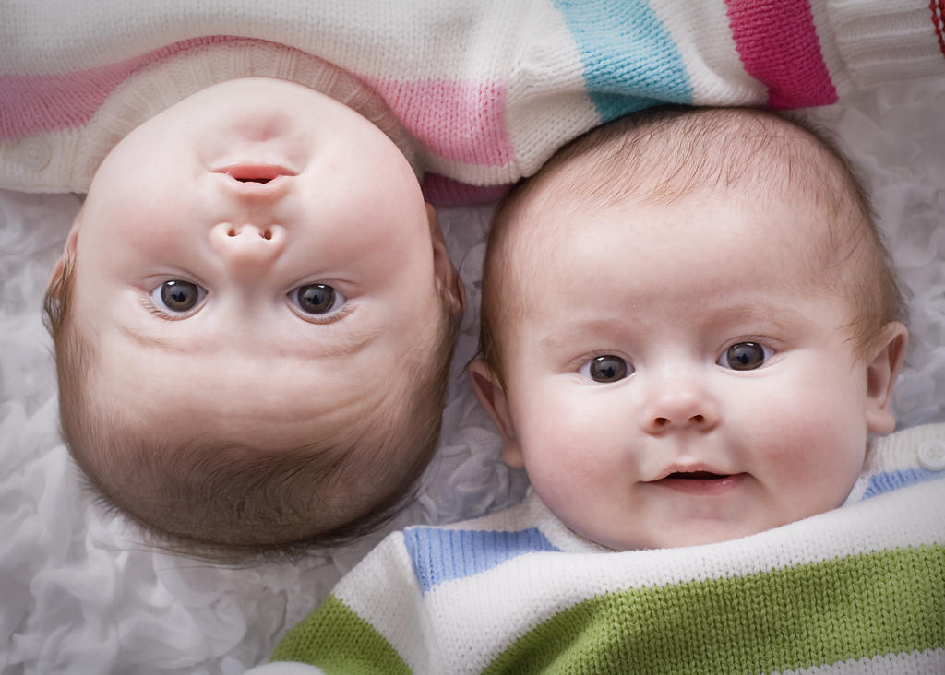
If twins lived in different environment, their habit will be same?

Slide 4
1) Why boys like a car and why girls like a doll?
2) If twins lived in different environment,
do there habit will be same?

Slide 5
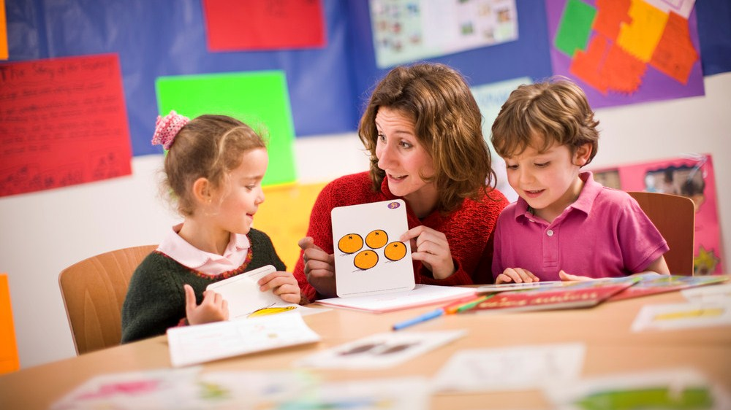
What’s the differences between adult and children, when they acquire language?

