Slide 1
Articles
Presenter: Kyung

Slide 2
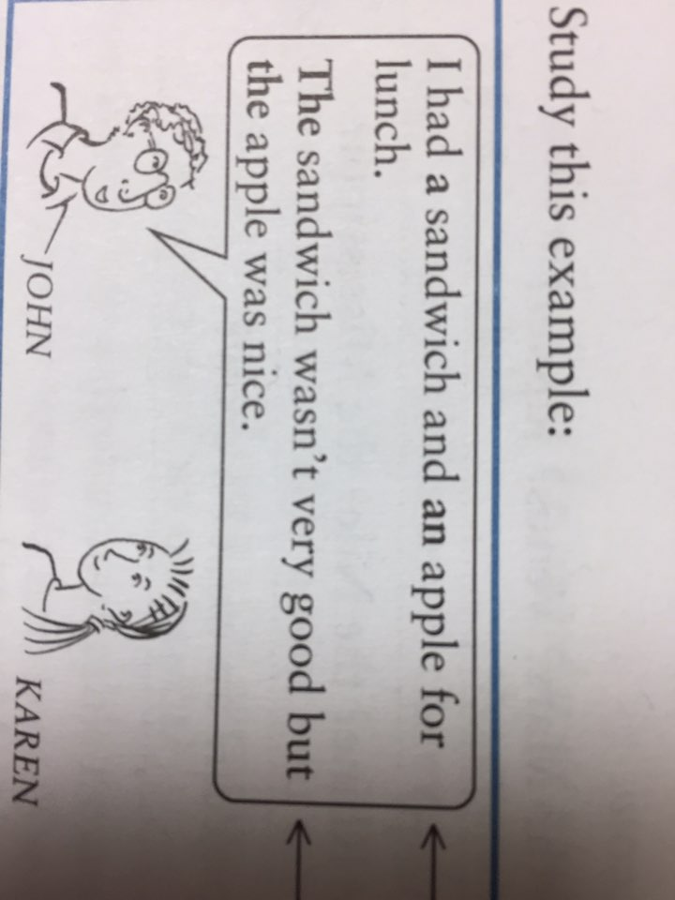
Articles

Slide 3
Worksheet- A
alarm clock / calculator/ envelop/ useful book / knife/ tin-opener
> You use a tin opener to open tins.
1. You can use an envelop when you send a letter.
2. A calculator is useful for mathematics.
3. I like this book because when I study English, it is a useful book.
4. A knife is useful for cutting things.
5. An alarm clock wakes you up in the morning.

Slide 4
Articles(phonology) - when we choose a,an/ the
a
[ə]: before a consonant sound
ex. a house
an
[æn]: before a vowel sound
ex. an hour
the
[ðə]: before a consonant sound
ex. the woman
[ði]: before a vowel sound
ex. the address

Slide 5
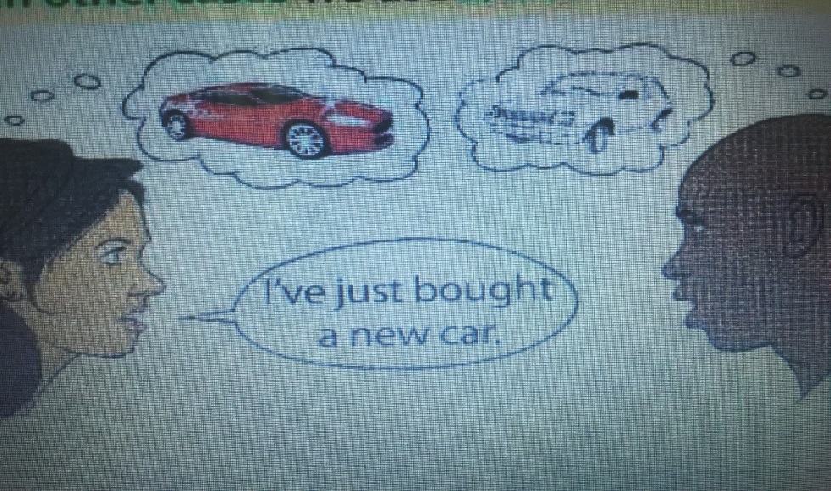
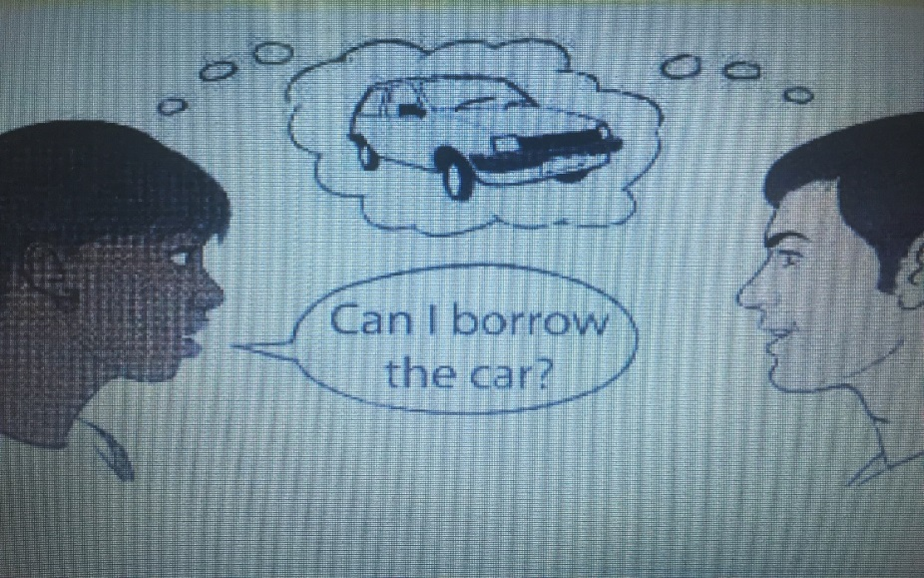
Articles (function) - when we choose a,an/ the
Step 1
Anna says to Timo,
“ I’ve just bought a new car.”
Anna says to Timo,
“ Can I borrow the car?”

Slide 6
Articles (function) - when we choose a,an/ the
Step 2.
I need an umbrella.
David, I have a question
I go to church with Dave once a week.
I found the pen which I lost yesterday.
Anna, I’ll be waiting for you in front of the store.
Emma is the youngest woman in our class.
The Sun rises early in Summer.

Slide 7
Worksheet- C
1. This morning I bought a newspaper and a magazine. The newspaper is in my bag but I don’t know where I put the magazine.
2. I saw an accident this morning. A car was badly damaged.
3. There are two cars parked outside: a blue one and a grey one. The blue one belongs to my neighbors; I don’t who the owner of the grey one is.
4. My friends live in an old house in a small village. There is a beautiful garden behind the house. I would like to have a garden like that.

